Slide 1
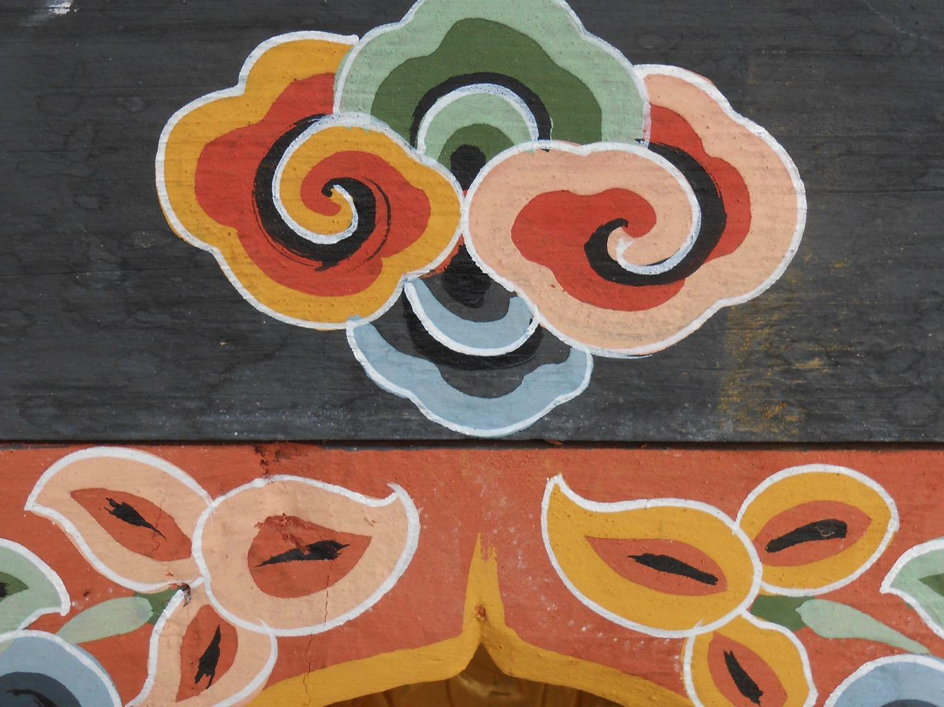
Home-Ranges for Birds Home-Ranges for Deities: Citadels of Conservation in Bhutan David Hecht, PhD Candidate Integrative Conservation & Anthropology University of Georgia (UGA)
Notes:
Over the course of today’s discussion, I aim to unpack the details of this title, exploring the complexities of meaning within “home-ranges” in conservation ecology, ontologies in cultural anthropology, and the politics of knowledge, scale, and agency at play in community-based conservation, particularly in the Bhutanese context.
Front load: Bhutan is a place interwoven with pre-Buddhist beliefs in an animate landscape, deities (neydah zhida, yul lha) are found throughout the country and in proximity to areas that are the subject of conservation conversations, notably for species like the BNCs and WBHs.

Slide 2
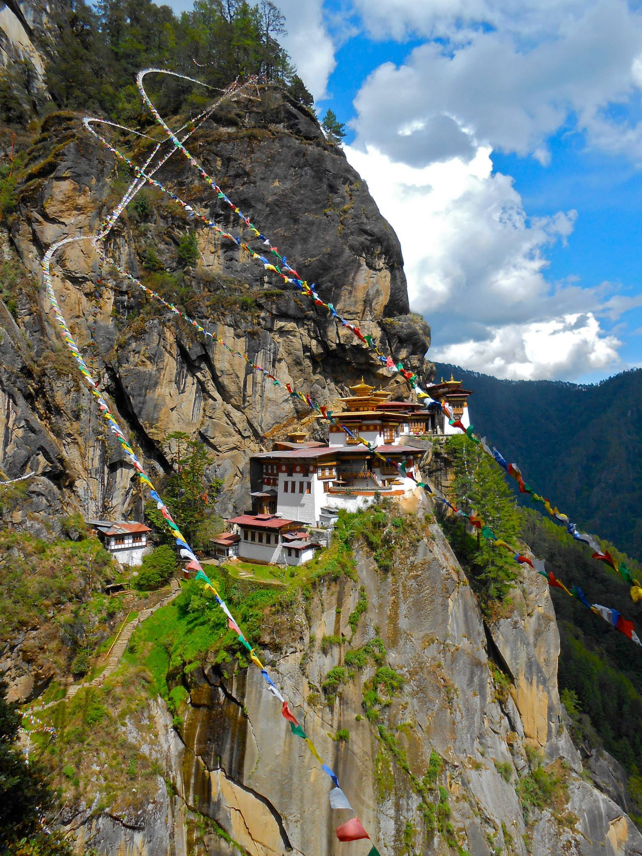
Overview
Background & Context
Theoretical Framework
Research Design
Objectives & Questions
Methodology
Intellectual Merit & Broader Impacts
Acknowledgements & References
Notes:
Let’s first take a look at our roadmap, I will begin by briefly describing the trajectory of my work in Bhutan since 2014, how my research collaborations and questions emerged. Then I will provide the theoretical framework which will help to situate my integrative research questions, discuss the objectives and design this research, as well as the methodological strategies to inform and address my central questions. Finally, I will share my perspective and understanding of the intellectual merits of this project and the potential broader impacts. I hope we will have a few short minutes for questions near the end.

Slide 3
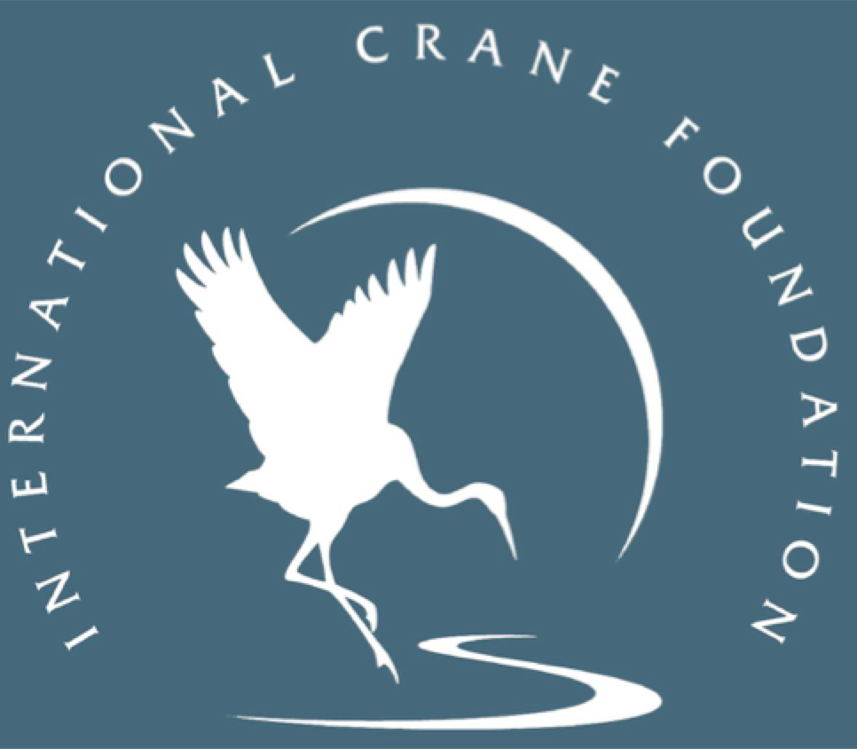
Notes:
Inspiration from ICF
CED Department
Cranes & Culture Curriculum
Jigme & RSPN

Slide 4
Notes:
Inspiration from ICF
CED Department
Cranes & Culture Curriculum
Jigme & RSPN

Slide 5
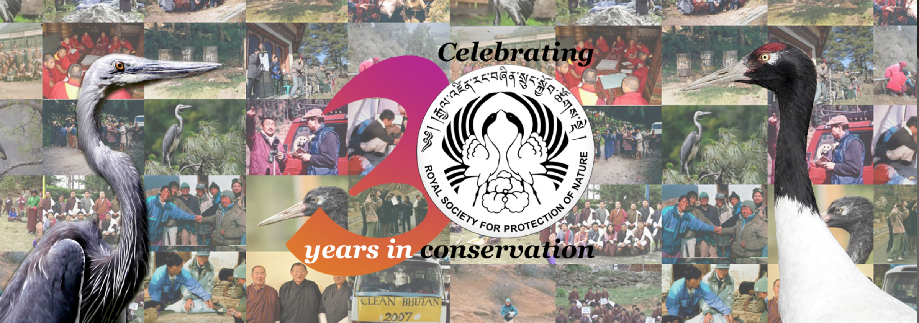
Royal Society for Protection of Nature (RSPN)
White-bellied Heron (WBH)
(Ardea insignis)
Ja Aechorim
Global Population: ~60
Black-necked Crane (BNC)
(Grus nigricollis)
Thrung Thrung Karmo
Global Population: ~9,000
Notes:
This research focuses on community-based conservation programs for White-bellied Herons and Black-necked Cranes in Bhutan in partnership with the RSPN. While the two species appear similar, they represent distinct family groups in the avian world, exhibit different life history strategies, are differently threatened according to IUCN- critically endangered vs. vulnerable, and have had differential cultural relevance in Bhutan- with the BNC known as a sacred being, a heavenly bird, some using terms loosely translated as god, god-like.

Slide 6
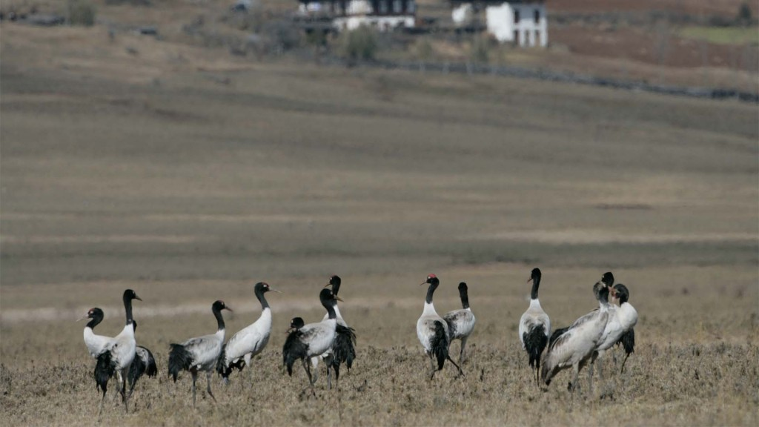
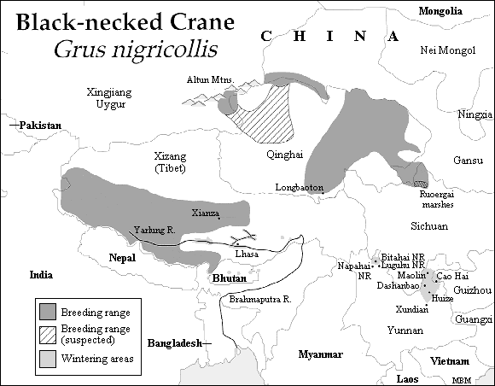
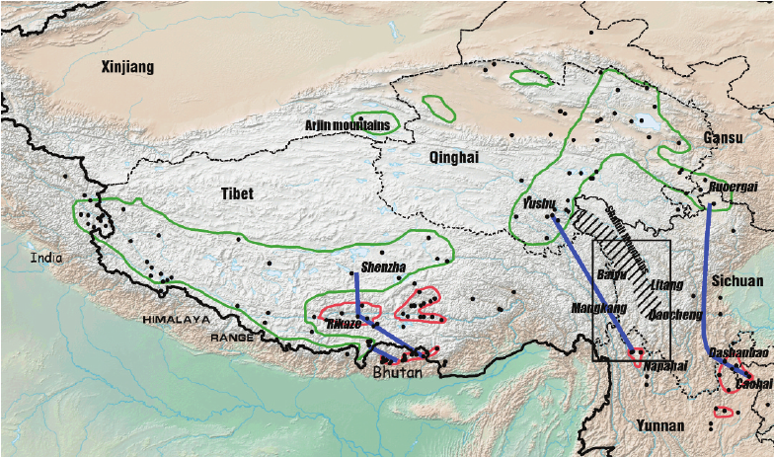
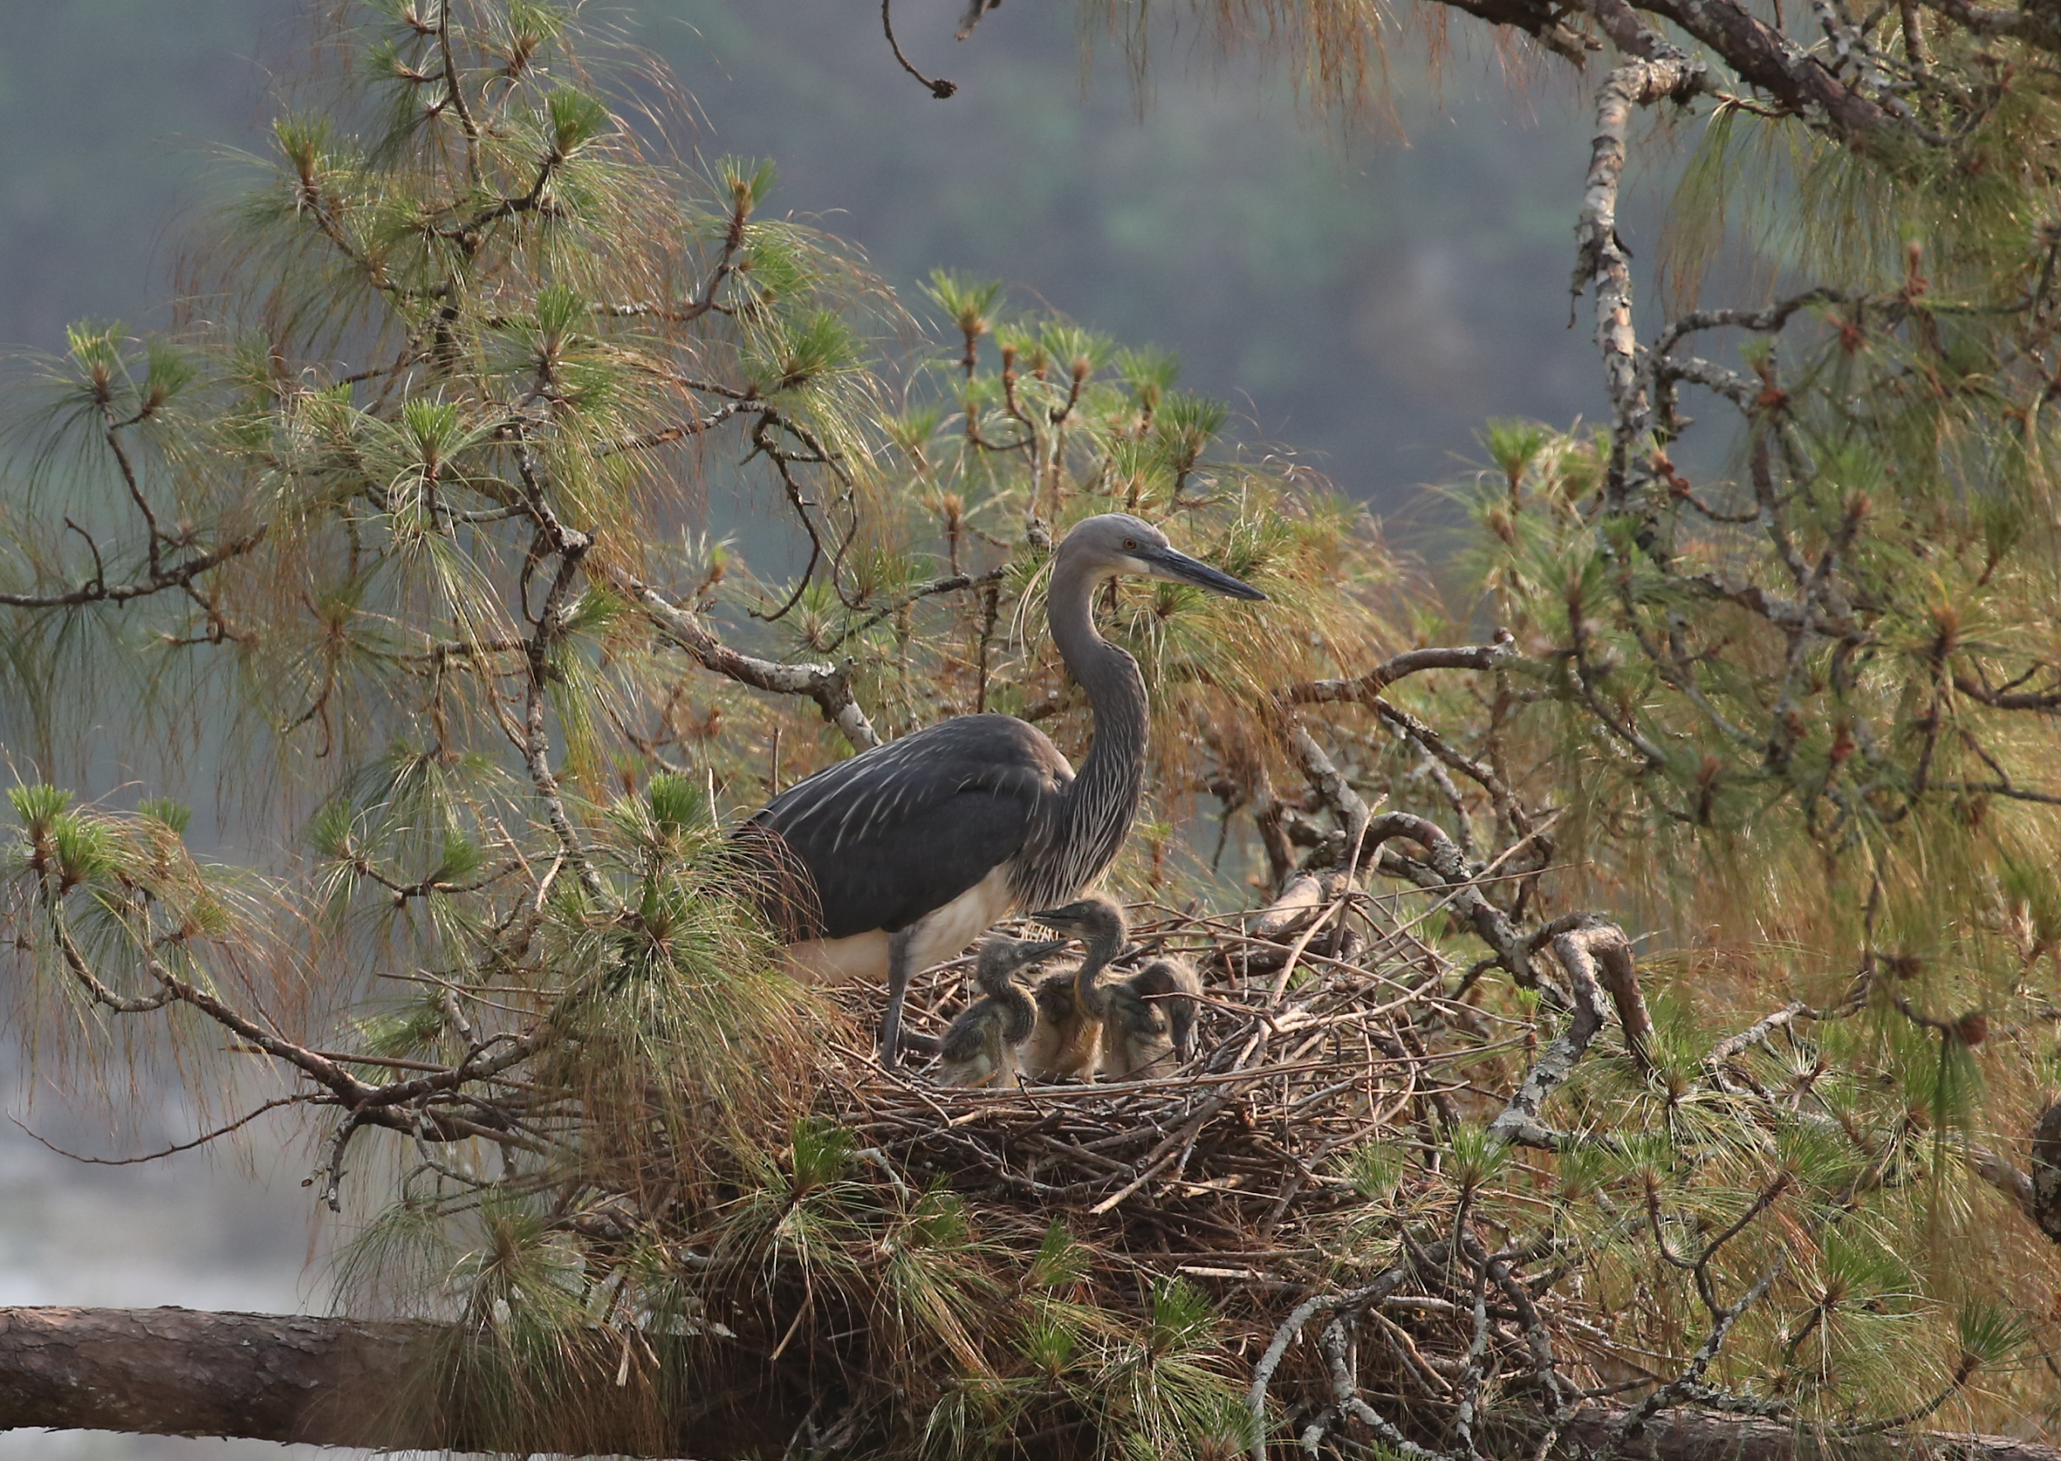
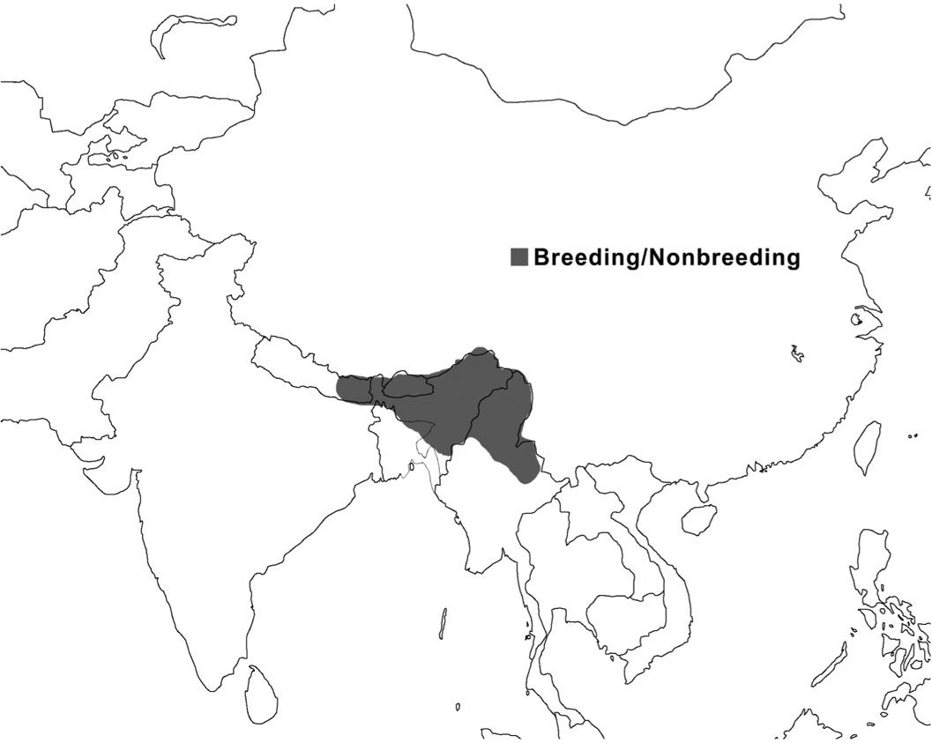
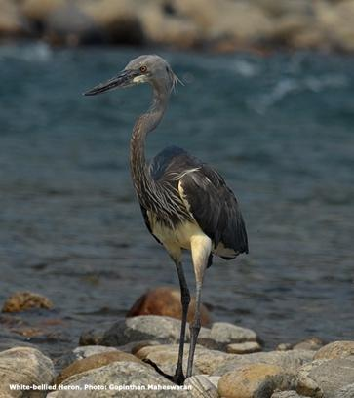
White-belled Heron
Ardea insignis
Notes:
Here we see their home range maps, with BNCs found in parts of Tibet, China, and Bhutan; and the White-bellied Heron with a much more limited range in India, Myanmar, and Bhutan.

Slide 7
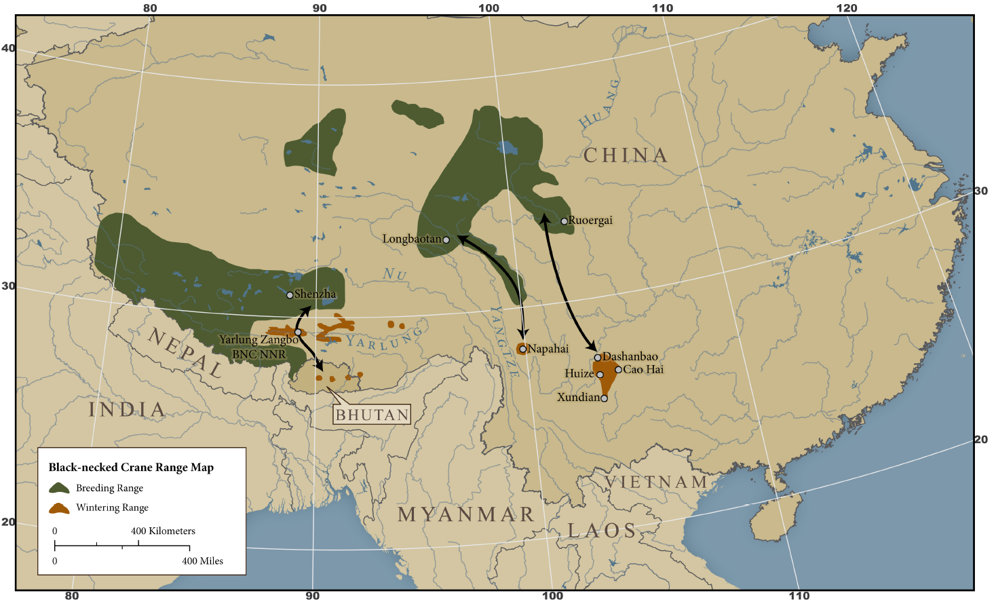
Background
Notes:
Updated home-range maps illustrate the three wintering populations of cranes in Bhutan

Slide 8
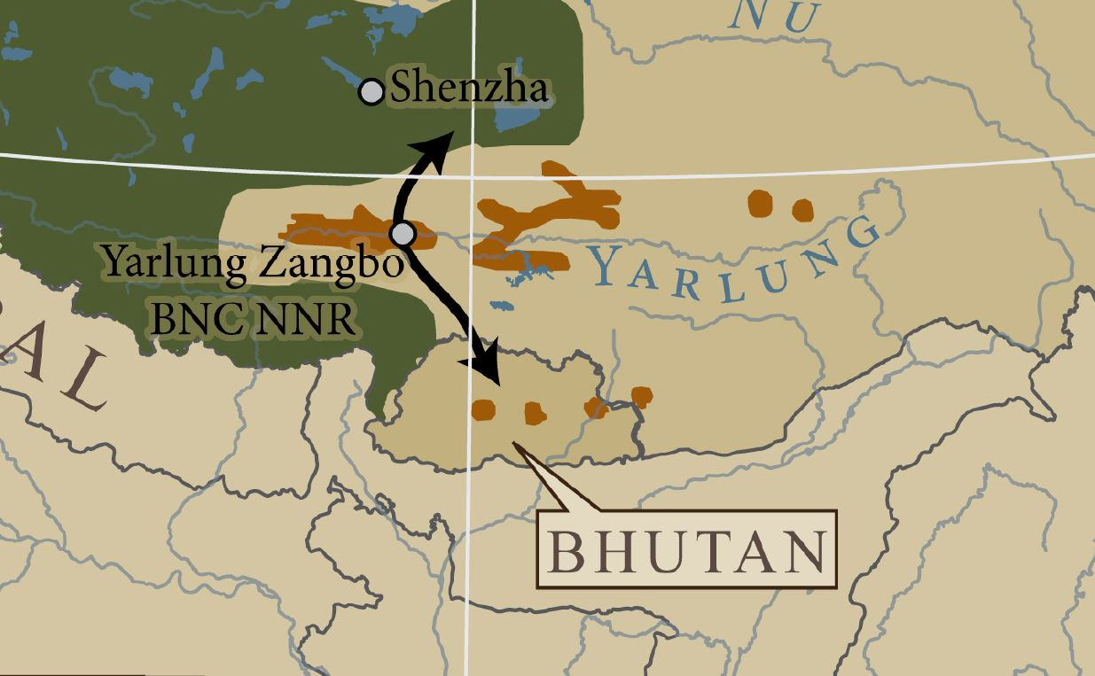
Background
Notes:
With the migratory distrubtions in Phobjikha, Bumthang, and Trashi-yangtse/Lungtse

Slide 9
Background
Notes:
Effectively, the last stronghold of the white-bellied Herons is just here, along the Punatsangchhu river

Slide 10
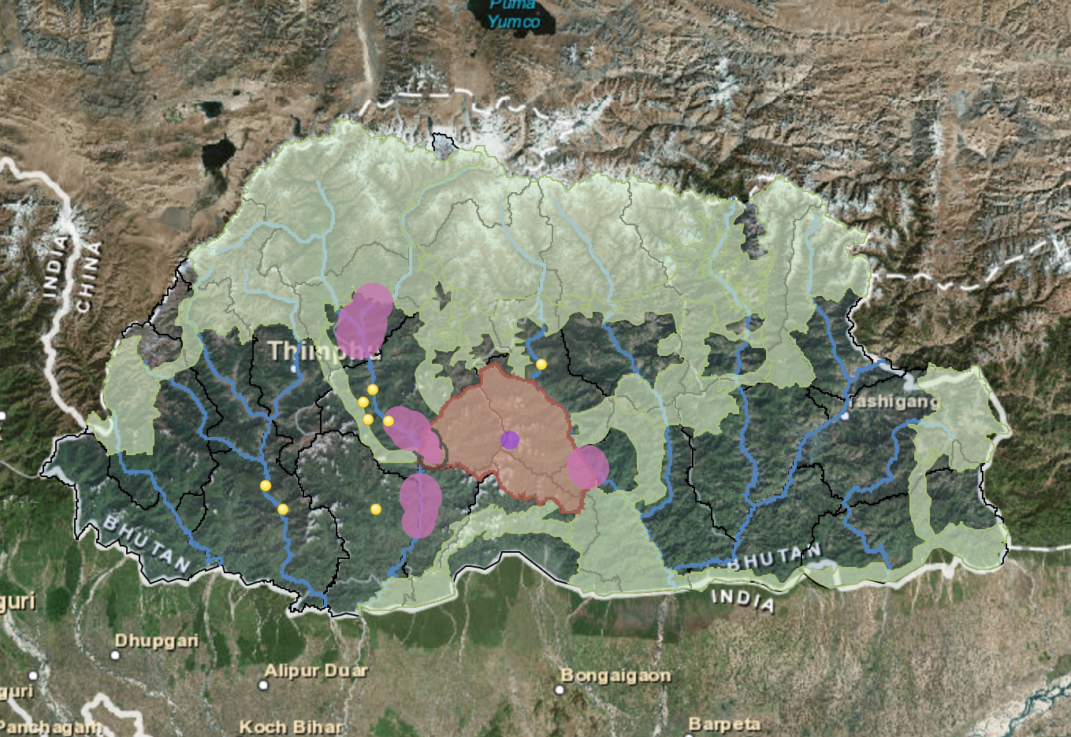
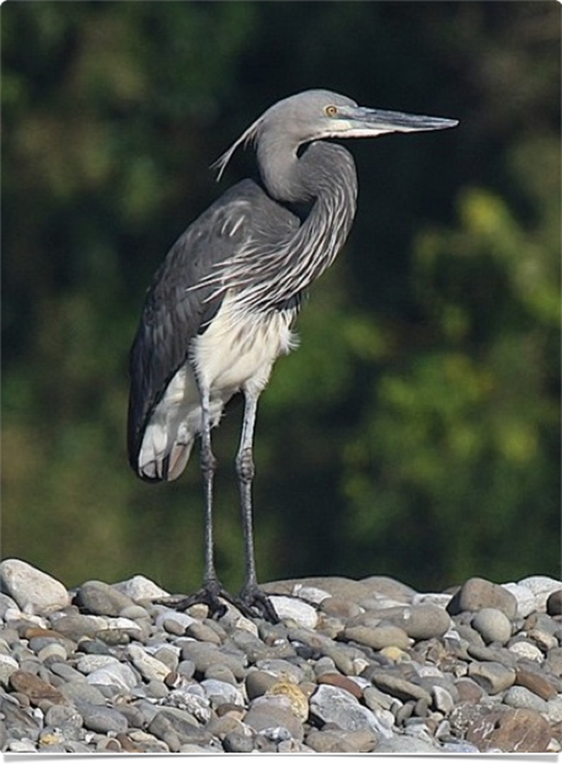
Background
Notes:
Part of my initial engagement with RSPN was to produce story maps for BNCs and WBHs, in partnership with long-term ecological research on WBH habitat and nesting ecology, their central nesting sites shown here in white, with the yellow-dots correlating to developing hydropower infastructure along the Punatsangchhu.

Slide 11
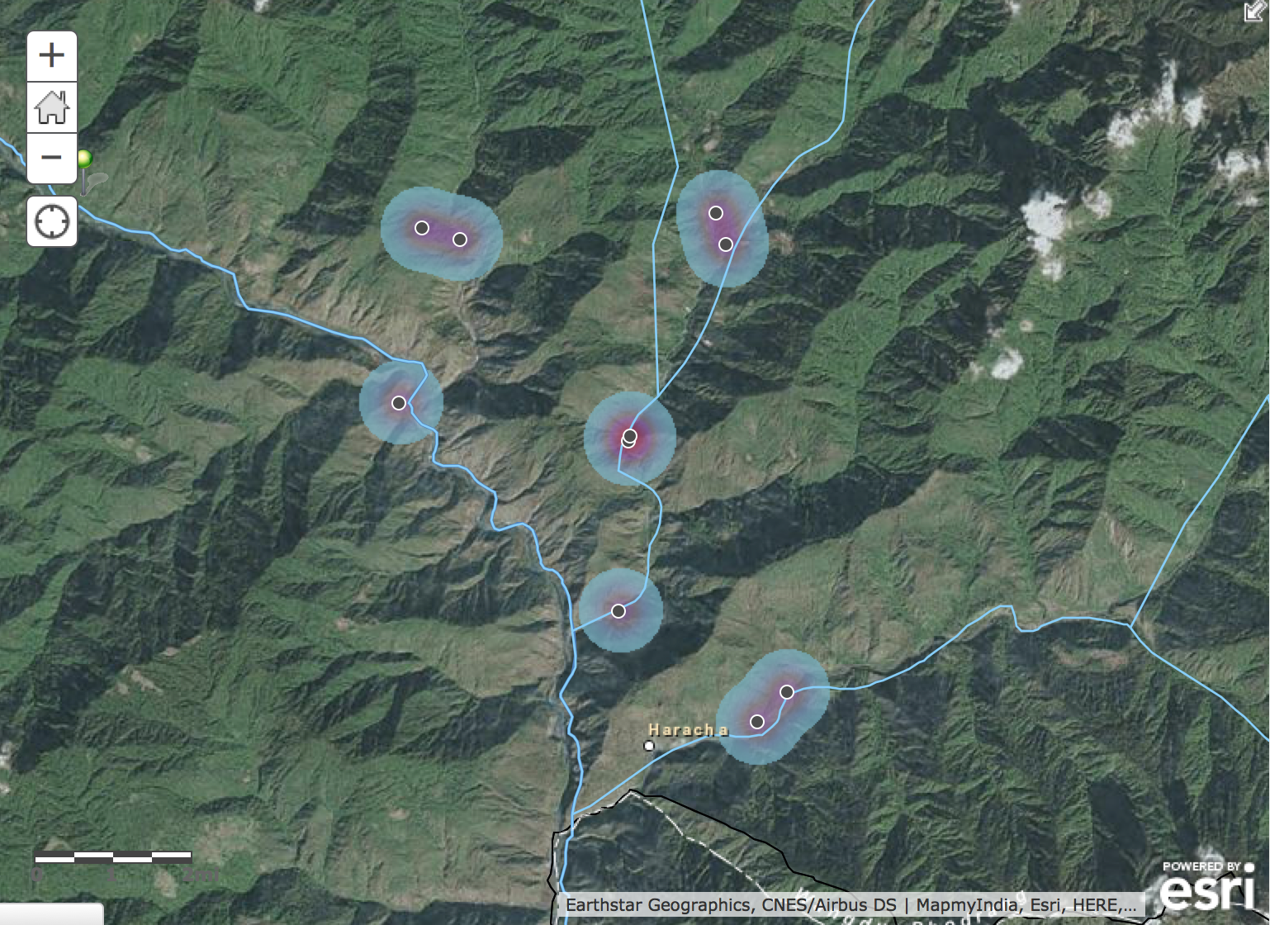
Notes:
This work primarily focused on identifying past and present nesting sites for White-bellied Herons, where community members have been engaged for years as part of a Local Conservation Support Group to help monitor this species in more remote valleys and river territories. Because of this already existing network of local citizen species monitoring stewards, we also began having more in-depth conversations with local people about their perceptions of environmental change as well as their relationship to WBHs, their local ecology, and land-use/land-values on the landscape.

Slide 12
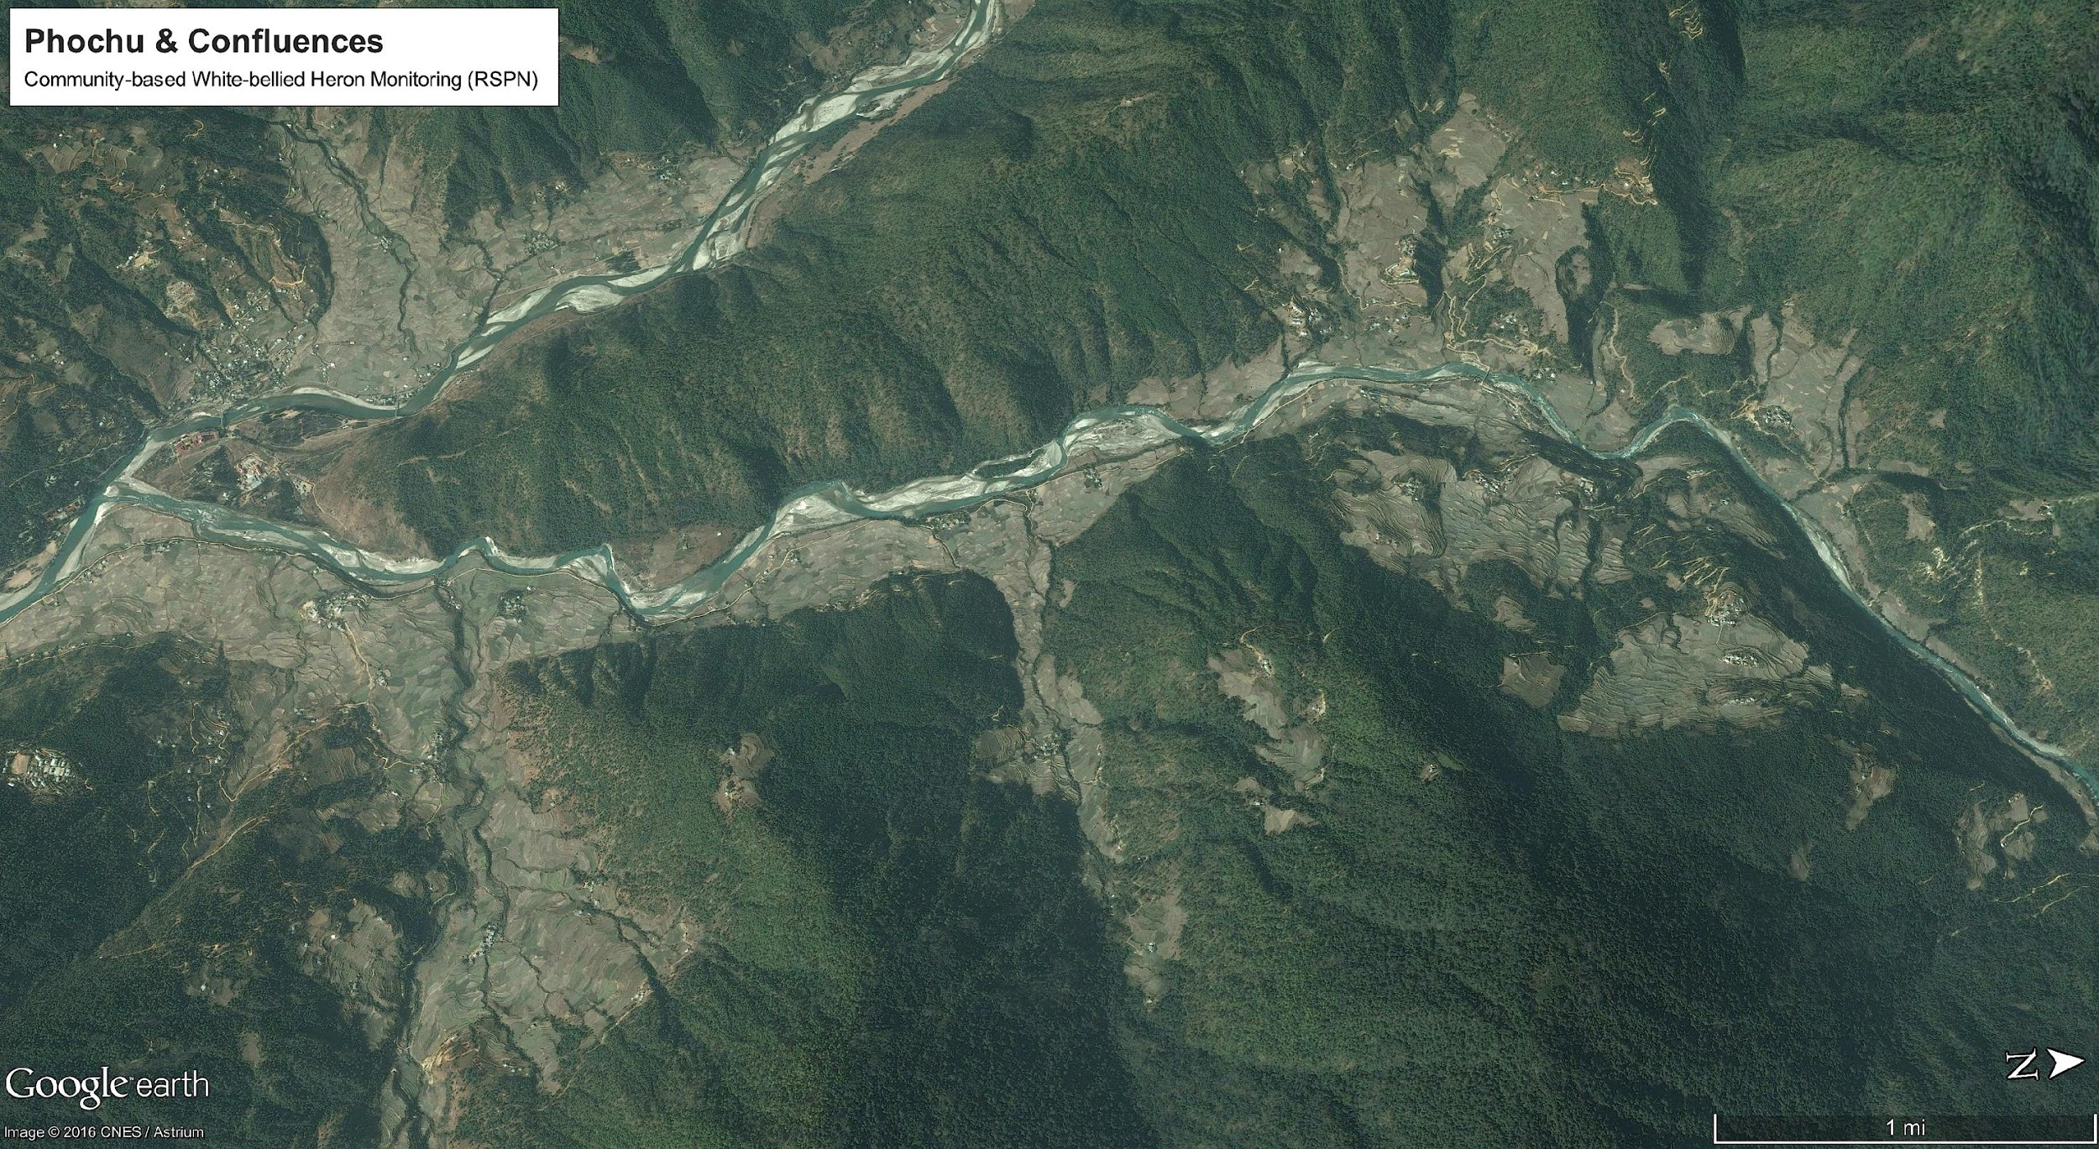
Notes:
Instead of just digital maps we also printed a series of satellite maps to talk about different landscape scale patterns, ecological, social, cultural, generating an interactive story map interface, which yielded a number of insights

Slide 13
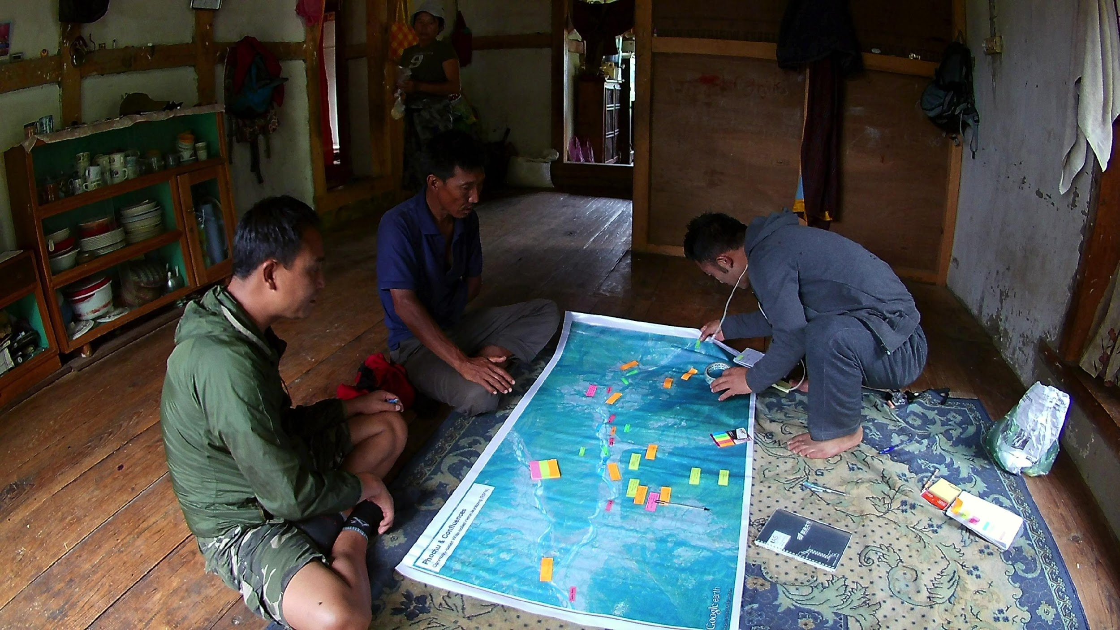
Notes:
These insights were color tagged corresponding to a series of categories relating to infastructure, storied places, and deity spaces

Slide 14
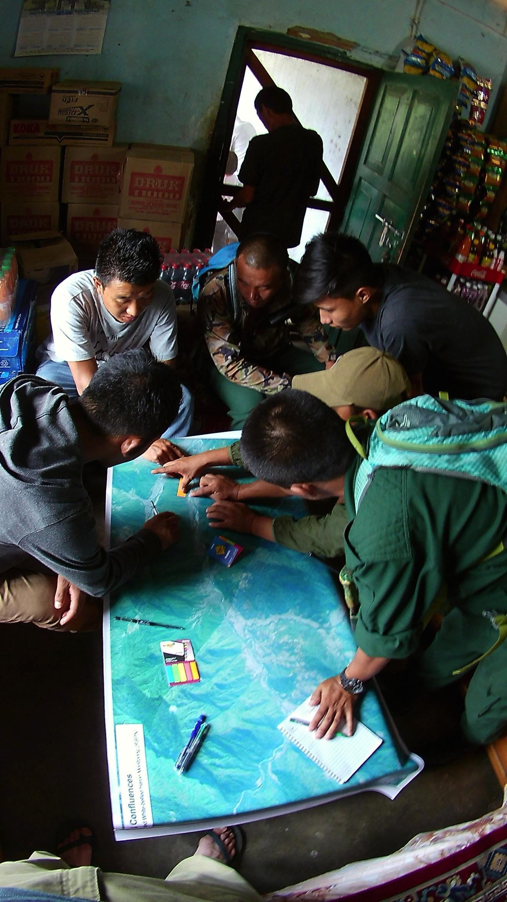
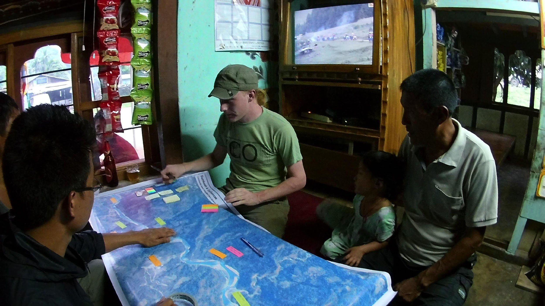
Notes:
We spoke with foresters, farmers, fisherman, and fruit-stand venders along the Punatsangchu

Slide 15
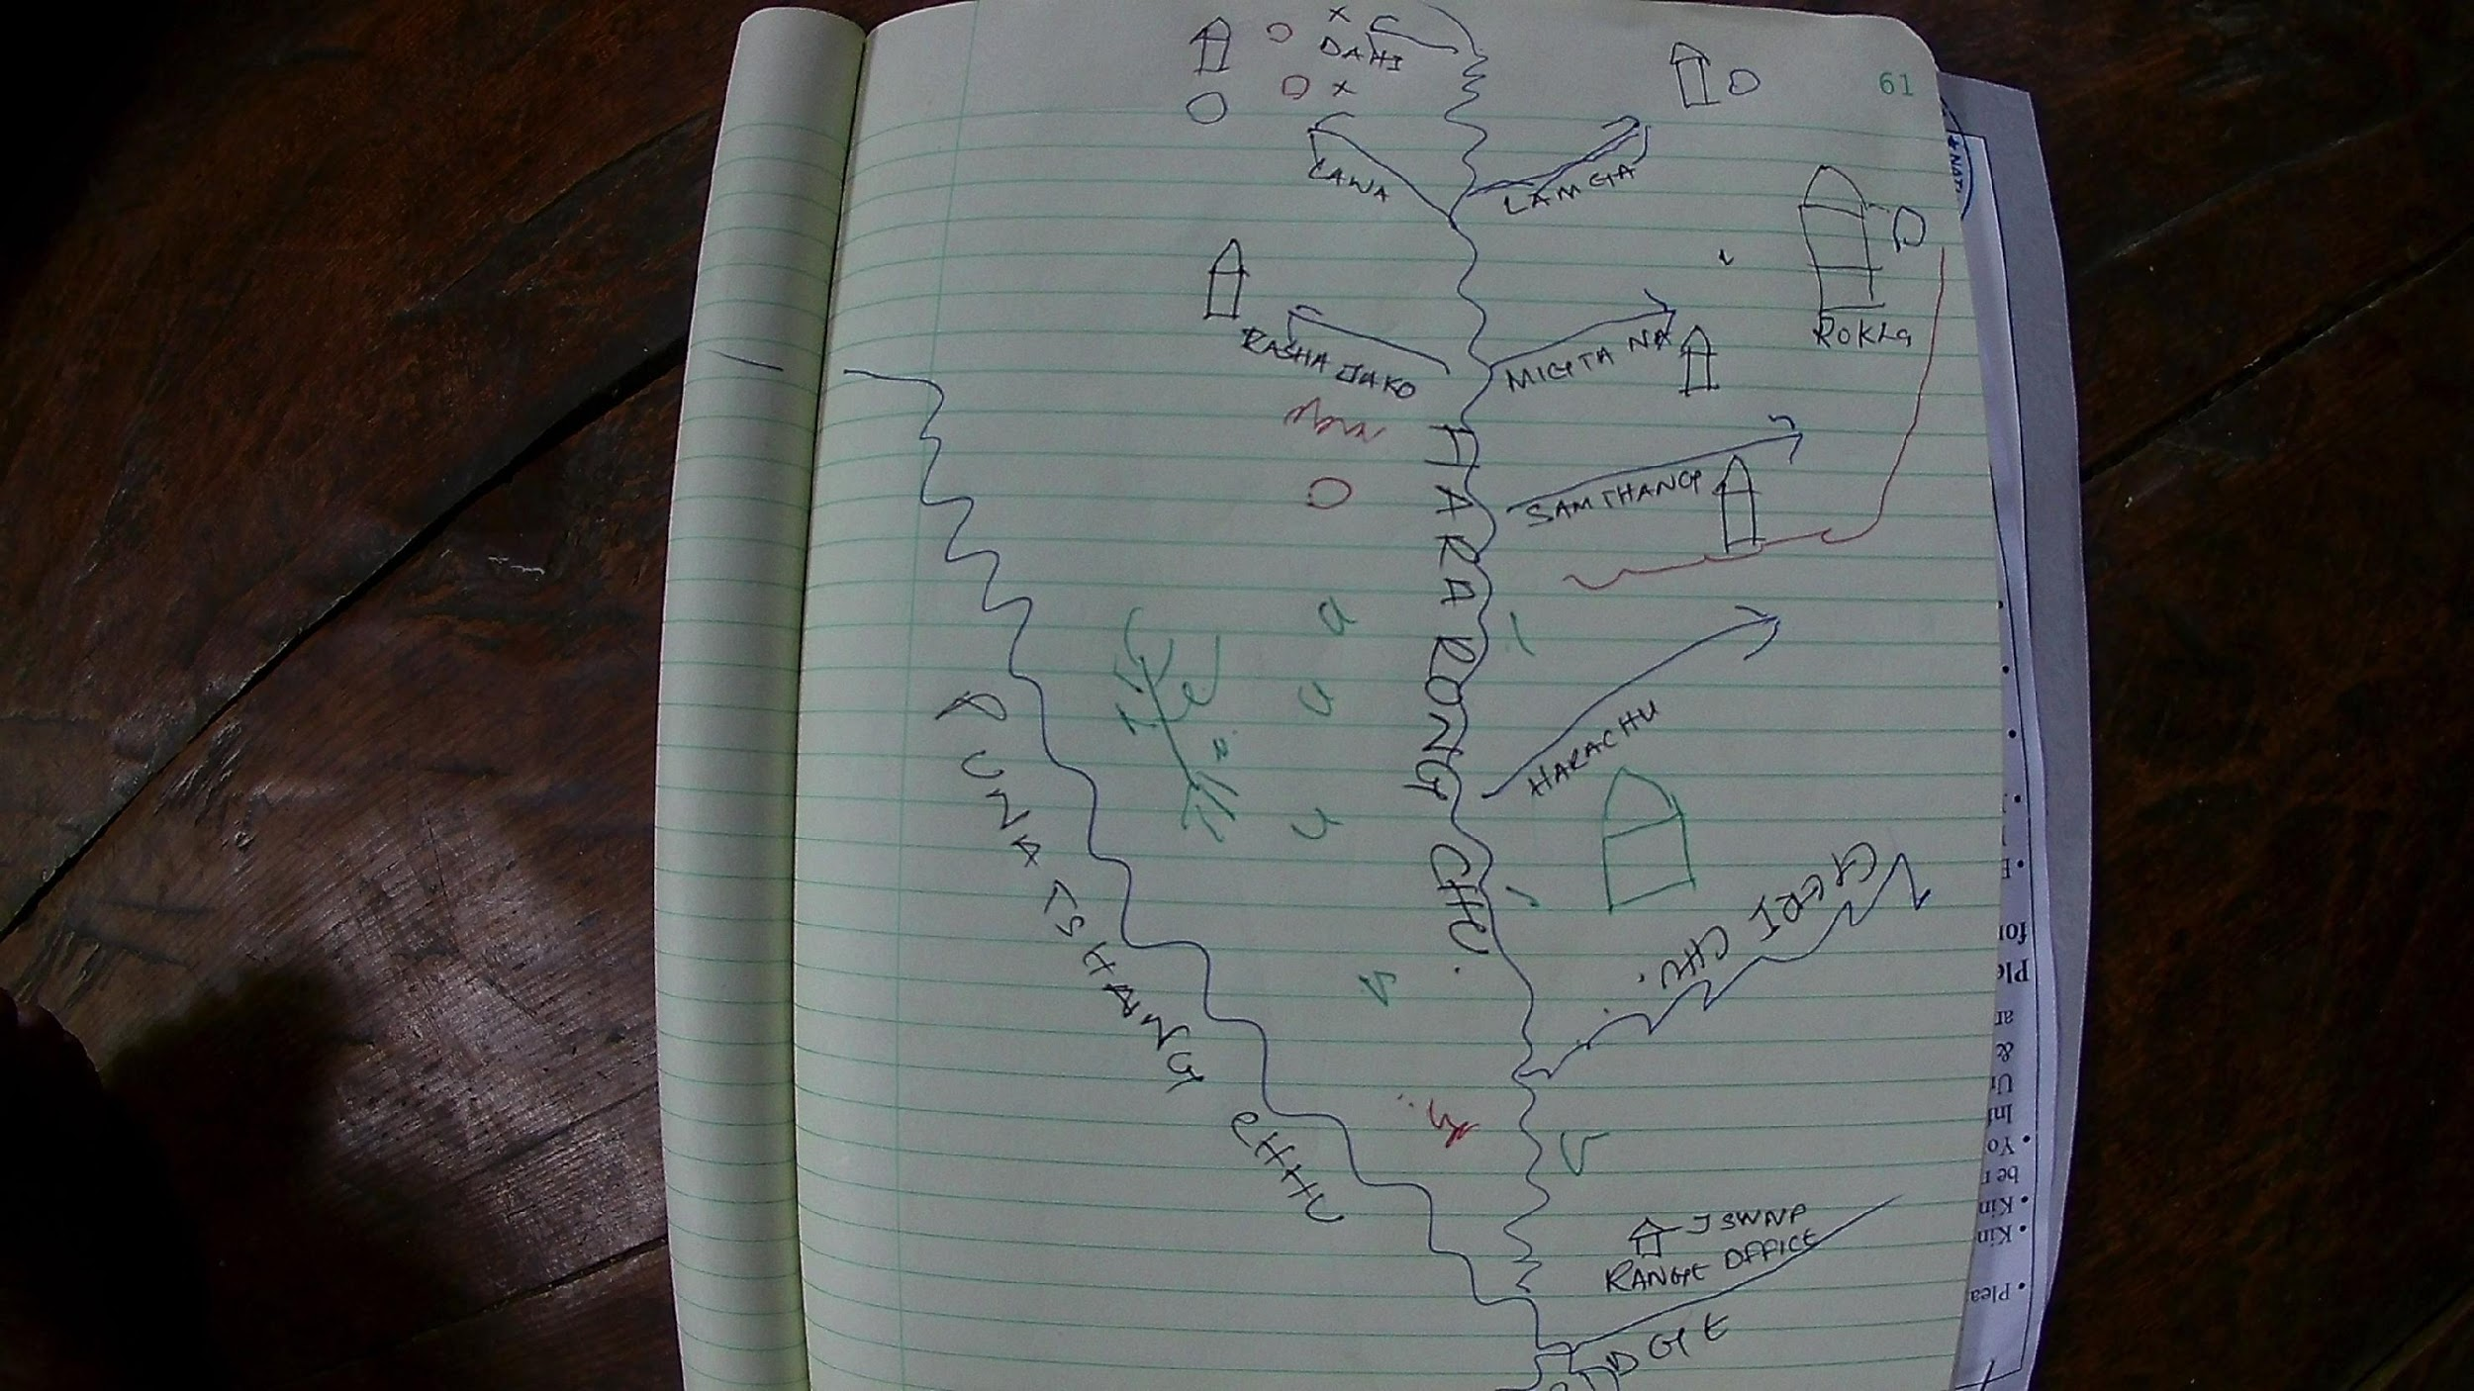
Notes:
And in some of our longer-extended overnight field vists engaged in sketch mapping to gathering insights into the relationships between people and WBHs, perceived threats to individauls or nesting sites in the future. This map, in addition to highlighting the nesting tree, and areas where Ap Penjor described a fight between owls and herons, he also highlights ritual sites, temples, and sacred areas along other riverine territories

Slide 16
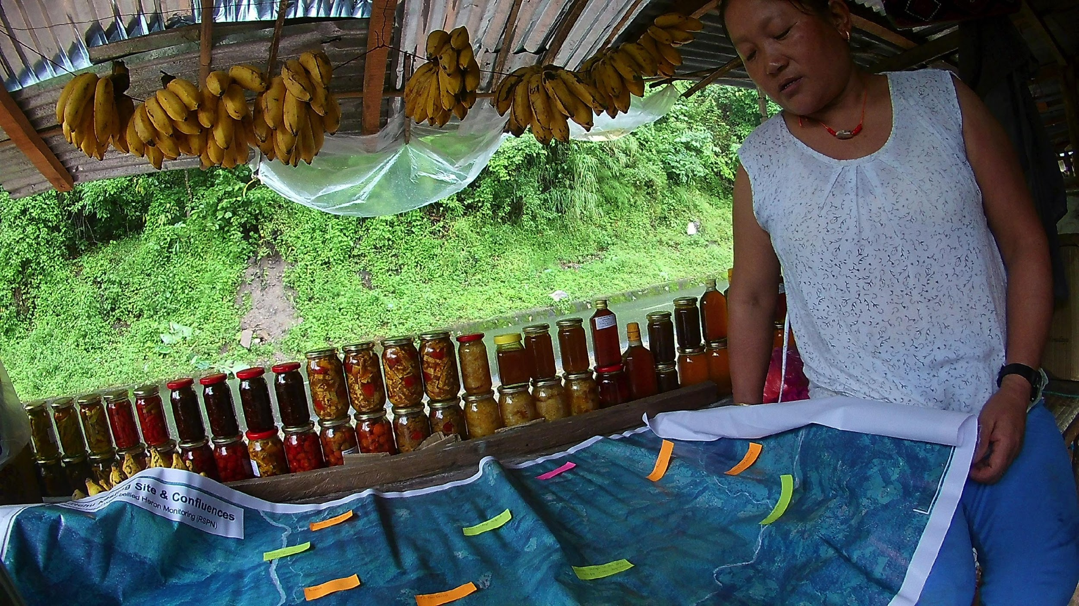
Notes:
Am Deki, whose house is right along the river of one of the highest concentrations of WBH nesting trees, shared much insights into times and areas she sees Herons, as well as changes shes witnessed along the riverside over the last few decades.

Slide 17
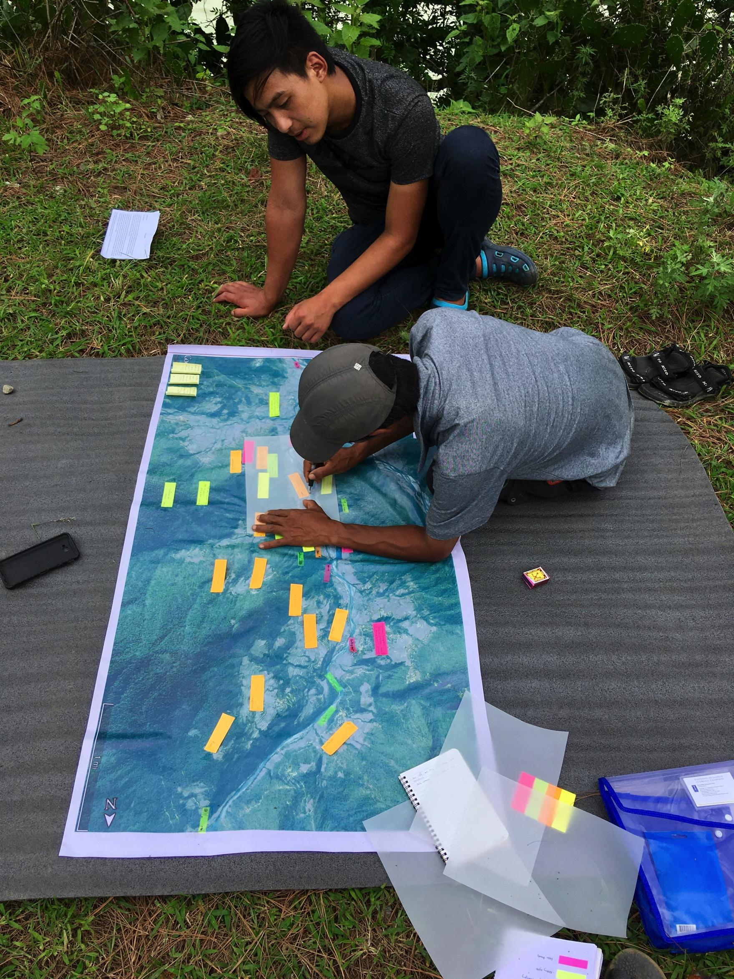
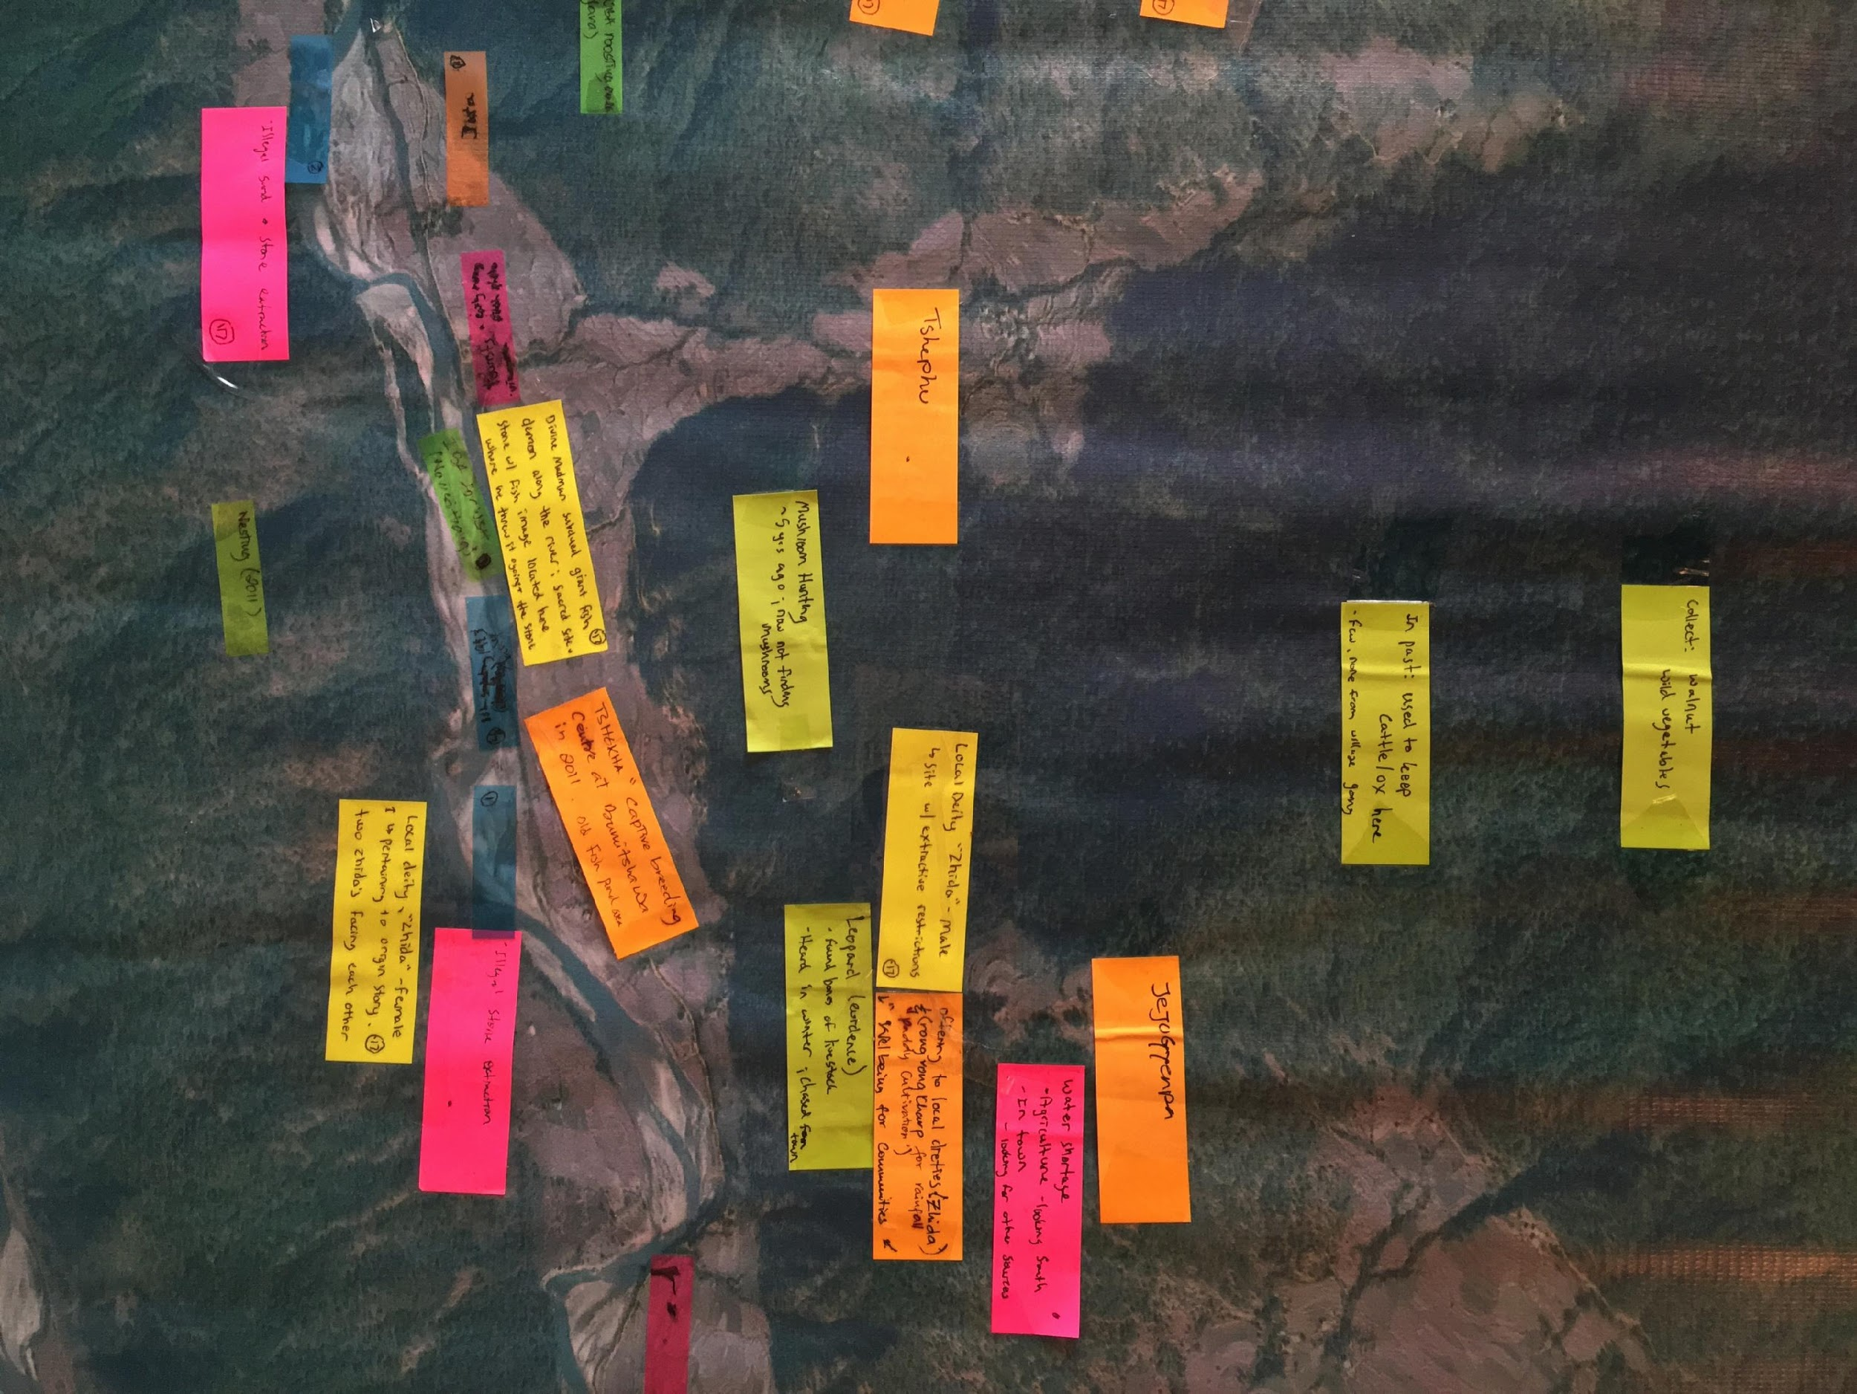
Notes:
As I returned the previous summer, we added to these maps and gleaned greater socio-ecological complexities, mapping their relationships on the map with color coded tags. In our most recent summer fieldwork, we began talking more about the presence of often unrecognized actors in conservation practice, most notably the stories of local deities, in this particular case territorial neydah zhida, with M & F here, there is also a site where the Divine Madman subdued a fish demon, its imprint remains on a river rock

Slide 19
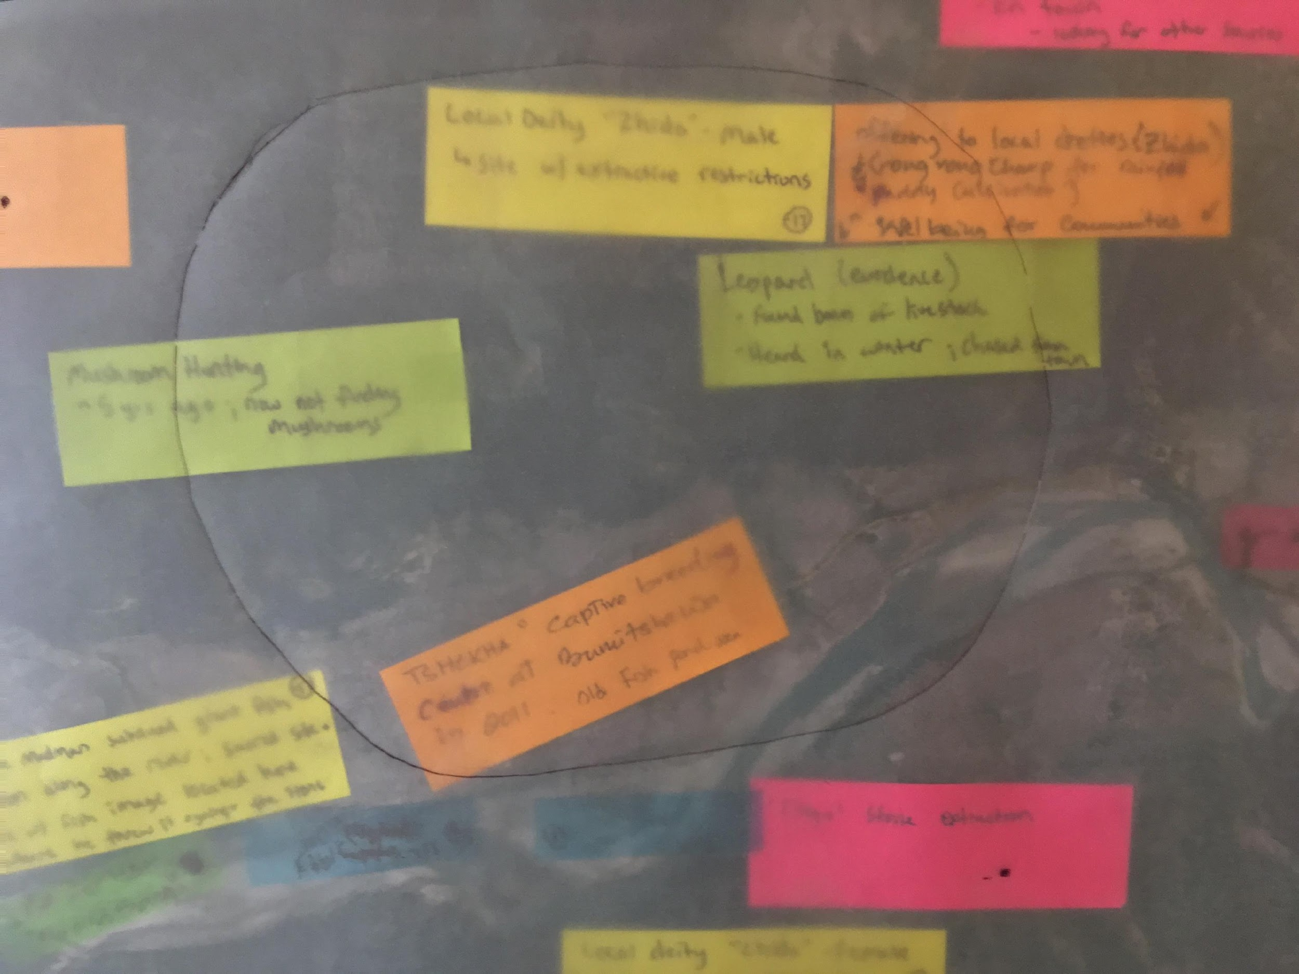
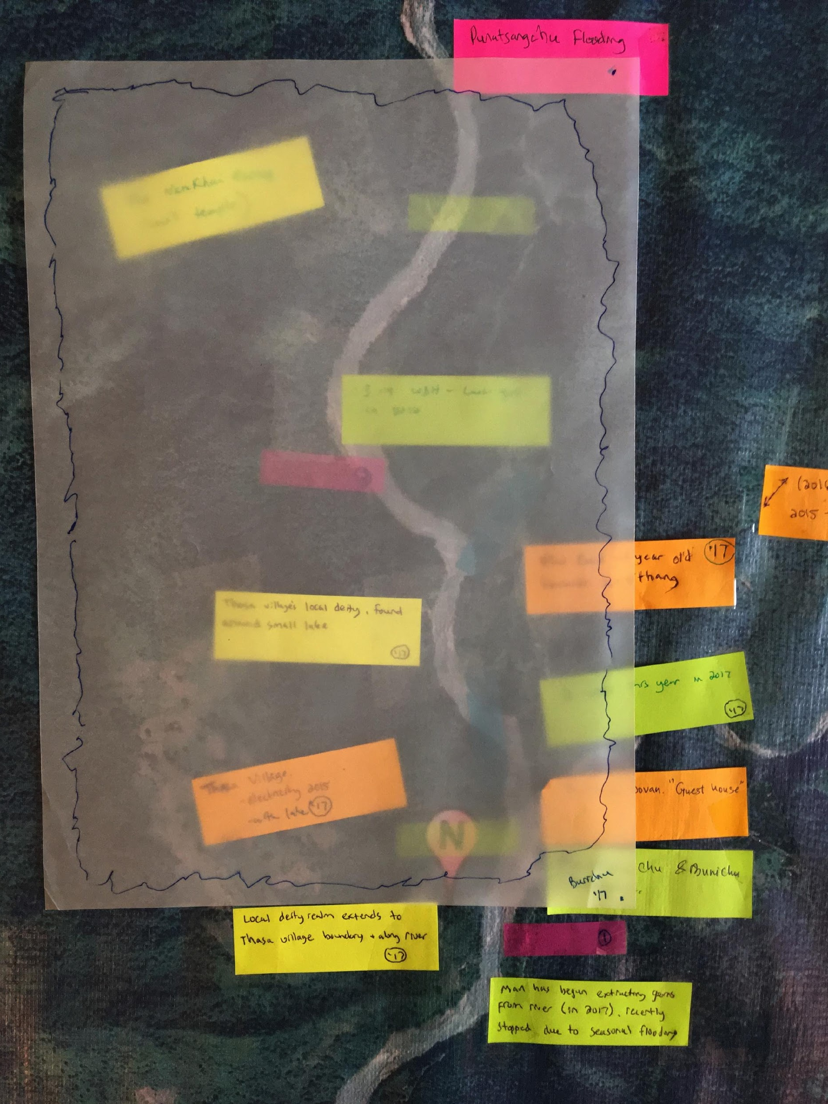
Notes:
At this stage I began wondering if these territorial deities, divinities, spirits could be spatialized, we talked about their control over certain territories or their power in relation to certain areas, but was uncertain if this could be translated to a 2D map. This experiemental phase demonstrated that there is the capacity to utilize maps and participatory mapping to visualize the shared cultural realties (or ontologies) of local people, and the capacity to foreground and prioritize local knowledge systems (or epistemologies) related to space/place, landscape, and the cultural geographies of local areas in relation to how species-conservation, and in this case avian conservation, is practiced.

Slide 20
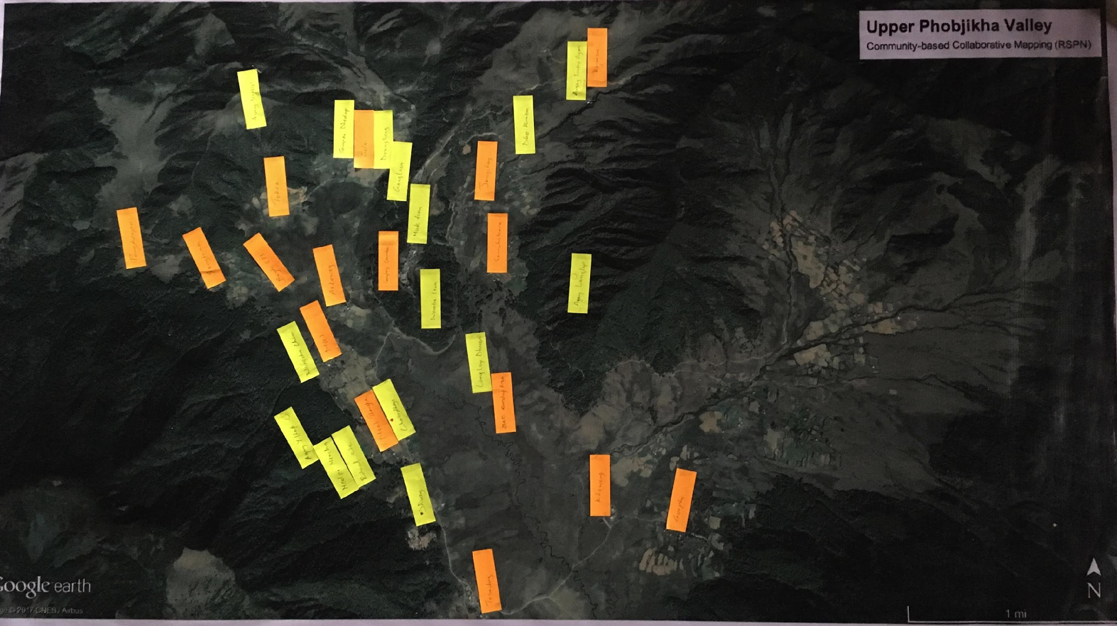
Notes:
If this could be done in the context of white-bellied heron population monitoring and management, what about for a culturally revered species like the BNC? In conjunction with another BNC community perception study and my colleague Jigme Tshering, we engaged in a broad series of community-household questionnaires, semi-structured interview series with students from the Asian University for Women, and focus group discussions with district officials across the 3 wintering habitats for black-necked cranes. This map was produced in Phobjikha valley, where the largest concentration of wintering BNCs can be found, and a celebration for their return is hosted every year. We found that Phobjikha valley is deeply, and intricately affiliated and inscribed as a sacred landscape, where territorial deities (neydah zhida, yul lha) and sacred sites (baeyul) are everywhere, and differentially underestood by neigbhorhoods and communities. Each of these yellow tags is inscribed with the name of a local deity

Slide 21
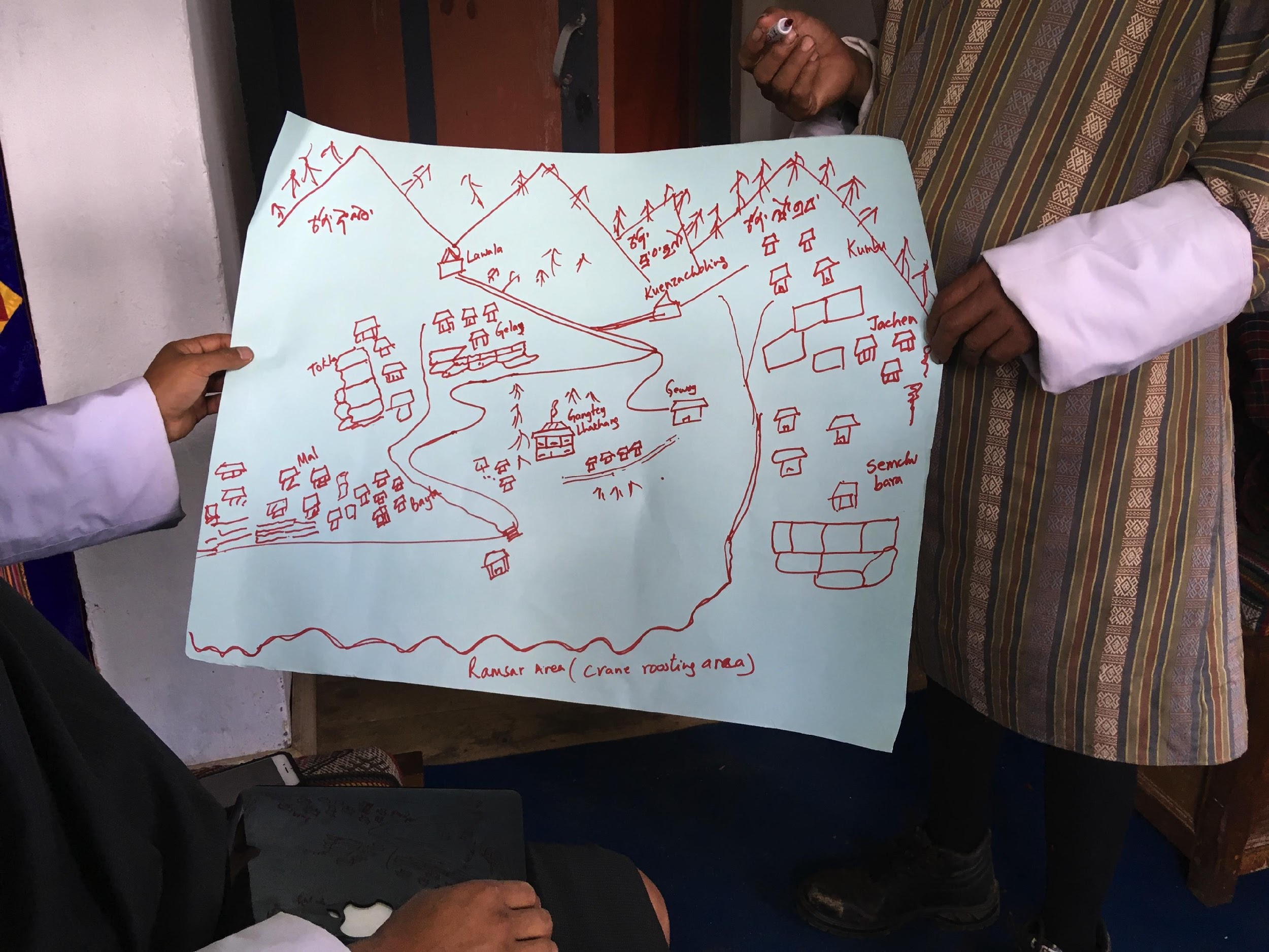
Notes:
We also expanded on our sketch mapping protocols, and district officials produced sketch maps that clearly indicated knowledge of local deities along mountain sides, forests, and even in the Ramsar Wetland area.

Slide 22
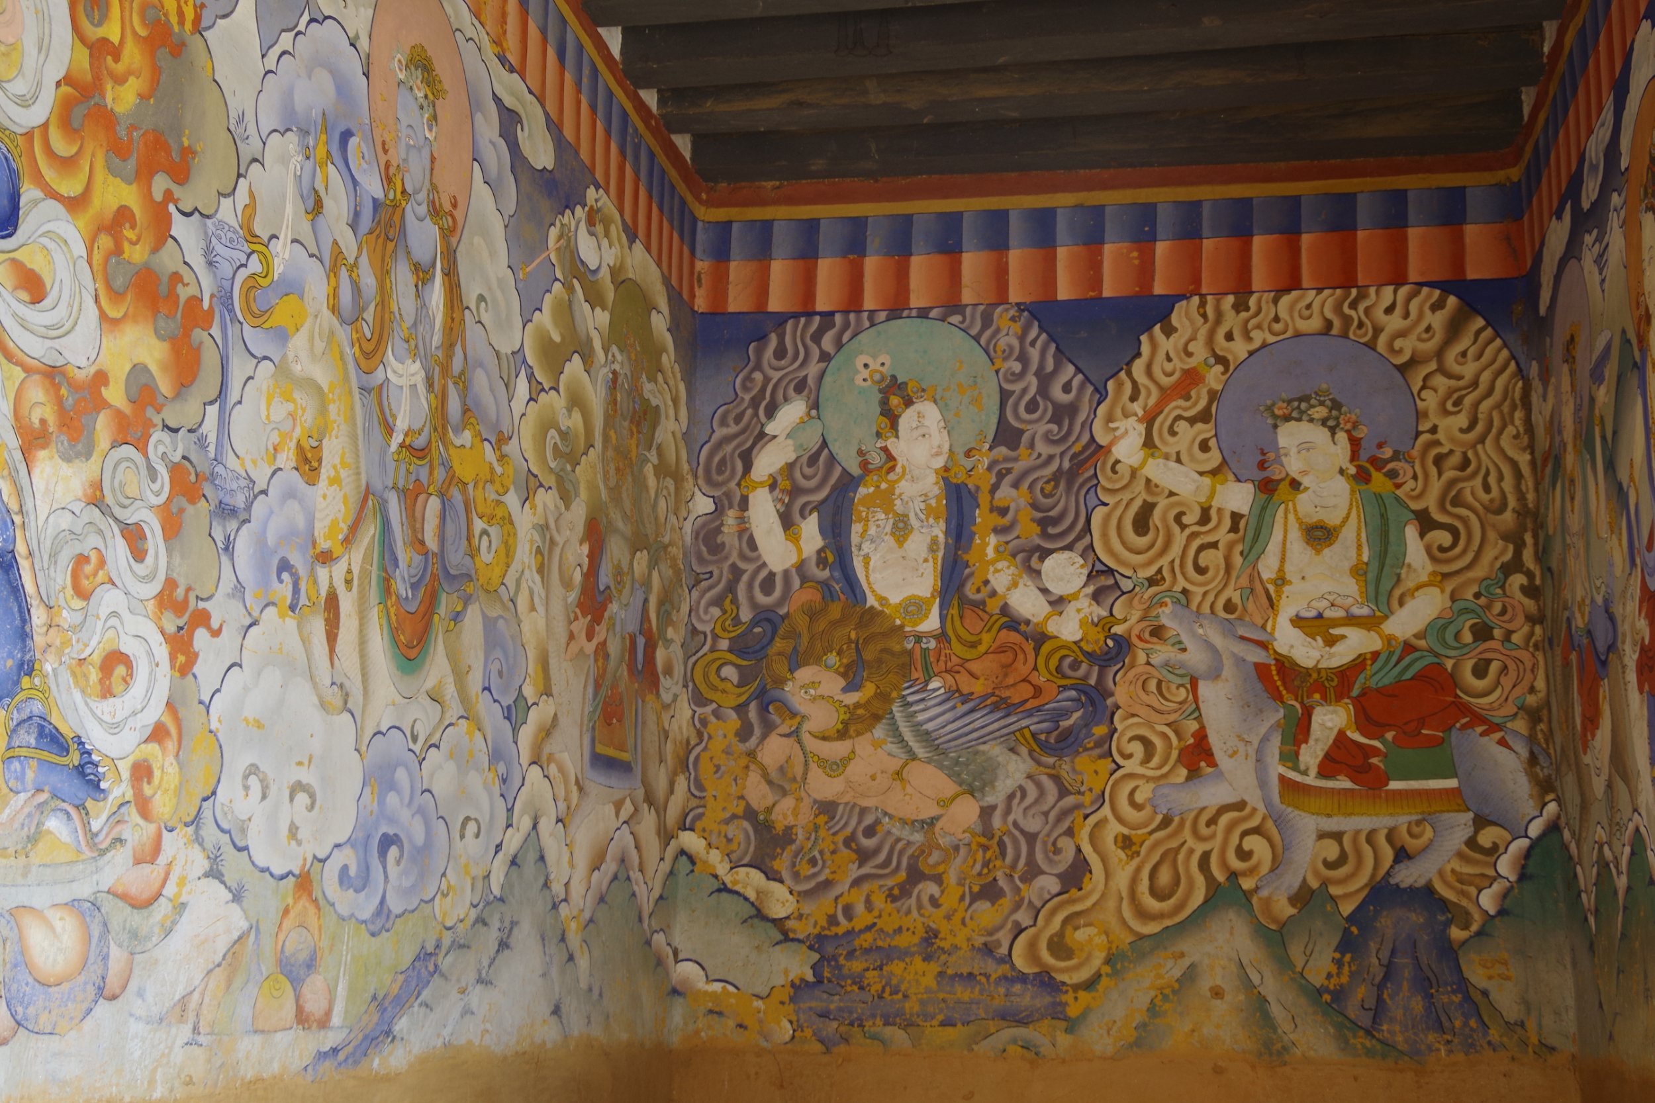
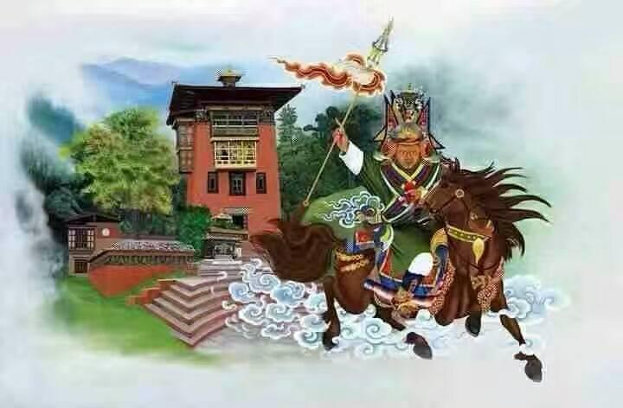
How do these intensely spatial spiritual realities, where deity citadels also occupy space, influence the spatial dimensions of conservation initiatives for BNCs and WBHs?
Notes:
This trajectory of engagement lead me to ask more broadly, how do these intensely spatial spiritual realities, where deities occupy space, influence the spatial dimensions of conservation initiatives for BNCs and WBHs? Deity citadels.
So if we think of ontology as a shared concept of reality (inclusive of the pantheon of Himalayan Buddhism, local deities, spirits, and divinites), how might we go about navigating the complexities of spatializing ontologies in conservation research?

Slide 23
Theoretical Framework Overview
Towards spatializing ontology in conservation research
Conservation Science
& the Politics of Knowledge
Critical Geography
& the Politics of Scale
Anthropology of Landscapes
& the Politics of Agency
Notes:
In order to approach this initial inquiry, I am proposing an integrative theoretical entry point, my first theoretical lens will be to explore theory in conservation science, in particular critiques of conservation that navigate the politics of knowledge, and different ways of knowing, and as we will discuss different ways of being in the world.
+Critical Geography +Anthropology of Landscapes

Slide 24
Key Terms
Home range (ecology): the area in which an animal lives and moves on a periodic basis
Epistemology (anthropology): system of knowledge, “worldview”
Ontology (anthropology): shared cultural reality, “world”

Slide 25
Theoretical Framework Overview
Towards spatializing ontology in conservation research
Conservation Science
& the Politics of Knowledge
Critical Geography
& the Politics of Scale
Anthropology of Landscapes
& the Politics of Agency

Slide 26
Theoretical Framework Conservation Science & the Politics of Knowledge
Conservation science informed by the construction of knowledge(s) in ecology/environmental science (Fletcher 2010)
Community-oriented initiatives- integrating local and indigenous knowledge towards improving conservation outcomes (Bala and Gheverghese Joseph 2007; Gadgil, et al. 1993; Weiss, et al. 2013)
Policies that ignore multiple knowledge systems demonstrated to create unintended social consequences related to exclusionary conservation strategies (Brockington and Igoe 2006; West, et al. 2006)
(Tengö et al, 2017: 18)
Notes:
For most of its history, conservation science has been informed by the construction of knowledge and the legacies of knowledge in ecology and environmental science; over the last few decades the field has seen an embrace of social science angles, and calls for community-based initiatives that aim to involve local community members; more than that critical literature discusses the complexities underlying global calls for the integration of local and indigenous knowledge towards improving conservation outcomes, since policies that ignore multiple knowledge systems have been demonstrated to result in unintended social consequences such as the extirpation of people from parks.

Slide 27
Theoretical Framework Conservation Science & the Politics of Knowledge
Collaborations that respect the integrity of each knowledge system, and “take seriously” the diversities of shared cultural realities, while not presupposing commensurability, necessarily navigate… (Heywood 2012)
Epistemology vs. Ontology
(Viveiros de Castro 2011: 136-137)
The politics of knowledge in conservation science explores different ways of knowing and being in the world, fostering dialogues between knowledges (Goldman et al. 2011)
Notes:
Navigating the complexities of these knowledge systems in collaborative enterprises will mean finding a way to respect the integrity of each knowledge systems (epistemology) but also to take seriously the diversities of shared cultural realities (ontologies) while not presupposing commensurability. The politics of knowledge in conservation is a broad theoretical lens, but I am particularly interested in the ways scholars aim to bridge these knowledge systems, which I think will be even more challenging when talking about finding ways to create dialogue across shared cultural realities (ontologies).

Slide 28
Theoretical Framework Conservation Science & the Politics of Knowledge
“The ‘ontological turn’ in anthropology is premised on the notion that anthropologists are fundamentally concerned with alterity and that this is not a matter of ‘culture’, ‘representation’, ‘epistemology’, or ‘worldview’, but of being” (Heywood 2012: 143)
Notes:
The ontological turn has not been a strong part of the theoretical lens of the politics of knowledge, particularly since the ontological turn: is premised on the notion that anthropologists are fundamentally concerned with alterity , and that this is not a matter of culture, representation, epistemology, or worldview, but of being.

Slide 29
Theoretical Framework Overview
Conservation Science
& the Politics of Knowledge
Critical Geography
& the Politics of Scale
Anthropology of Landscapes
& the Politics of Agency
Notes:
So if we are talking about different ways of knowing and being, what happens when we add the dimension of scale, scalar ways of knowing and being in the world? Here is where critical geography and the politics of scale are a particularly valuable theoretical lens

Slide 30
Theoretical Framework Critical Geography & the Politics of Scale
Critical geography attempts to disrupt common binaries & underscore power dynamics (Elwood 2006)
Participatory mapping can be “a more democratic way to elicit local knowledge and facilitate discussion about land use and boundaries within communities” (Bauer 2009).
Interrogate the complexities of “scale”: spatial, temporal, epistemological, and functional (Boyd, et al. 2008; Cash, et al. 2006)
Notes:
With attention to these complexities, critical geography attempts to disrupt common binaries and polemics generated in Cartesian cartographies by considering alternative human geographies and spatialities. Importantly, it underscores power dynamics in representational productions of space, place, and landscape, pointing to the relationships between institutions, individuals, governments, and communities. Applications of this theoretical lens in participatory mapping, while non- unproblematic, have been demonstrated to facilitate discussion and exhibit an emancipatory politics in some circumstances. Critical geography, beyond spatial ecology, can also better explore other scalar categories: temporal, jurisdictional, epistemological, functional, and perhaps ontological .

Slide 31
Theoretical Framework Critical Geography & the Politics of Scale
These “politics of scale” play out in maps/mapping, power-laden and political. Who has power to define the scale? (Crampton 2001; Crampton 2009; Elwood 2006)
There are no neutral ways to map or represent human geography as they are all fundamentally different “ontological landscapes of human inscription” (Ezzy 2004).
The concept and application of “landscapes,” as an analytic of geographic perception, varies greatly across disciplines (Runk et al. 2010, Sletto et al. 2009, Humphrey 1995)
Notes:
These politics of scale, play out in mapping and force reflexivity on who has power to define scale, extent, focus, and range of analysis. Ultimately, however, there are no neutral ways to map or represent human geography, as they are all fundamentally different ontological landscapes of human inscription. Even the concept and application of “landscape” is a contested term, and as an analytic of geographic perception, varies across disciplines. Which leads me to my third theoretical lens/framework.
5). This research aims to address critiques in critical geography by employing reflexive participatory mapping methodologies in a collaborative capacity, facilitating a community approach to co-constructing representational ontologies of conservation landscapes and creating a spatially-oriented dialogue between knowledge systems.

Slide 32
Theoretical Framework Overview
Conservation Science
& the Politics of Knowledge
Critical Geography
& the Politics of Scale
Anthropology of Landscapes
& the Politics of Agency
Notes:
Which leads me to my third theoretical lens/framework. The anthropology of landscapes is a diverse theoretical construct, but essentially distills the diversities of ways of being in landscapes, producing landscapes, co-constituting landscapes, and engagement within those create landscapes landscapes.

Slide 33
Theoretical Framework Anthropology of Landscapes & The Politics of Agency
Landscapes via “relationships” and “similarities”, as opposed to discrete distinctions between “object” vs “field” & “culture” vs. “nature” (Mark and Turk 2003).
Sacred landscapes exhibit “gradients” of sacredness (Huber 2015; Salick, et al. 2007; Stutchbury 1994), not as pin-points on a map, but akin to a mandala (Verschuuren and Furuta 2016; Zogib, et al. 2016)
“Landscapes” are patterned and produced by the actors that populate and perceive them, and the agency they exhibit within them (Humphrey 1995; Jianchu 2006; Johnson 2000; Maginnis, et al. 2004).
Notes:
Many scholars discuss how landscapes are viewed differently across cultures, some arguing that local and indigenous knowledge systems often hold perceptions that view landscapes via relationships and similarities, stories and spiritual inscription, rather than more euro-centric views that make discrete distinctions between “object” vs “field”, and “culture” vs. “nature”. In the lens of the ontological turn, the notion of a stable and universal “nature” viewed through various “cultural” perspectives is not shared by many of the people anthropologists study. One fruitful component of this theory has been sacred landscapes, which are defined by their complexities of spiritually inscribed places/spaces and interactions- existing as gradients of sacredness akin to mandalas (show mandala). Anthropological inquiries into “sacred” landscapes, have demonstrated the ontological complexities that arise when exploring the intersection of “sacredness” with contestations of geographic perception, scale, and ecological inter-relationships within landscapes. Anthropology of landscapes, in addition to recognizing the many ways of visualizing and perceiving landscapes, recognizing that there are a diversity of actors/agents that produce these landscapes and exhibit agency within them.

Slide 34
Theoretical Framework Anthropology of Landscapes & The Politics of Agency
Theoretical conceptions of the “actor”/”agent” vary in anthropology, both beings and things, in social relations, producers of social patterns (Giddens 1987; Latour 1996).
Multi-species Ethnography- Most research differentially recognizes the importance of human actors; MSE & agency of non-human species? (Kirksey & Helmreich 2010)
Politics of Agency- equally significant non-species (other-than-human) agents exhibit agency in the formation of “ontological landscapes of human inscription” (Allison 2017, Diemberger 1995, Pommaret 1994, Ura 2001, Yeh 2013, Yeh 2016)
Notes:
Theoretical concepts of actor vary in anthropology, but actor status can belong to both beings and things, enmeshed in myriad social relations as mediators and producers of social patterns. In this context, my research has been informed by multi-species ethnography, which rejects human essentialisms by recognizing the importance/agency of non-human species in condition the human. By considering the politics of agency in diverse conceptualizations of landscapes, I would propose there are equally significant non-species actors/agents that exhibit agency in the formation of ontological landscapes of human inscription;

Slide 35
Theoretical Framework Anthropology of Landscapes & The Politics of Agency
Theoretical conceptions of the “actor”/”agent” vary in anthropology, both beings and things, in social relations, producers of social patterns (Giddens 1987; Latour 1996).
Multi-species Ethnography- Most research differentially recognizes the importance of human actors; MSE & agency of non-human species? (Kirksey & Helmreich 2010)
Politics of Agency- equally significant non-species (other-than-human) agents exhibit agency in the formation of conservation landscapes (Maginnis 2004)
Notes:
in this case, we are talking about conservation landscapes for birds within the sacred landscapes of Bhutan. Asking who’s conservation landscape and therefore who’s trade-offs? in this case, we are talking about conservation landscapes for birds within the sacred landscapes of Bhutan, and the territorial deities, divinities, and spirits that occupy those landscapes.

Slide 36
Research Design
The goal of this project is to:
Spatialize cultural ontologies to inform community-based avian conservation research, prioritizing the cultural realities, ideologies, and spatialities of local people through community ethnography and participatory (counter) mapping.
Notes:
With this theoretical framework to understood my methodologies and research design, I aim to, engage in research that will allow me to understand if it is possible to: spatialize Bhutanese cultural ontologies to inform community-based avian conservation research, prioritizing the shared cultural realities, ideologies, and spatialities of community partnerships through community ethnography, multi-species ethnography, and participatory mapping.
Local ontologies and social inter-relationships with local deities (neydah zhida, yul lha) and sacred areas (baeyul) have historically shaped environmental management and conservation initiatives within Bhutan. To achieve community-oriented conservation for endangered species, the perceptions and ontological “worlds” of involved communities must be recognized in conservation planning, research, protected area design, and even BNC & WBH home-range maps, whether at more local or trans-national scales //

Slide 37
Research Design Central Question(s)
Supplemental Material
Q → How do spatially-explicit Bhutanese spiritual realities influence the spatial dimensions of conservation landscapes for BNCs and WBHs?
(Q1) What are the social and cultural histories that influence BNC & WBH conservation, locally and regionally?
(Q2). How are human-animal-deity inter-relationships spatially negotiated?
(Q3) How do different ways of representing space & landscapes differentially privilege certain socio-cultural realities and cultural geographies over others?
Notes:
Importantly, we must ask, how can cultural ontologies be differentially spatialized to inform landscape-scale conservation research for multiple species/non-species/SHOULD add other-than-human agentive forces or beings? Non-species inclusive of other-than-human beings or agentive forces that act and make choices within cultural ontologies
Research Questions
1
2
3
Q2- considering the alternative spatialities or Bhutanese spatial ontologies of human inscription

Slide 38
Methods Overview
(Q1 & Q2)
Community & Multi-species Ethnography
(Q1)
Semi-structured Interviews & Oral Histories
(Q1, Q2, & Q3)
Participatory (Counter) Mapping
Notes:
from methodological strategies from disciplines of human geography and conservation ecology in addition to cultural anthropology. While each method will inform each question, different methods will be differentially capable of addressing specific components, with Q1 and 2 informed through ethnography, Q1 through semi-structured interviews, but I would posit that all questions will be richly informed by participatory mapping.

Slide 39
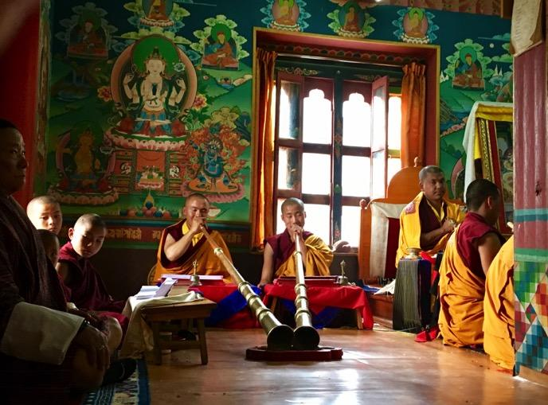
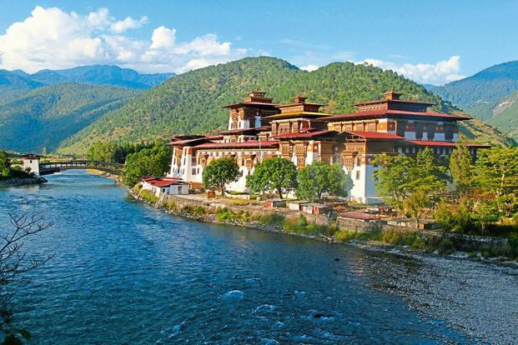
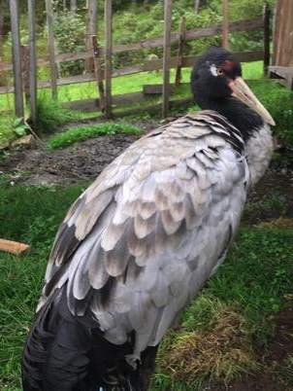
Methods Community & Multi-species Ethnography
Community Ethnography
Socio-cultural inter-relationships within & between focal communities
Multi-species Ethnography
Inter-species/other-than-species relationships condition conservation initiatives
Participant Observation
Account for locally experienced political and cultural forces that influence perceptions of protected areas and BNC/WBH conservation
Notes:
Ethnography will be particular important for elucidating the complexities of the inter-relationships between local communities, conservation actors, BNCs & WBHs, and the complexity of deities, divinities, and spirits, which I am only beginning to understand, knowing there to be a vast pantheon of invisible agents. Multi-species ethnography, beyond a species focus to accommodate other-than-human beings will be valuable.
Participant observation, in this context, will need to vary in degrees and levels of direct engagement, as much of this knowledge is privileged knowledge, intentionally kept secret, vague, and opaque, being reflexive enough to recognize that I may not have nor should have access to this knowledge or shared cultural realities held by our network of local collaborators and partners. Ranging from complete participant, participant observer, complete observer, or not-present/participating.

Slide 40
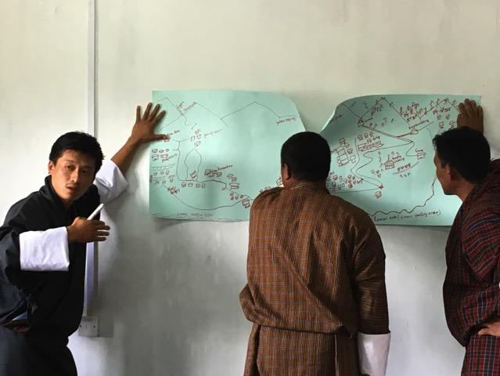
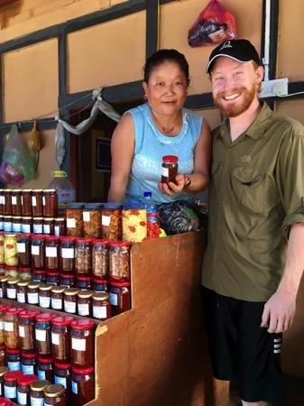
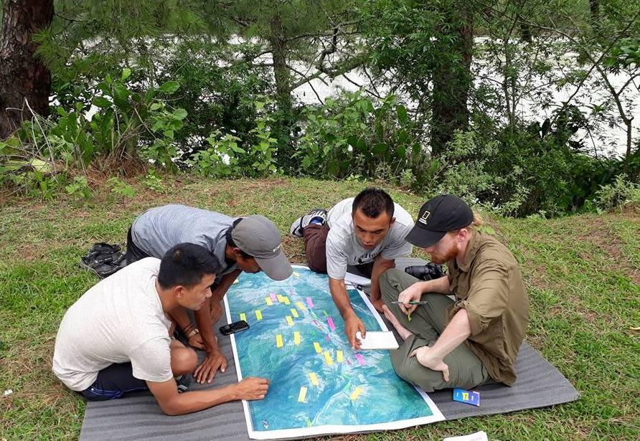
Methods Semi-structured Interviews & Oral Histories
Semi-structured Interviews
10 households across 4 study sites (40 total)
Oral Histories
5 across 4 study sites (20 total)
Focus Group Discussions
4 across study sites (4 total)
Notes:
//In adding to the collection of interviews, questionnaires, and focus group discussions from our last two field seasons, these methods will be important entry points for facilitating understanding and shared, co-produced knowledge in the form of these community-held, proprietary ontologies. As in the past, interviews and oral histories have been valuable at describing the present geo-political circumstances that influence landscape change in the country, and the histories of conservation that have a lot to do with international conservation attention, differential cultural values and veneration of species, and different population levels for BNCs and WBHs. These focus group discussions across geogs/districts will allow for the exploring of ideas from a diversity of human actors/agents exhibiting power and agency in their respective capacities, across community/ institutional scales and levels.

Slide 41
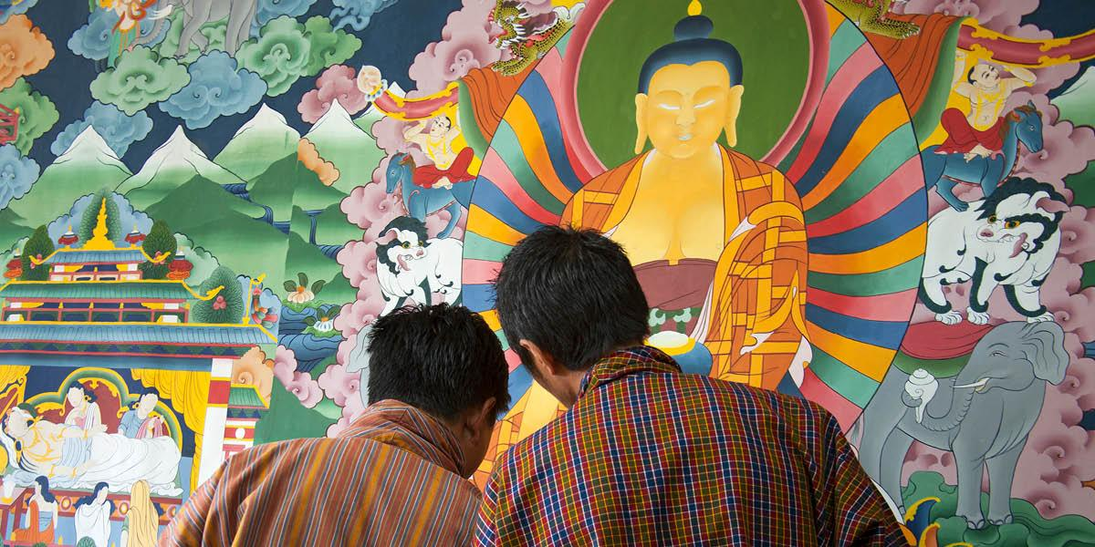
Methods Participatory & Collaborative (Counter) Mapping
Participatory (Counter) Mapping
Workshops across 4 study sites
Ground preparation, first workshop, first fieldwork, second workshop, second fieldwork, third workshop
Meaning of “home-range”
Thangkha Story Maps
Reflexivity: who is present, what is important, when maps produced, why and for what?
Notes:
Participatory mapping with explorations of ways of spatialzing cultural ontologies will be a particularly valuable application of both critical geography AND anthropology of landscapes. Counter mapping, which also seeks to dismantle the binaries generated in Cartesian cartography, can be applied in thinking about how maps of relations between beings might be generated in the style of Thangkha story maps, which have been explored by other scholars, notably Dr. Kenneth Bauer with his work on land-use, development, and pastoralism in Tibet and Nepal. How could Thangkha paintings (like this one), be utilized to display the inter-relationships between local communities, cranes, herons, and the diverse pantheon of deities, in a way that informs a broader ontological re-consideration, not just of
Home ranges for Birds, but Home-ranges for Deities.

Slide 42
Research Schedule 2019-2020
Feb ‘19 | Royal Society for Protection of Nature (RSPN) Research Schedule |  |  | Feb ‘20
Breeding/Nesting Season for White-bellied Herons in Bhutan |  | Non-Breeding/Wintering Season for the Black-necked Cranes in Bhutan
Participant Selection & Community Ethnography (RSPN & BOPL) | Data Collection: Semi-structured interviews, Collaborative/Participatory Mapping, MSE | Participant Selection & Community Ethnography (RSPN & BOPL) | Data Collection: Semi-structured interviews, Collaborative/Participatory Mapping, MSE
 | Sites: Punatsangchu (Tsirang District) |  | Sites: Phobjikha, Bumthang, Tr. Yang.
Notes:
I will conduct this ethnographic study over the course of one year, correlating to the life history (temporal) and species distribution (spatial) of BNCs and WBHS in Bhutan.

Slide 43
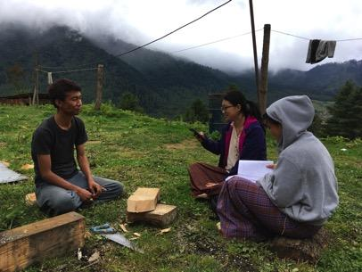
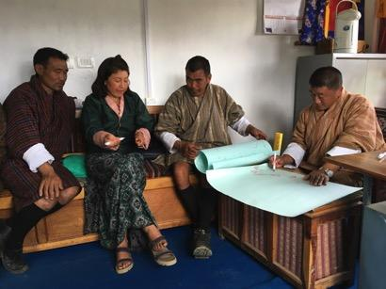
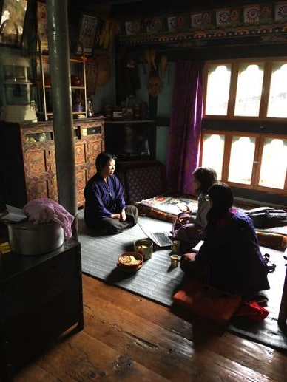
Notes:
Went from a non-participatory CBST & BNC Story Mapping, to an increasingly participatory/collaborative WBH mapping with community members; AND now through my research I hope to demonstrate the value of these different kinds of methods to not only highlight the relationships between conservation landscapes and cultural landscapes in Bhutan, if they are distinct at all, and further consider ways in which these types of social and cultural engagements with community members can illuminate aspects of conservation, re-introduction, or project planning that might not otherwise be illuminated or explicitly documented as a form of data; this type of data can help to better understand the entanglements between changing land use practices, cultural/ritualistic traditions, conservation and scared landscapes, the politics of conservation of critically endangered species, and sacred ecology of species, landscapes, and communities.
-Went out into the field in both WBH and BNC territories to talk with community members abouet the perceptions and perspectives on conservation and protected areas for these two birds, particularly as they relate, directly or indirectly, with the landscape and topography of the unseen world of local and regional deities, as well as sacred sites and landscapes
-Collaborative Mapping as Method
-New Collaborations: BOPL (for future ethno-ornithology investigations) and AUW (as enumerators in BNC perception study)
-Communicated my positionality, was able to meet with friends of 3 years, shared stories, spatialized stories, and communicated co-production
-Making community-based conservation about listening/adopting/valuing knowledge rather thanpurely education & advocacy at a community-level/scale

Slide 44
Intellectual Merit & Broader Impacts
Intellectual Merit
Spatializing Ontology
Expanding Multi-Species Ethnography, beyond species
Exploring Participatory (Counter) Mapping as Methodology
Broader Impacts
Co-produce Knowledge
Share Results/Publish Research
Encourage an Integrative Community-based Conservation
Expand Outreach and Strategic Communication
Notes:
My aim for this research is to advance theory in ontological anthropology by introducing a scalar component and way of being in the world towards informing anthropological engagement. I think this research has implications for multi-species ethnography to re-consider what it means to recognize and foreground other agents exhibit agency that are not only not human, but not-animal, and not-species, deities, divinities, spirits. I will also explore the capacity of applications in critical geography and the anthropology of landscapes via participatory (counter) mapping as methodologies. With the broader impacts being, ideally, a way to navigate the co-production of knowledge, that in many circumstances may not include my direct knowledge, share the results of this research first and foremost with the involved communities and then consider joint publishing with the RSPN. I see this as encouraging community-based conservation that is not only focused on education and outreach, but with a goal, and with deep moral seriousness, of prioritizing the ontological realities and epistemologies of local people, and thereby aim to expand what outreach and strategic communication in this context might look like.

Slide 45
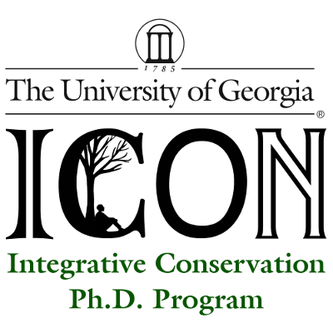
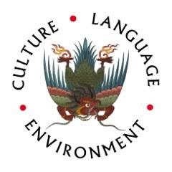
Thank You!
Notes:
I see this as encouraging community-based conservation that is not only focused on education and outreach, but with the goal, and with a deep moral seriousness, of prioritizing the knowledge and belief systems, shared cultural realities, and perspectives of local people, and thereby aim to expand what outreach and strategic communication in this context might look like, by prioritizing conservation landscapes for cranes and herons, while considering the sacred landscapes, animated and mediated by deity citadels, as well in this evolving narrative at the intersection of cranes, culture, and conservation.

Slide 46
Acknowledgements Advisory committee: Dr. Peter Brosius Dr. Julie Velasquez Runk Dr. Meredith Welch-Devine Dr. Robert Cooper Dr. Sienna Craig, Dartmouth College Dr. Kinley Tenzin, RSPN Dr. Rebecca Pradhan, RSPN Dr. George Archibald, ICF Mr. Jigme Tshering, RSPN Family & Friends

Slide 47
Allison, E. (2002). "Spiritually motivated natural resource protection in eastern Bhutan." Society & Natural Resources 15(1): 41-64. Allison, E. (2017). "Spirits and Nature: The Intertwining of Sacred Cosmologies and Environmental Conservation in Bhutan." Journal for the Study of Religion, Nature & Culture 11(2): 197-226. Bala, A. and G. Gheverghese Joseph (2007). "Indigenous knowledge and western science: the possibility of dialogue." Race & Class 49(1): 39-61. Bauer, K. (2009). "On the politics and the possibilities of participatory mapping and GIS: using spatial technologies to study common property and land use change among pastoralists in Central Tibet." cultural geographies 16(2): 229-252. Brockington, D. and R. Duffy (2010). "Capitalism and Conservation: The Production and Reproduction of Biodiversity Conservation." Antipode 42(3): 469-484. Brockington, D. and J. Igoe (2006). "Eviction for conservation: a global overview." Conservation and society: 424-470. Campbell, L. M. and A. Vainio-Mattila (2003). "Participatory development and community-based conservation: Opportunities missed for lessons learned?" Human Ecology 31(3): 417-437. Crampton, J. W. (2001). "Maps as social constructions: power, communication and visualization." Progress in human Geography 25(2): 235-252. Crampton, J. W. (2009). "Cartography: performative, participatory, political." Progress in human geography 33(6): 840-848. de Castro, E. V. (2011). "Zeno and the art of anthropology: Of lies, beliefs, paradoxes, and other truths." Common Knowledge 17(1): 128-145. Dove, M. R. (2006). "Indigenous people and environmental politics." Annu. Rev. Anthropol. 35: 191-208. Elwood, S. (2006). "Critical issues in participatory GIS: Deconstructions, reconstructions, and new research directions." Transactions in GIS 10(5): 693-708. Ezzy, D. (2004). "Geographical Ontology: Levinas, Sacred Landscapes and Cities." Pomegranate 6(1). Fletcher, R. (2010). "Neoliberal Environmentality: Towards a Poststructuralist Political Ecology of the Conservation Debate." Conservation & Society 8(3): 171-181. Gadgil, M., F. Berkes and C. Folke (1993). "Indigenous knowledge for biodiversity conservation." Ambio: 151-156. Goldman, M. (2007). "Tracking wildebeest, locating knowledge: Maasai and conservation biology understandings of wildebeest behavior in Northern Tanzania." Environment and Planning D: Society and space 25(2): 307-331. Goldman, M. J., P. Nadasdy and M. D. Turner (2011). Knowing nature: Conversations at the intersection of political ecology and science studies, University of Chicago Press. Gururani, S. (1995). "“The Forests Are Forever!” The Politics of Conservation and Use in Central Himalayas, India." Culture & Agriculture 16(53): 13-18. Haraway, D. (1988). "Situated knowledges: The science question in feminism and the privilege of partial perspective." Feminist studies 14(3): 575-599. Hazen, H. D. and L. Harris (2006). Power of maps:(Counter) mapping for conservation, University of British Columbia. Heywood, P. (2012). "Anthropology and What There Is: Reflections on 'Ontology'." The Cambridge Journal of Anthropology 30(1): 143-151. Huber, T. (2015). Source of Life: Revitalization Rites and Bon Shamans in Bhutan and the Eastern Himalayas, Humboldt University of Berlin. Humphrey, C. (1995). "Chiefly and shamanist landscapes in Mongolia." The anthropology of landscape: perspectives on place and space: 135-162. 1
References Cited…

Slide 48
Jianchu, X. (2006). "The political, social, and ecological transformation of a landscape: the case of rubber in Xishuangbanna, China." Mountain Research and Development 26(3): 254-262. Johnson, L. M. (2000). "“A Place That's Good,” Gitksan Landscape Perception and Ethnoecology." Human Ecology 28(2): 301-325. Kuyakanon, R. and D. Gyeltshen (2017). "Propitiating the Tsen, Sealing the Mountain: Community Mountain-closure Ritual and Practice in Eastern Bhutan." HIMALAYA, the Journal of the Association for Nepal and Himalayan Studies 37(1): 7. Latour, B. (1996). "On actor-network theory: A few clarifications." Soziale welt: 369-381. Maginnis, S., W. Jackson and N. Dudley (2004). "Conservation landscapes. Whose landscapes? Whose trade-offs." Getting Biodiversity Projects to Work: Towards more effective conservation and development: 321-339. Sillitoe, P. (1998). "The development of indigenous knowledge: a new applied anthropology." Current anthropology 39(2): 223-252. Runk, J. V., G. O. Negría, L. P. Conquista, G. M. Peña, F. P. Cheucarama and Y. C. Chiripua (2010). "Landscapes, legibility, and conservation planning: multiple representations of forest use in Panama." Conservation Letters 3(3): 167-176. Sletto, B. I., C. R. Hale, B. R. Middleton, A. Nygren, I. Rodríguez, R. S., A. Ulloa and B. I. Sletto (2009). "“We Drew What We Imagined” participatory mapping, performance, and the arts of landscape making." Current anthropology 50(4): 443-476. Stephanie, M., J. M. Dias, S. T. Buckton and S. J. Ormerod (1999). "Alternative methods for predicting species distribution: an illustration with Himalayan river birds." Journal of Applied Ecology 36(5): 734-747. Stutchbury, E. (1994). "Perceptions of Landscape in Karzha:" Sacred" Geography and the Tibetan System of" Geomancy"." The Tibet Journal: 59-102. Tengö, M., E. S. Brondizio, T. Elmqvist, P. Malmer and M. Spierenburg (2014). "Connecting diverse knowledge systems for enhanced ecosystem governance: the multiple evidence base approach." Ambio 43(5): 579-591. Tengö, M., R. Hill, P. Malmer, C. M. Raymond, M. Sp., F. Dani., T. Elmqvist and C. Folke (2017). "Weaving knowledge systems in IPBES, CBD and beyond—lessons learned for sustainability." Current Opinion in Environmental Sustainability 26: 17-25. Verschuuren, B. and N. Furuta (2016). Sacred Mandala: protecting Bhutan’s sacred natural sites Liza Zogib, Khenpo Phuntshok Tashi, Tshewang Gyalpo, Sangay Dendhup, Riamsara Kuyakanon, Kelzang Wangchuk, Lopen Namgay Tenzin and Ngawang Gyeltshen. Asian Sacred Natural Sites, Routledge: 79-90. Weiss, K., M. Hamann and H. Marsh (2013). "Bridging knowledges: understanding and applying indigenous and western scientific knowledge for marine wildlife management." Society & Natural Resources 26(3): 285-302. West, P. and D. Brockington (2006). "An anthropological perspective on some unexpected consequences of protected areas." Conservation biology 20(3): 609-616. Yeh, E. T. (2016). "‘How can experience of local residents be “knowledge”?’ Challenges in interdisciplinary climate change research." Area 48(1): 34-40. Zogib, L., K. P. Tashi, T. Gyalpo, S. Dendhup, R. Kuyakanon, K. Wangchuk, L. N. Tenzin and N. Gyeltshen (2016). "Protecting Bhutan's sacred natural sites." Asian Sacred Natural Sites: Philosophy and practice in protected areas and conservation. 2

Slide 49
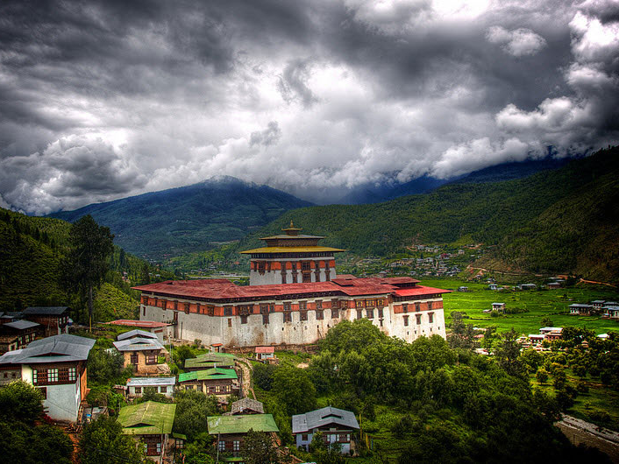
Comments & Questions
Notes:
There are calls to map these sacred and spiritual landscapes in order to better protect them and document their existence. In doing so, I think it is important to acknowledge that the institutions charged with this task be mindful of the value systems motivating their actions, the implications of those actions, and ultimately the progression of mapping sacred sites

Slide 50
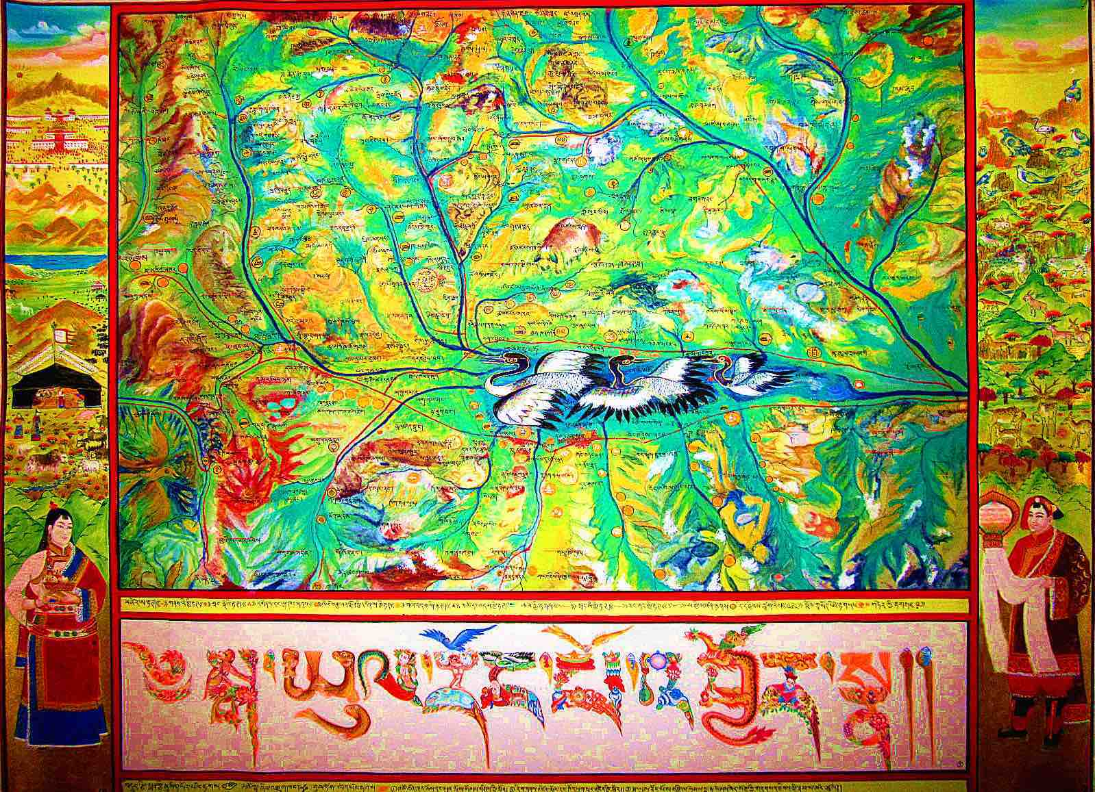
Supplemental Material
Dr. Kenneth Bauer, Dartmouth College
Notes:
I commissioned it in 2011 and recorded GPS locations for 150 of the 450+ toponyms recorded for this watershed (approx.. 30x20km) in Yushu Prefecture. The map is cartographically accurate so I can analyze it alongside different spatial layers (altitude, aspect, vegetation, 1960s remote sensing images, contemporary Google maps). The black-neck cranes depicted in the painting are highlighted since this is the Longbao Wetland Reserve and the site of a WWF field office; John Farrington did some work there and published some data a few years ago. This map is one of three major mapping projects I’ve worked on, in Dolpo, the TAR, and Qinghai

Slide 51
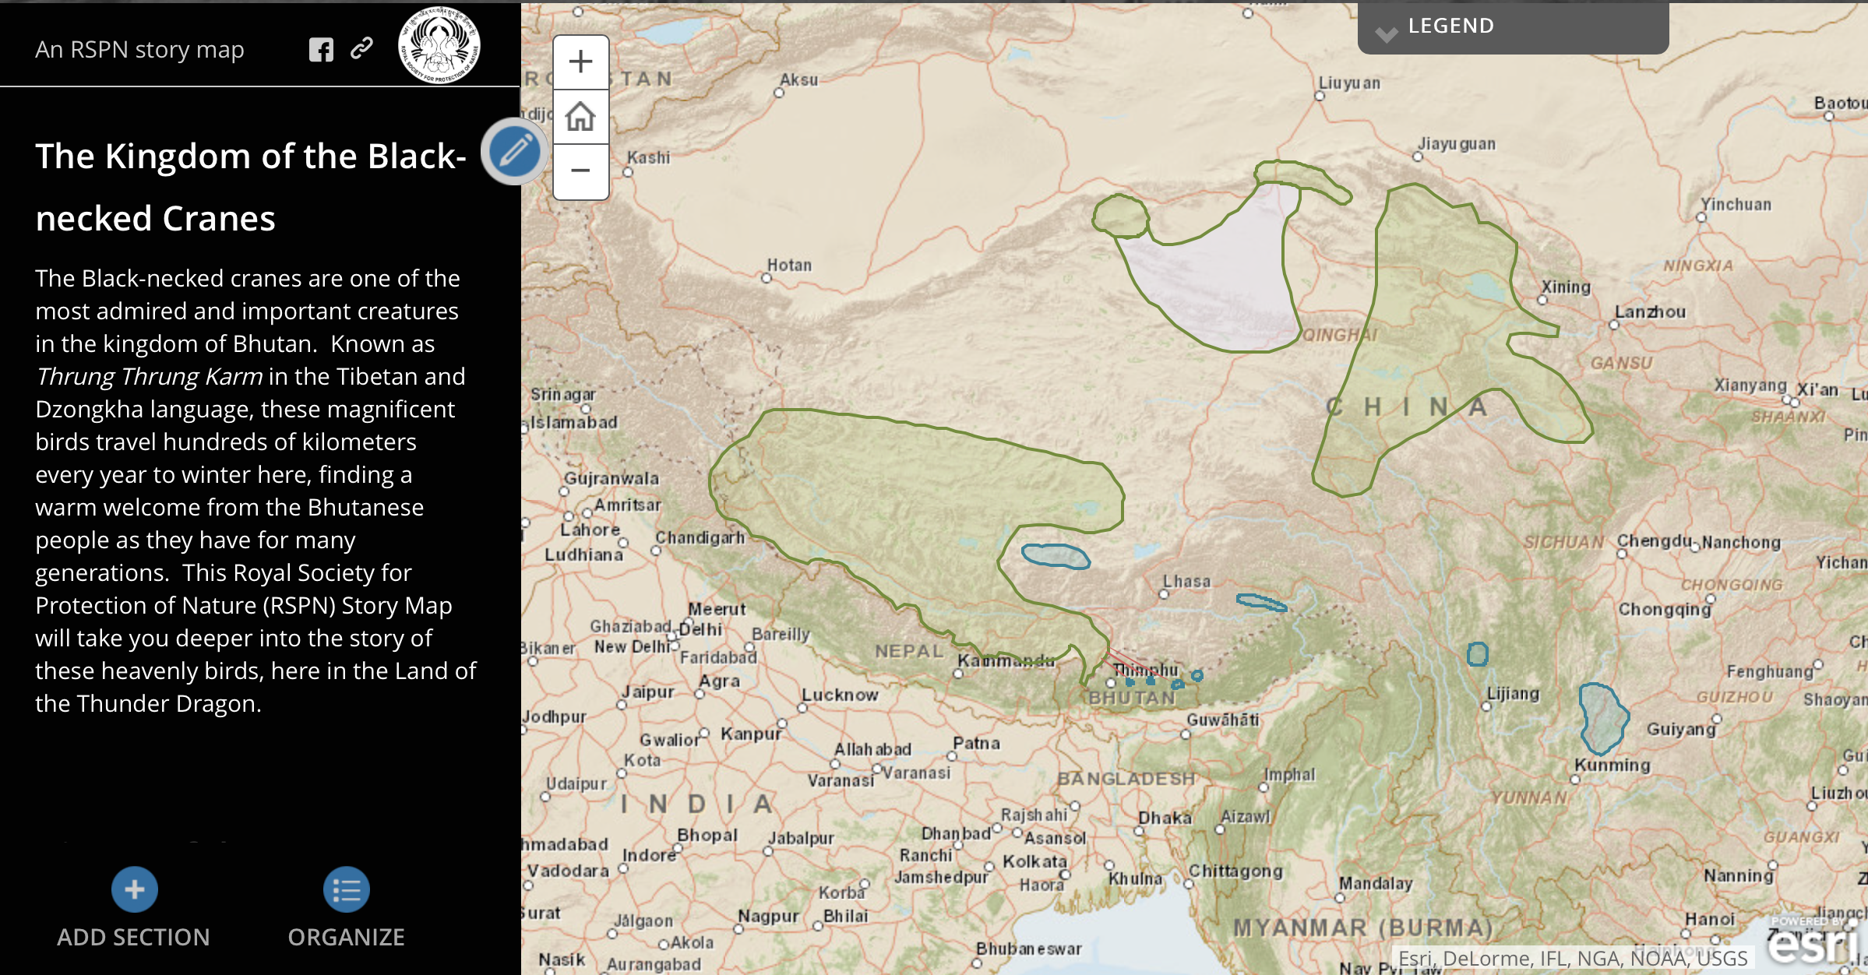
Supplemental Material

Slide 52
Supplemental Material

Slide 53
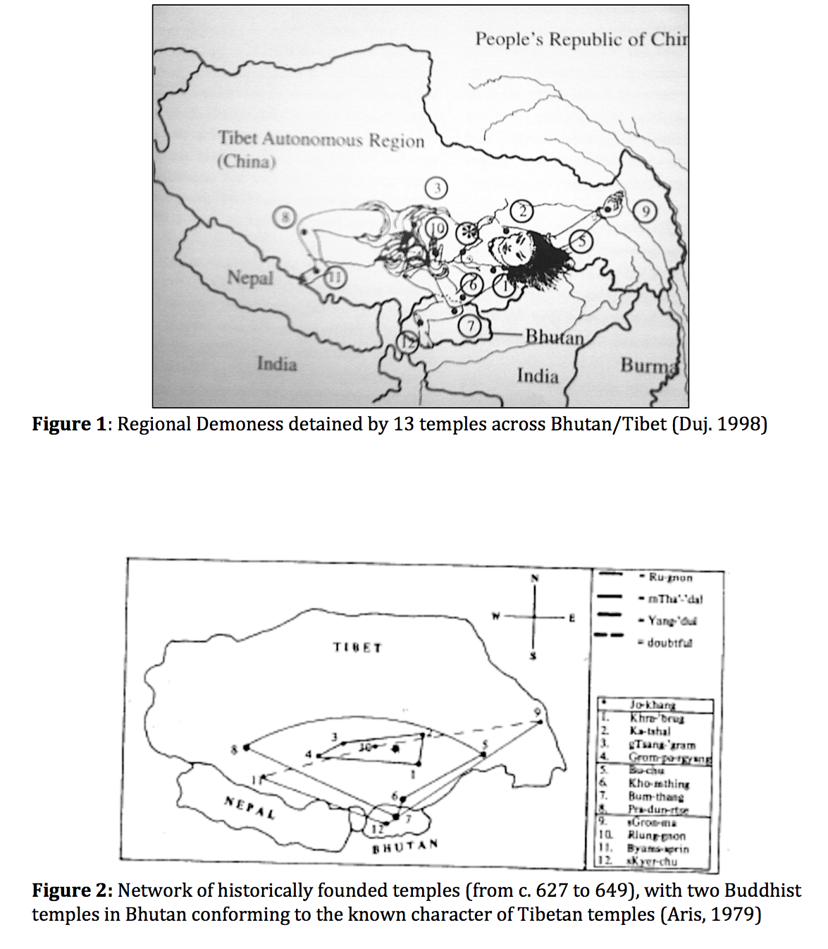
Supplemental Material
Notes:
Religious festivals are numerous. Tshechu are clelebrated in honour of Guru Rinpoche. Dances which have deep religious significance are performed annually at various Dzongs (fotress) and Monasteries. Some important Dzongs conduct Dromchoe, in honor of Yeshe Gompo (Mahakala) or Palden Lhamo (Mahakali)-the two main protective deities of the Drukpas.

Slide 54
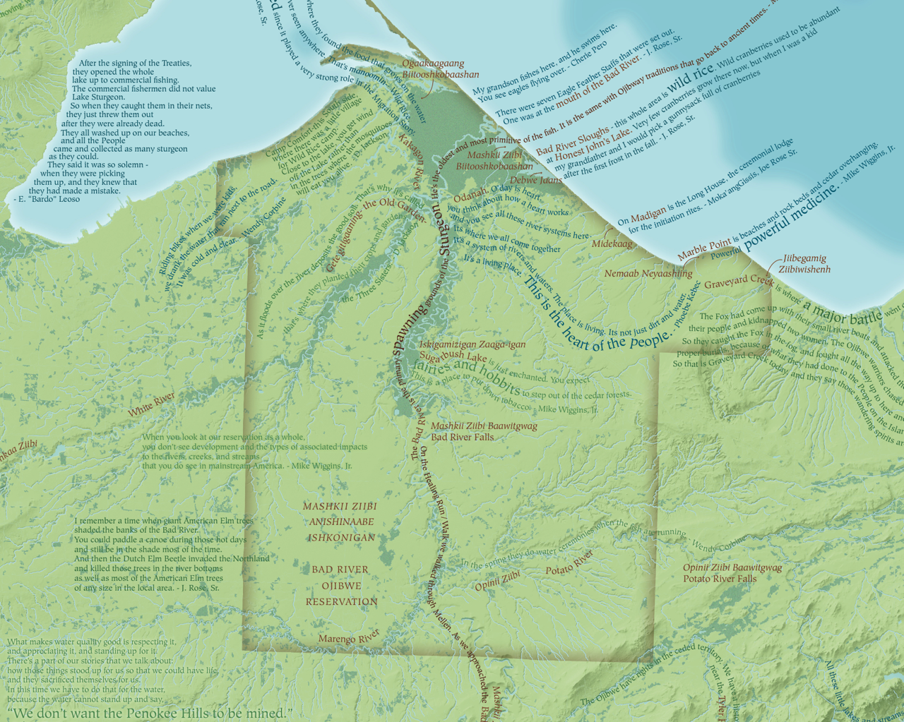
Supplemental Material
Notes:
Tshechu are clelebrated in honour of Guru Rinpoche. Dances which have deep religious significance are performed annually at various Dzongs (fotress) and Monasteries. Some important Dzongs conduct Dromchoe, in honor of Yeshe Gompo (Mahakala) or Palden Lhamo (Mahakali)-the two main protective deities of the Drukpas.

Slide 55
Selected Outputs (2014-2017)
Supplemental Material
(2) Teacher Trainings at BNCVC- Interpretive Naturalist Protocols
(3) ArcGIS Online Story Map Journals (BNCs & WBHs)- Links (some expired): http://arcg.is/19CzGW0 & http://arcg.is/0qLLe5
(1) Program Manual for Black-necked Crane Visitor Center (*See attached)
(10) High-resolution satellite imagery maps of critical WBH habitat areas/watersheds for use in participatory mapping workshops
(4) Community-led Participatory WBH Monitoring Maps (*See attached)
(1) Community BNC Perception & Deity Citadel Map
(3) Focus Group Discussions, Geog Offices- "BNC Perception Study" w/ Jigme Tshering
(3) BNC Sketch Mapping Workshops, Geog Offices- Wangdi, Bumthang, Trashiyangtse

Slide 56
Objectives/Outputs (2018-2020)
Supplemental Material
Complete 1-year of field research
(4) Collaborative Topographic Ethno-Ornithological Maps (Community-Owned)
(1) Ethno-Ornithological Atlas- Printed & Digital- w/ University of Oxford's Ethno-Ornithology World Archive
(1) Thangkha Community-based Story Maps for BNC & WBH Conservation
(1) Dissertation Manuscript, Integrative Conservation (ICON) & Anthropology PhD
(3) Peer Reviewed Journal Submissions for Collaborative Publications (Journal Considerations: Journal of Bhutan Studies, Ecology & Society, Conservation Biology)

