Slide 1
African Ubuntu & Buddhist Happiness & native American Buen Vivir
DEVELOPMENT AS SERVICE
Versus Sustainable Development Goals

Slide 2
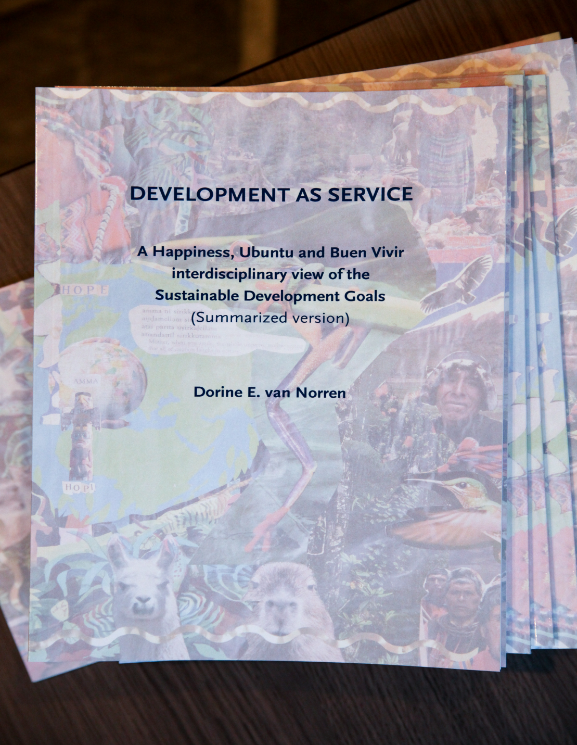
dorinevannorren@yahoo.com
University of Tilburg
University of Amsterdam

Slide 3
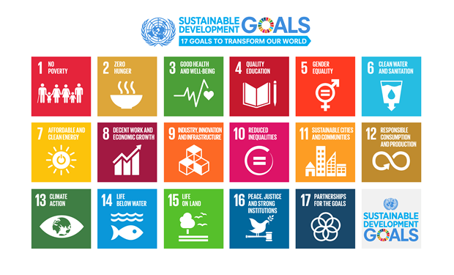
SDGs
Modernist notions of development: Sovereignty of humans over their environment, individualism, freedom (rights rather than duties), self-interest, belief in the market leading to collective welfare, private property, rewards based on merit, materialism, quantification of value, and instrumentalization of labor (for the market and productions process).
The SDGs are also linear result-based and human right approach oriented.

Slide 4
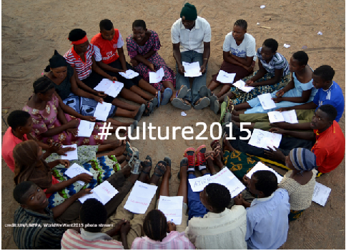
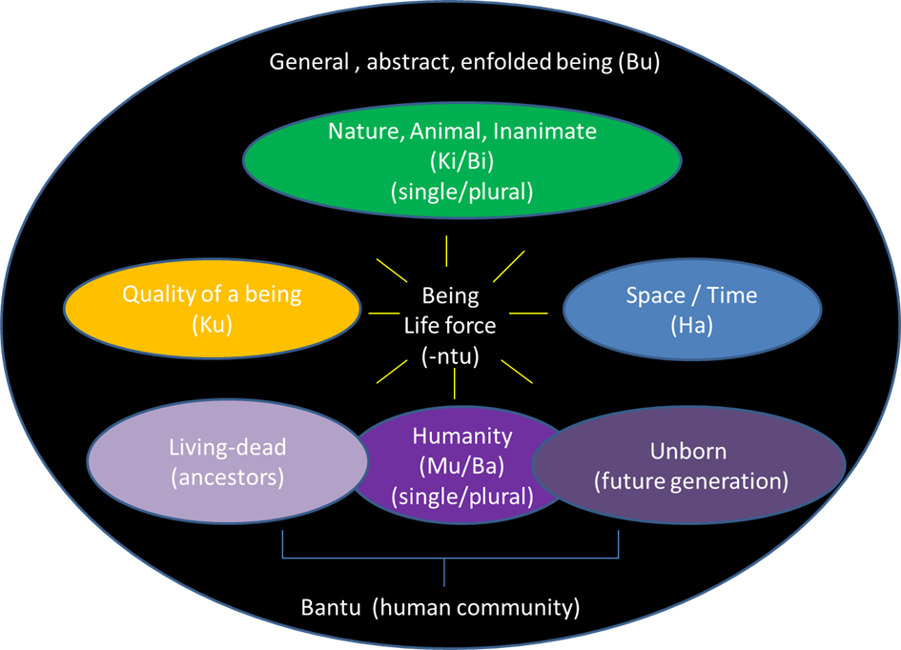
UBUNTU: I am because we are
collectivist worldview
Abstract Being (Bu) +
Life Force Being (Ntu) = u-Bu-Ntu
underlying all things:
Kintu/Bintu, Hantu, Kuntu, Muntu/Bantu
People=ancestors + now + unborn

Slide 5
Gross National Happiness (GNH)
4 pillars
Culture
Socio-economic
Nature
Good governance
9 domains

Slide 6
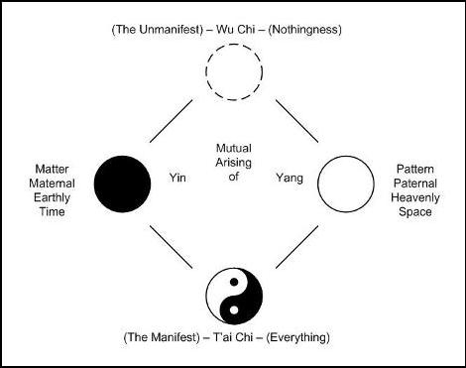
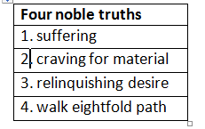
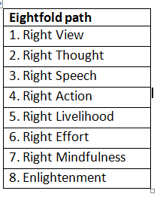
Underlying worldview
Middle Path/Simple life/
harmony and balance

Slide 7
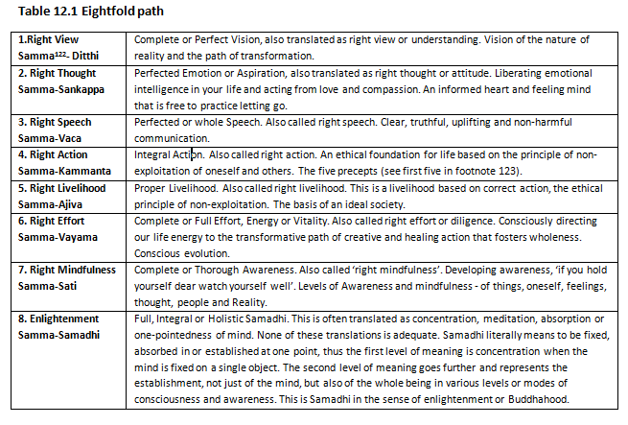

Slide 8
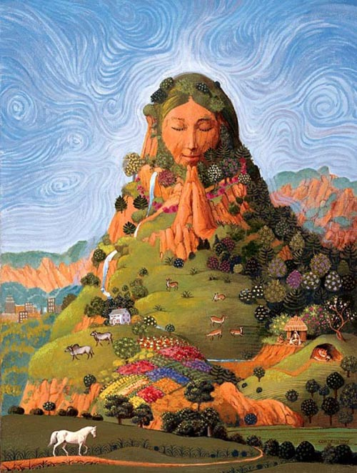
Buen Vivir, Sumak Kawsay Good Living (Ecuador/Quecha)
Biocentric, centred around mother earth
Harmony with nature and others
Balance between spiritual and material wealth
Cyclical

Slide 9
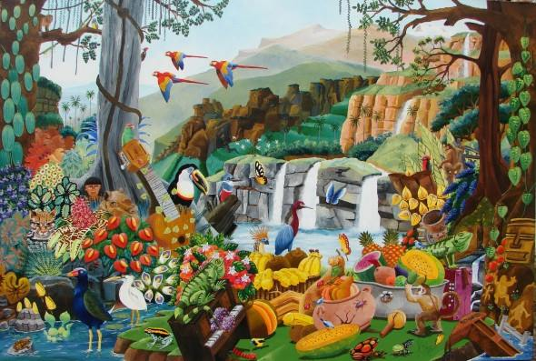
Human as subject and equal to all other living beings (animate and inanimate)
Rights of nature in the constitution

Slide 10
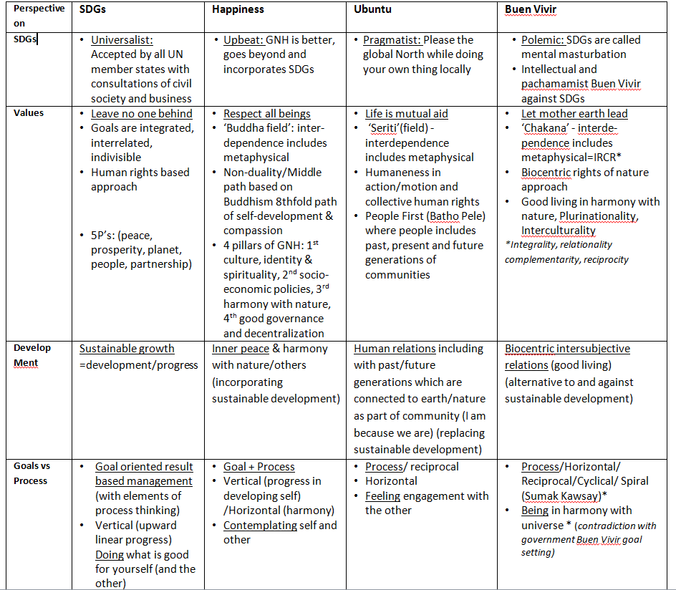

Slide 11
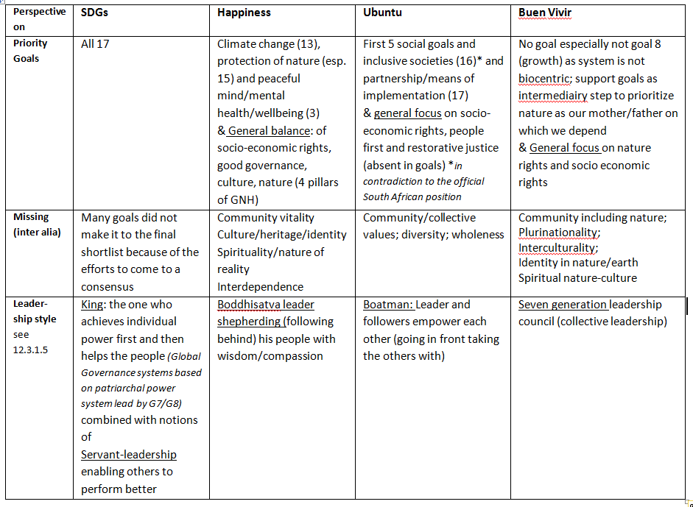

Slide 12
dorinevannorren@yahoo.com
University of Tilburg
University of Amsterdam

