Slide 1
People on the move. In-country migrations in Bhutan (Draft ppt, not for circulation) Inaugural Conference of the International Society for Bhutan Studies (ISBS) Oxford, Magdalen College, 8 January 2019
Françoise Pommaret
Directeur of research CRCAO-CNRS
& Associate Professor, CLCS, Royal University of Bhutan

Slide 2
When we speak of migration into Bhutan, the term evokes either the major movements of people from Tibet during of the early historical period (8th-9th century) or the early 20th century migrations from Darjeeling and Sikkim by different peoples who are often grouped together under the blanket term, "Nepali".
In this paper, however, I would like to turn to a different set of migrations – those that have occurred within Bhutan since the 11th century and which continue up until the present day. These intra-migrations within Bhutan, which involved all or many of the various linguistic groups within the country, were, and indeed are, of a different nature from either the early migrations from Tibet or the more recent ones from Darjeeling and Sikkim. They mostly reflect a longer cultural and socio-economic as well as religious process, marked by repetitive, on-going patterns of movement and settlement.

Slide 3
These intra-migrations were the result of complex histories and multiple factors: transhumance, taxation, the search for new lands for cultivation, religious affiliation, marital alliances, and so on. These have produced the complex and rich linguistic mosaic, with its distinctive array of seasonal and geographic variations, which we recognize today as Bhutan.
In this paper, I draw on an approach to internal migration that has been largely overlooked until recently in this field, one that aims to capture the ongoing, dynamic, synchronic character of these demographic shifts, rather than the more static approach found in conventional accounts.
To avoid over-running my time, I will only present a summary of the findings, using maps to illustrate, and inevitably to simplify, what is a complex issue. So please forgive me for not presenting you with an exhaustive list of all known migrations; instead, I have made a selection, necessarily a somewhat impressionistic one, showing a number of examples of these movements.

Slide 4
Methodology based on different tools
1-Short Bibliography Works in English
Aris, Michael. 1986. Sources for the history of Bhutan, Universität Wien: Wiener Studien zur Tibetologie und Buddhismuskunde, n°14, Arbeitskreis für Tibetische und Buddhistische Studien.
Bodt, Timotheus A. 2012. The new lamp clarifying the history, peoples, languages and traditions of Eastern Bhutan and Eastern Mon. ('Brug shar phyogs lung pa dang shar mon gyi lo rgyus dang mi rigs skad rigs lugs srol rnams kyi gsal ba'i sgron me gsar pa). Wagenigen: Monpasang publications, ISBN 978-90-818610-0-7.
Karma Phuntsho. 2013. The History of Bhutan, Noida: Random House.
Karma Ura. 2004. (1995). The Hero with a thousand eyes, Thimphu: Karma Ura.
Karma Ura (transl.). 2015. Longchen Rabjam, The illuminating map – titled as forest park of flowergarden - of Bumthang, the divine hidden land (Bum thang lha’i sbas yul gyi bkod pa gsol bar byed pas me tog skyid mos tshal), composed in 1355. Thimphu: CBS.
Pain, Adam and Pema, Deki. 2000. "Continuing Customs of Negotiation and Contestation in Bhutan", Journal of Bhutan Studies, vol 2, Number 2, Winter 2000, 219-227.
Pain, Adam. 2004. "State, economy and space in Bhutan in the early part of the 19th century" in Karma Ura and Sonam Kinga (eds.), The Spider and the piglet. Proceedings of the first international seminar on Bhutan Studies. Thimphu: Centre for Bhutan Studies, 160-193.
Pain, Adam and Pema, Deki. 2004. "The matrilineal inheritance of land in Bhutan", Contemporary South Asia 13 (4), Dec. 2004, 421-435.
Pommaret, Françoise.
2016. "Alliances and Power in Central Bhutan: A narrative of religion, prestige and wealth (mid 19th -mid 20th centuries)" in Saul Mullard, The Dragon and the Hidden Land: Social and historical studies on Sikkim and Bhutan (Bhutan-Sikkim panel, 12th Seminar of the International Association for Tibetan Studies, Vancouver 2010), Bulletin of Tibetology, 45(2) /46(1), pp. 49-66. http://www.digitalhimalaya.com/collections/journals/bot/
2017 "Finding Yarlung in South-central Bhutan. Myths, migrations and society: The community of Ngangla Trong in Lower Kheng" in Jenny Bentley (ed.), Series 2, The Dragon and the Hidden Land: Social and historical studies on Sikkim and Bhutan, Bhutan-Sikkim panel held at the 13th Seminar of the International Association for Tibetan Studies, Ulaan Bator, Mongolia, 2013. Bulletin of Tibetology Volume 50 Number 1 & 2. 2017, 17-52. issn 0007-5159.
2018 "The Bumthang web. A story of interdependence: Myths, alliances, religion and power in Bhutan" in S. Kumagai (ed.) Buddhism, Culture and Society in Bhutan. Proceedings of the 14th IATS, Kathmandu: Vajra. 149-170. ISBN 978-9937623940.
2-Classical historical texts
Lama Ngawang, rGyal rigs.
Bla ma Gsang sngags. 1983. 'Brug tu 'od gsal lha'i gdung rabs 'parung tshul brjod pa sMyos rabs gsal ba'i me long, Thimphu.
3- Web site www.bhutanculturalatlas.org
4-Personal observations, interviews & field work for 30 years

Slide 5
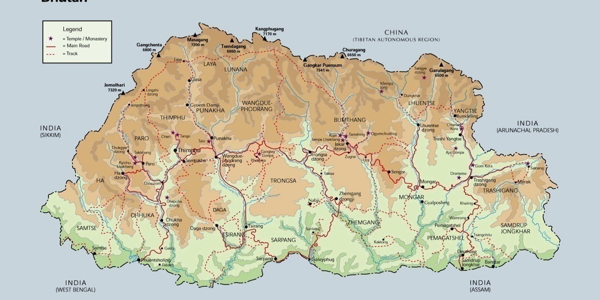
Transhumance & economic seasonal migrations Ha to Paro Ha- Sombeykha - Samtse Thimphu-Punakha Shar-Phobjika Bumthang Chume-Trongsa Bumthang Tang & Ura-Lhuntse (Kurtoe) Bumthang Ura- Mongar Bumthang Chume & Ura-Upper Kheng Sakteng-Chaling-Lauri Merak-Khaling Laya-Punakha Hongtso-Toebesa
All these migrations are both ways according to seasons

Slide 8
Alliances (Marital) migrations. Both ways especially among Choeje: Religious nobility (magpa, nama) From Trashiyangtse to Bumthang From Bumthang to Drametse From Lhuntse to Bumthang From Dungsam and Mongar Kheng to Lower Zhemgang

Slide 9
Religious seasonal migrations Bumthang-Lhuntshe (Kurtoe) Bumthang- Kheng (Zhemgang) Bumthang- Mongar (Sengor- Tsakaling- Tindangbi) Thimphu-Punakha

Slide 11
One clue on understanding the migrations is to follow the local deities which migrate with the people and look after their welfare.

Slide 12
Long term migrations: resettlements due to taxes, lack of water, of land, political causes, and now jobs opportunity
From Tibet to ”Lhomon”
From Dungsam and Mongar Kheng to Lower Zhemgang
Ngangla Trong – Pangbang ( Zhemgang district)
Easterners to Dagana
Easterners to Gelephu & Tsirang
Rural-Urban migrations
Just to mention Three examples extra-territorial cases
Ha & Paro to Pedong (Kalimpong) and Sikkim
Merak-Sakteng from Tshona, Tibet, to Eastern Bhutan (14th c.?)
Easterners to Pemakoe in Tibet (Meto county)

Slide 13
Some examples
Excerpt from Shejun FB 22 June 2014
In 1887 the people of Peljorling, Bongo, moved and settled to an upper valley because they were levied heavy tax and made to work like slaves by their lords during their visit to the hot spring in the village. When they could not bear the burden anymore, they demolished the hot spring and moved to the present village (Ketokha) so as to live peacefully and happily. It is also interesting to note that they initially named their new home as 'Kiptonga' meaning peaceful.

