Slide 1
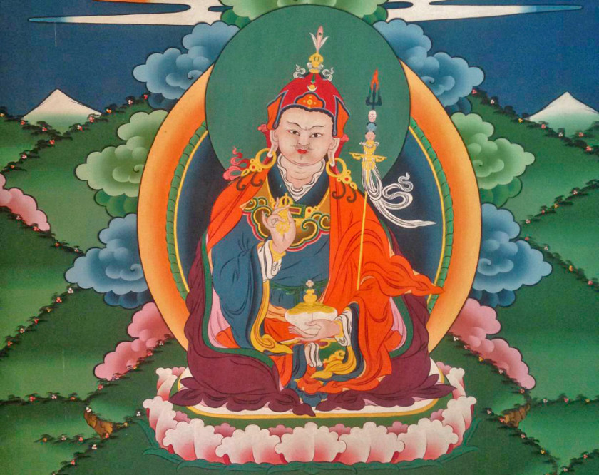
ISBS Inaugural Conference 2019
Sacred geography: Foot prints of Padmasambhava in Bhutan
Karma Gyeltshen
Nan Tien Institute of Higher Education
NSW, Australia

Slide 2
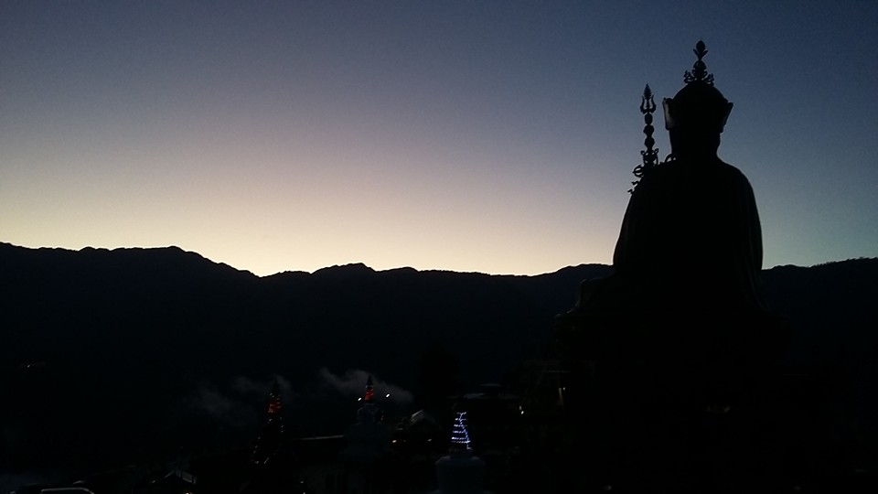
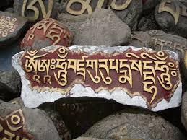
Introduction: Questions?
Story: Guru Rinpoche, my mother and me
Who is Padmasambhava?
Why is Bhutan’s geography sacred?
Notes:
*Guru himself concealed the treasures in presence of his 25 disciples and consigned it to the local deity. Later, Guru’s disciples Yeshe Tshogyal, Penchen Vimalamitra, Vairochana, Nubchen Sangay Yeshe, Namkhai Nyingpo, Nanam Dudjom and Nyangben Tingdzin Zangpo continued to conceal the remaining treasures after Guru left to Zangdokpelri.
At least 18 kinds of spiritual treasures were hidden in all five directions–east, west, north, south and within the central areas of the Himalayan region.
Treasures were concealed at the outskirts of the Tibetan border regions in locations such as Bhutan, Sikkim, Nepal, Lhadakh and Pema Koe.
Guru himself said: “All Himalayan regions were filled with treasures and blessed as the sacred sites for the future practitioners.”
The main scribes of Guru was Yeshe Tshogyal, assisted by Legjin Nyima, Denma Tsemang and Acharya Yeshe Yang who were excellent in writing Tibetan or dakini script.
Many scholars (Dalton 2004, p. 759; Kapstein 2000, pp. 155-160; Phuntsho 2013, p. 85) are of the view that the Padmasambhava legend began flourishing during post-imperial tenpa chidar wherein the adherents of the rNyingma school who called themselves gter ston revealed ter or gter ma (treasures) as in extracting spiritual texts and ritual objects, from cliffs, rocks, lakes, sky and mind, and claimed direct association with Padmasambhava. The gter ma texts were believed to be the words of Padmasambhava or that of his direct disciples and were usually constituted of mythological biographies of Guru himself and his treasure teachings. As such, some scholars who studied these biographies tend to regard the gter ma writings as “mythologized histories” (Hughes 2012, p. 10). Meaning ‘period of the later spread of the teachings’ in contrast to tenpa ngadar ‘period of the early spread of the teachings.’

Slide 3
Background & significance of Padmasambhava in Bhutan
The ultimate source of refuge, power, peace, happiness, health, wellbeing, enlightenment – peasant up to the king.
© HisMajestyKingJigmeGesarNamgyel Wangchuck/facebook
Notes:
Picture copyright © His Majesty King Jigme Singye Wangchuck (facebook)
Art and architecture – statues, murals, scrolls, temples and stupas etc.
Mantras, sadhanas and prayers (Sogyal 1992): Source of power, protection, peace, prosperity, health & wellbeing etc.
Bhutan’s legal system is Buddhist-influenced (Thrimzhung Chenmo)

Slide 4
Significance - what the scholars say?
“The Bhutanese world is imbued with Padmasambhava’s presence ─ the history, culture and nature are but a reflection of his actions.”
(Phuntsho 2015)
Padmasambhava bestowed spiritual, social, cultural, intellectual, political and legal legacies to Bhutan, which are still being followed today.”
(Tobgay 2016)
Notes:
He is drawing from the traditional accounts.

Slide 5
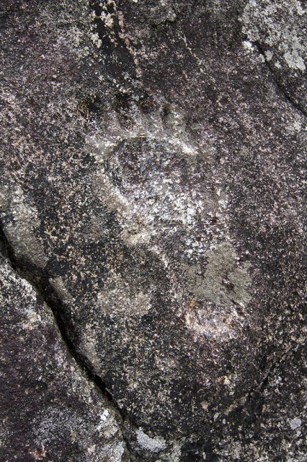
Tracing Padmasambhava’s journeys
“Guru Rinpoche…………….traces his journeys in Kashmir, Pakistan, Xinjiang, Tajikistan, Zhangzhung, Nepal, Bhutan and Tibet and many parts of India. The hagiography mentions Guru’s journey further afield into China, Mongolia, Lanka and Cannibal Lands, though I was unable to make out whether it was physical or metaphysical.”
(Ura 2016)
“Guru Padmasambhava travelled from Northwest India through Lahaul-Spiti, Himachal Pradesh, Ladakh, Tibet, Nepal, Sikkim, Bhutan, and Arunchal Pradesh and firmly established Buddhism in these lands.”
(Hollmann 2007)
Notes:
Guru who has been a strong aspect of cultural unity from the Hindu Kush to the Eastern Himalayas.
*The rock sculptures, in particular, of Swat depict a scenario fully compatible with the biography of Padmasambhava. In this
context, Padmasambhava appears as the epigone of a chain of unnamed masters in a consolidated tradition that preceded
him and found in him its first recorded exponent. Many others will follow after him as his disciples till the dawn of modern
times. Viewed in this light, legendary accretion is as historically significant as the identifiable historical core. (Olivieri 2016)

Slide 6
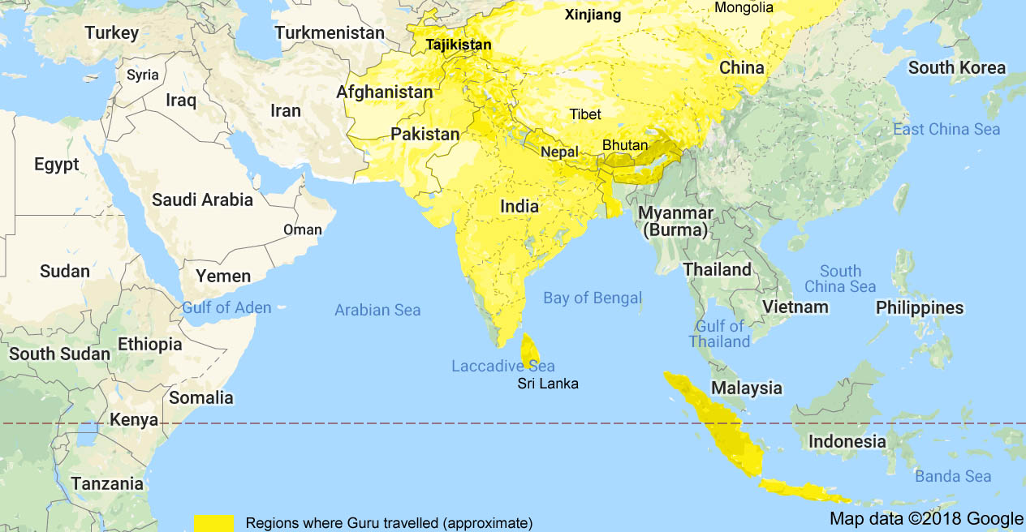
Tracing Padmasambhava’s journeys
Notes:
The identification of Oddiyāna is a subject of intense debates among historians. Following Tucci in 1940, D. C Sircar, Sylvain Levi, Bagchi and recently on the basis of translation of medieval inscription by Kuwayama Shoshin, Ronald Davidson have identified it in the Swat Valley in present day Pakistan.( Tucci, 1940; Sircar, 1948/71:12;Levi: ; Shosin 199: 267-87; Davidson 2002: 160 ). On the other, Harprasad Shastri, N. K Sahu, Karunakar Kar have argued for location of Uddiyana in Orissa on linguistic and geographical basis (Shastri; Sahu 1958). (in Mishara)
Guru Rinpoche’s mission of subduing unrighteousness and establishing the Buddhist doctrines took him, in addition to many places in India, Bhutan and Nepal, to several other countries, such as, Persia, China, Ceylon, Sikkim and Tibet.

Slide 7
Did Padmasambhava visit Bhutan?
“Guru Rinpoche travelled the length and breadth of the country and that Bhutan is indeed a sacred land practicing the teachings of the sacred Vajrayana tradition.”
(Dorji 2016)
“Close to the middle of the eighth century, Bhutan was blessed to receive repeated visits and stays of Guru Rinpoche……….. From Singye Dzong, Gomphu Kora, and Omkar Drag in the East; Nabji in Tongsa and Kurjey in Bumthang in the centre; Paro Takstsang in the West, Bhutan has been blessed by him with numerous holy sites where he meditated, and gave teachings to guide the people of that time as well as the future generations.”
(Dasho Tshering Tobgay 2016)

Slide 8
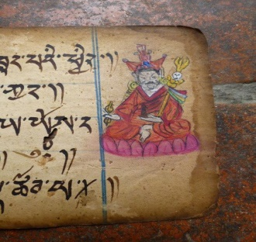
What the treasure texts say?
From the text Mind accomplishment that bears the seal of secrecy (thugs sgrub gsang ba rgya can) states:
“A place [in Bhutan] that I have not set my foot on,
Even the size of a horse-shoe or sesame is not there!”
From the Religious history of southern dragon (lho ‘brug chos ‘byung), Guru Rinpoche stated:
“Just by traveling there, one would find the path [to liberation],
My followers, who practice the dharma,
Flee to the southern gorges, the hidden sacred land!”

Slide 9
What the treasure texts say?
The lamp that illuminates all prophecies (lung bstan kun gsal sgron me) says:
“At the border between Mon and Tibet, there are four [greater] hidden lands, eight lesser hidden lands, and ten thousand sub-hidden lands, I, Padmasambhava, concealed them as they will be of use in future!”
Thinley (2016) states that the undeceiving and indestructible words of the scriptures thus confirm Bhutan as sbas yul.
Notes:
(Kuenzang Thinley 2016)

Slide 10
Padmasambhava’s visits to Bhutan
Three major visits to Monyul (Brown et al. 2007; Dorji 2016; Harding 2003; Tashi 2013; Tobgay 2016 & Ura 2010):
First visited Mon Bumthang from India/Nepal in 746/747 CE on the invitation of King Sindhu before he went to Tibet* (or back to India/Nepal)
Second visit from Tibet to Taktsang escorted by Denma Tsemang
The third and last visit was from Tibet to Khenpajong, accompanied by his Tibetan consort Yeshe Tshogyal, and the banished Tibetan prince Khikha Rathod.*
Notes:
*Even in Bhutan’s case, Guru first came, before he went to Tibet, as a peace-maker between the King of Bumthang and a neighbouring King of India.
*The story is said to be the main content of the terma text of Pema Lingpa “Guide to the hidden land of Khenpalung.”

Slide 11
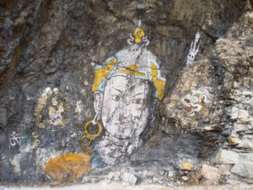
Padmasambhava’s time in Bhutan
According to the traditional sources (Kathang literature):
Guru spent 3 months in Singye Dzong
3 months in Mon Gom (or Gomkora)
3 or 4 months in Taktsang (Thinley 2016)
2 months in Chumophug*
And for more than a year in other places in Monyul
Some sources however tend to assert that Guru meditated in Paro Taktsang for 3 years, 3 months, 3 weeks, 3 days and 3 hours (Leviton 2014)
Notes:
(see Pema Lingpa’s Chos ‘gyung Mun sel sDron me smad chag: 277).
The omnisient Jigme Lingpa (1729–1798) noted that Guru stayed for three months in Singye Dzong and four months in Paro Taktsang (see Jigme Lingpa’s gTam tshog: 608).
Chronicles of Golden Rosary (bka’ thang gser phreng ma), Guru Rinpoche says, “Four months at Paro Taktshang.” Hence, Paro Taktshang is a very special sacred place where Guru Rinpoche spent four months, concealed many dharmas and wealth treasures, and granted his blessings.
Picture copyright: http://pelingtreasures.com/guru-rinpoche/

Slide 12
Padmasambhava’s routes into Bhutan
“An oral tradition of the Monpas of Tongsa maintains that Guru came up from India through Nabji, Kubrag, Phrumzur and Jangbi and reached Bumthang via Ngangdagla”
“In all likelihood, Guru travelled from Lhodrag to Khenpajong along the route connecting Lhodrag, Boedla, Gangla, Singye Dzong, Denchung, Khomakang, Khoma Pangkhar and Khenpajong.”
“When Guru entered Monyul, perhaps for the third recorded time, later through Singye Dzong, he came from Mangyul Gunthang and Lhodrag Karchu.”
(Ura 2010)
Notes:
*Even in Bhutan’s case, Guru first came, before he went to Tibet, as a peace-maker between the King of Bumthang and a neighbouring King of India.
*The story is said to be the main content of the terma text of Pema Lingpa “Guide to the hidden land of Khenpalung.”
Guru is said to have travelled via Nabji and Korphu village in Trongsa (Kheng) region.

Slide 13
Padmasambhava’s major roles in Bhutan
1. Healing and conversion
Guru healed King Sindhu of Mon Bumthang after subduing Shelging Karpo and converted both of them to Buddhism
2. Peace making and law enforcement
Mediated between 2 rival Kings, Sindha Gyab of Bumthang and the neighbouring Indian King Naoche, and installed the ‘Immortal Stone Pillar of Peace’ at a place known as Nathang (Place of Oath)
3. Construction, art and architecture
Built/renovated temples in Bumthang including Jampa Lhakhang* and a number of stūpas and images
4. Treasure concealment and prophecy
Concealed spiritual treasures and prophesied future treasure revealers
Notes:
According to some religious chronicles, it is said that he established his headquarter at Bumthang and oversaw construction of a new temple in Paro (Bisht 2008, p. 11; Worden1993, p. 255).*

Slide 14
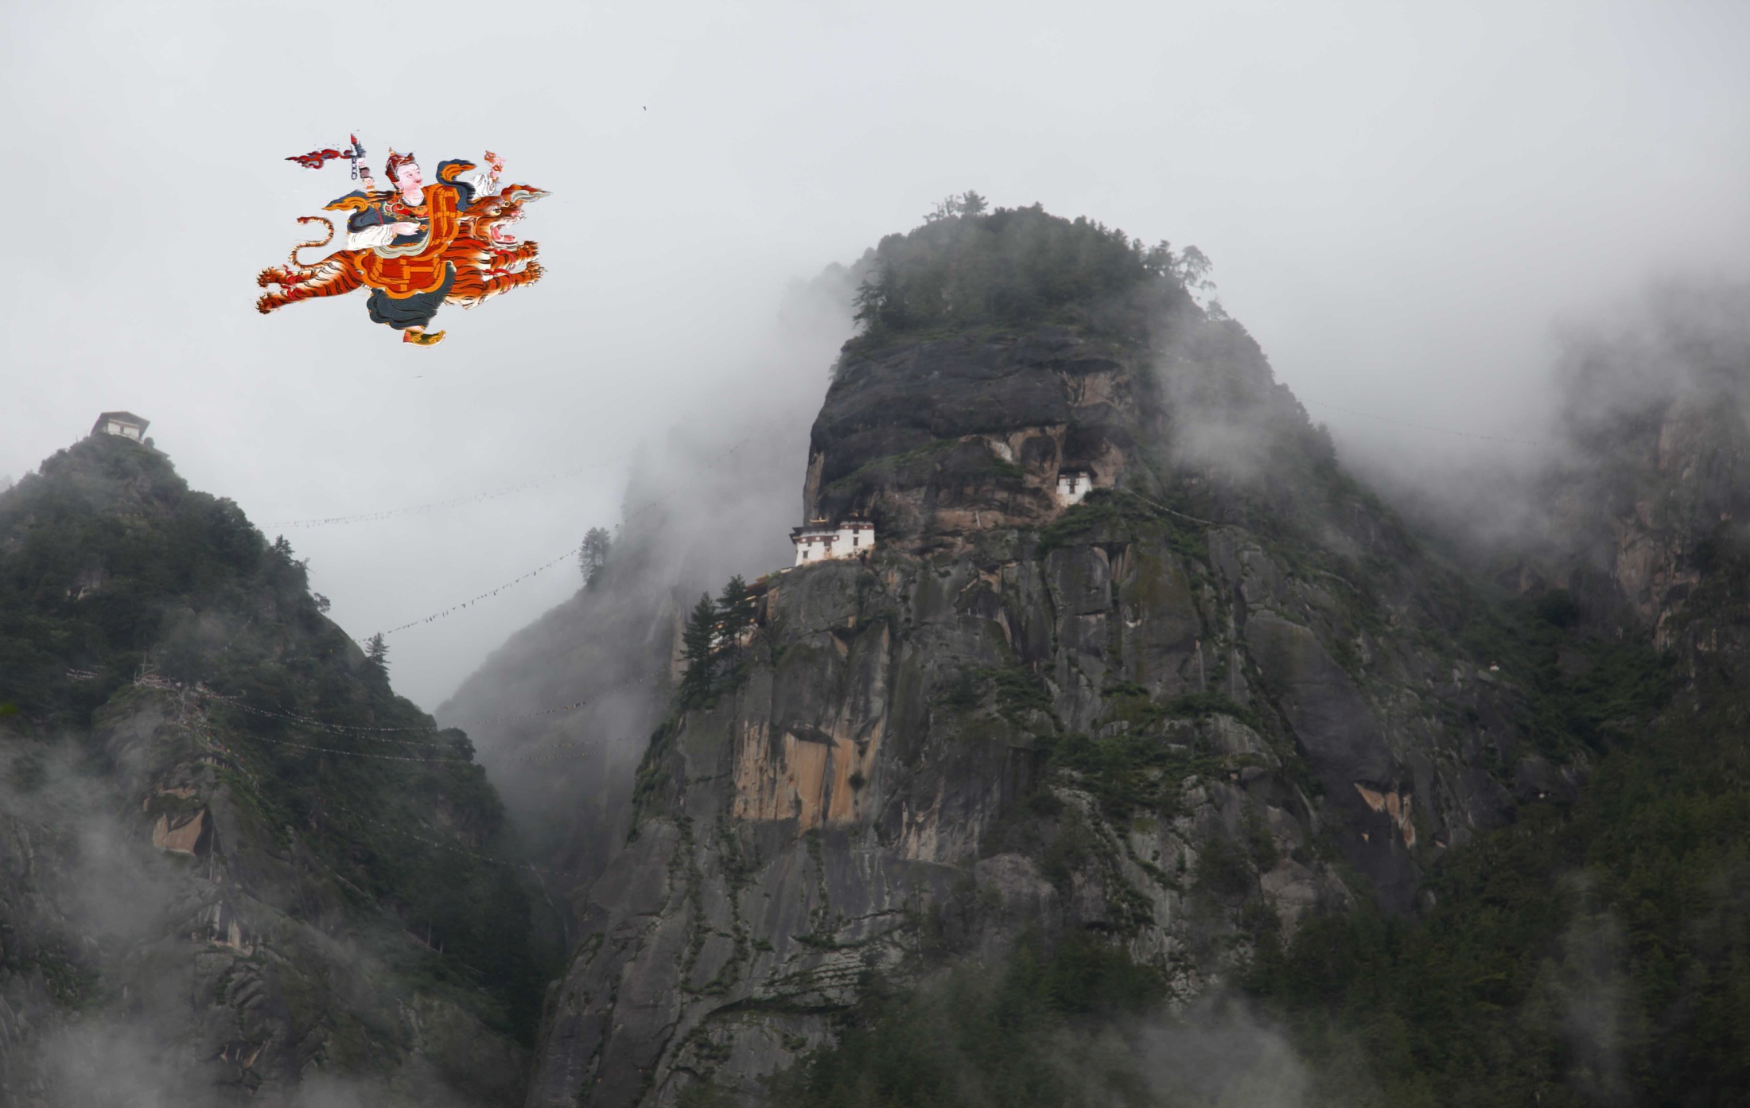
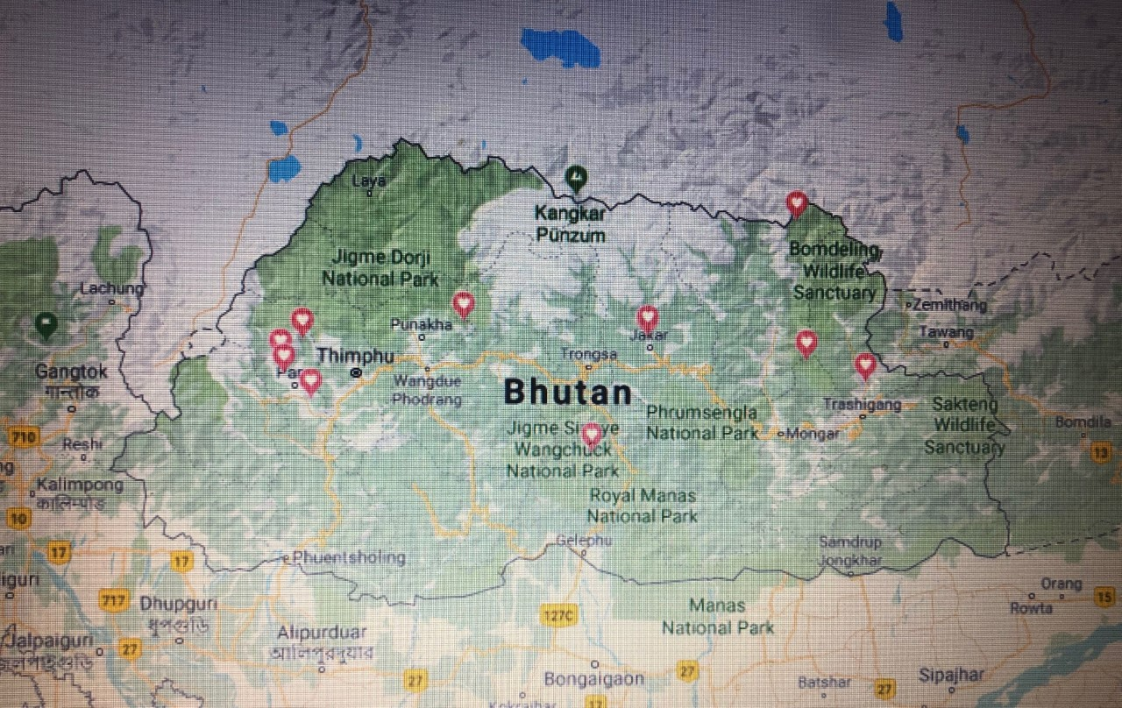
Padmasambhava’s sacred sites in Bhutan
Paro Taktsang – ‘tiger’s nest
Kurjey in Bumthang
Singye Dzong in Kurtoe
Gom Kora in Trashi Yangtse
Langdra Ney in Wangdue
Aja Ney in Mongar
Chumphug Ney in Paro
Ragoe Drak in Paro
Singye Drak in Paro
Ugyen Drak in Paro
Drak Karpo in Paro
Tumdrak Tshangtshig Ney
Tadroi Ney (Wangdi 2008)
https://www.google.com/maps/place/Nabji+Lhakhang/@27.4529736,90.5082767,8z/data=!4m5!3m4!1s0x375f2ca3f073a675:0xb8cf9045c99ed84a!8m2!3d27.1908445!4d90.5204407

Slide 15
Other places Padmasambhava visited
In Bumthang, Guru Rinpoche meditated at Remochen and Thowadra, visited and blessed Kunzangdra, Zhabjethang, Choejedra, Mebartsho and other places.
In eastern Bhutan, he visited 10 places in Trashi Yangtse, Mongar and Lhuntse including Aja Ney and Gom Kora.*
After meditating at Taktsang for three months he visited Drag Karpo, Namthog Karpo, Chumophu and Tshalungdra in Paro, and later to Haa and Gasa.
Visited 21 sacred places in Thimphu (Tandrin Ney), Punakha (Goen Tshephu) in and Wangdue (Baylangdra), after which he proceeded south via Dagana visiting Thanamkha Dzong and Beyul Gomdrak.
Notes:
Guru meditated at Gomkora and subdued the local deity, and left body impressions on a rock.
Aja Ney valleys in Mongar-Lhuntse region is believed to be the secret entrances to Guru’s paradise.

Slide 16
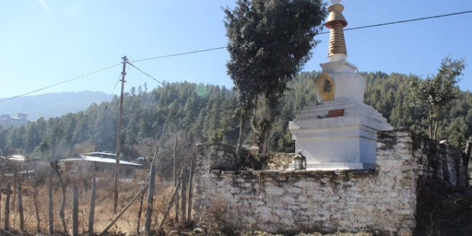
Padmasambhava’s teachings in Bhutan
Choekhor was named following the sermon given by Guru Rinpoche to the public of Bumthang.
Guru gave heart-essence (snying gyi thigs) teachings of ‘dzogpa chenpo selwai melong’ to the entourage of King Sindhu and Kyikha Rathoed in Kurjay.
Guru gave thirteen teachings on Vajrakila at Singye Dzong to Yeshey Tshogyal, Namkhai Nyingpo, Gyalwa Chogyang, Nanam Dorji Dudjom, and Ladrong Konchog Jungney.*
Gave empowerment of Eight Great Herukas (sgrub pa bka brgyad) at Nathang to the entourage of King Sindhu and Naoche.
Most likely Guru also gave teaching on Mo rgyud kuntu bzang mo klong gsel’ bar ba nyima’ gsang rgyud to Yeshe Tshogyal at Taktsang.*
Notes:
*(bdag mkha’ chen bzas/ rdo rje phur pai skor la yang zab snying poi chos skor cu gsum zhus).
*(Nyangrel’s Phurba Yangsang Lamed (p. 2).
* In Mo rgyud kuntu bzang mo klong gsel’ bar ba nyima’ gsang rgyud Terton Sherab Membar reveals that this female tantra text was recorded by Yeshey Tshogyal during its teaching by Guru at Taktsang.

Slide 17
Bhutanese disciples of Padmasambhava
King Sindhu of Mon Bumthang was converted to Buddhism
Bumdhen Tshomo acted as the tantric consort of Guru at Bumthang Kurjey
Haminatha (c. 750), ‘the meditator from Mon’, was a personal disciple of Padmasambhava who accompanied Guru to Tibet.
Monmo Tashi Chidren was the Bhutanese disciple of Guru Rinpoche who also accompanied Guru to Tibet and played the role of supporting consort (gzungs ma) in the cycle of Vajrakila with Guru in Onphu Taktshang
King Marapai (long beard in Monpakha) of Trongsa is said to have hosted Guru while enroute to Bumthang
Notes:
Tashi Chidron played the role of supporting consort (gzungs ma) in the cycle of Vajrakila with Guru in Onphu Taktshang (See mKha’ ‘dro Yeshey Tsho rgyal gyi rNamthar KMT 2005: 120-122). Ura 2010).
Certain Tibetan terton Molmokhyil (1087-1146) was believed to be the reincarnation of the ‘the meditator from Mon’, and he discovered rGyalpo srog-gi ‘khorlo, which was said to be first bestowed by Guru on King Thri Song Deu tsen who in turn entrusted it to Haminatha.

Slide 18
Coming of tertons – fulfilling the prophecies
According to the prophesies of Padmasambhava in Kathang Deup many tertons came and discovered ters:
Sangay Lama (10th century) was the first terton, follwed by Nyangrel Nyima Odzer (1124-1192) & Chöwang (1212-1270)
Ugyen Lingpa (1323-1360?), Dorje Lingpa (1346-1405), Ratna Lingpa (1403-1478), Pema Lingpa (1450- 1521), Terdag Lingpa (1646-1714), Zhigpo Lingpa (1524-1583), Karma Lingpa (14th century), Samten Lingpa (14th century) and so on.
Longchen Rabjam (1308-1363), Thangthong Gyalpo (1385-1509), Kunkhyen Pema Karpo (1527-1592), Fifth Dalai Lama (1617-1682), Jamyang Khyentse Wangpo* (1820-1892), Dudjom Jigdrel Yeshey Dorji (1903-1987), Dilgo Khyentse Rinpoche (1910-1991) and Khenpo Jigme Phuntsho (1933-2004).
Notes:
(see Pema Lingpa’s Chos ‘gyung Mun sel sDron me smad chag: 277).
Alias Pema Odsal Dhongak Lingpa

Slide 19
Ter discovery by tertons in Bhutan
Terton Sherab Meber (1267-1326) retrieved ters from Mebartso in Bumthang and Nuptshonapatra in Haa
Dorji Lingpa (1346-1405) retrieved a zab ter sethurma from Taktsang and many ters from Bhumthang and Langdraney
Thangtong Gyalpo (1385-1464) retrieved a yellow paper scroll from Taktsang
Terton Ratna Lingpa (1403-1478) revealed a text titled ‘glong gsal snying tig’ from Singye Dzong
Pema Lingpa (1450-1521) retrieved many ters from Bumthang
Dudjom Jigrel Yeshey Dorji (1904-1987) revealed Phurpa Pudri Regphung (Samuel G 2008 in Ura 2010)
Terton Zilnon Namkha Dorji (1874-?) revealed the corpus of ‘chimed srog thig’ in 1908 (Cantwell Cathy et al. 2009)
Notes:
(see Pema Lingpa’s Chos ‘gyung Mun sel sDron me smad chag: 277).
The omnisient Jigme Lingpa (1729–1798) noted that Guru stayed for three months in Singye Dzong and four months in Paro Taktsang (see Jigme Lingpa’s gTam tshog: 608).
Chronicles of Golden Rosary (bka’ thang gser phreng ma), Guru Rinpoche says, “Four months at Paro Taktshang.” Hence, Paro Taktshang is a very special sacred place where Guru Rinpoche spent four months, concealed many dharmas and wealth treasures, and granted his blessings.

Slide 20
Conclusions: thus the sacred geography
Padmasambhava physically visited, blessed, concealed treasures and left physical imprints
He tamed the local deities and mandated them to guard the treasure teachings
He built and/or renovated temples and stupas
He meditated himself and taught his root disciples who also attained enlightenment in these places
Many tertons came and discovered ters as prophesied by him
Numerous other Buddhist masters from all traditions have visited and practiced in these sites for centuries
Bhutan is dotted with numerous sacred sites of Guru, Guru temples, Guru Thongdroel and Guru statues etc.
His footprints are still intact and his teachings echo throughout the last Vajrayana kingdom of Bhutan

Slide 21
Tashi Delek – Thank you
“For anyone, man or woman, who has faith in me, I, the lotus born, has never departed – I sleep on their threshold.”
- Padmasambhava
© Wikimedia Commons
Notes:
Padmasambhava (Skt. Padmākara Tib. Pemajungné) means ‘Lotus-born’, which refers to Guru Rinpoche's birth from a lotus in the land of Oddiyana. Guru Rinpoche, the ‘Precious Master’, is the founder of Tibetan Buddhism and the Buddha of our time. Whereas Buddha is known primarily for having taught the teachings of the sutra vehicle, Padmasambhava came into this world, and to Tibet in particular, in order to teach the tantras. While Buddha Shakyamuni exemplifies the buddha principle, the most important element in the sutrayana path, Padmasambhava personifies the guru principle, the heart of Vajrayana Buddhism, and he is therefore known as the ‘second Buddha’.
http://www.rigpawiki.org/index.php?title=Padmasambhava

