Slide 1
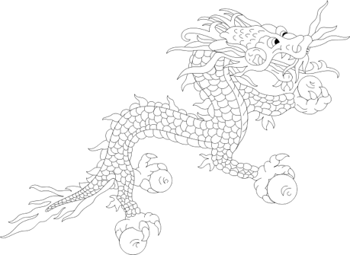
Education in Bhutan
Culture, Schooling, and Gross National Happiness
Dr Matthew Schuelka
University of Birmingham

Slide 2
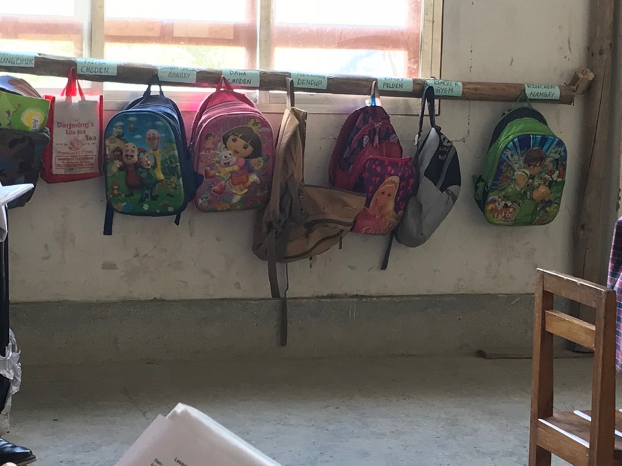
"…youth tend everywhere to occupy the innovative, unchartered borderlands along which the global meets the local"
(Comaroff & Comaroff, 2001)
Notes:
As Comaroff and Comaroff remind us, “youth tend everywhere to occupy the innovative, uncharted borderlands along which the global meets the local.” Similarly, sociologist Paul Willis suggests that “youth are the foot soldiers of modernity.” In my presentation today, I will be presenting my research on one particular aspect of culture and society that is being shaped and negotiated in school : disability.

Slide 3
The story of Bhutanese education in two charts
(Left) Number of schools, all types
(Up) Number of pupils, all types
Source: Ministry of Education, 2017

Slide 4
Borrowing and Learning
Originally, Hindi curriculum (incl. teachers, books, etc.) was used, with help from Canadian Jesuits from Darjeeling, and others
In the 1980s, a ‘Bhutanization’ period began
Today, the Bhutanese curriculum is mostly in English, with some Dzongkha used
Royal University of Bhutan was created in 2003, breaking away from their reliance on the University of Delhi
In the past 10 years, initiatives such as Early Childhood Education and Inclusive Education have taken hold

Slide 5
Successes
Bhutan was one of the earliest countries to meet its EFA gross enrollment targets
Unlike its South Asian neighbors, Bhutan has always had gender parity in schools
Everyone has the right to basic education (Class 10), according to the Bhutanese constitution
Increased participation from marginalized populations

Slide 6
Challenges
The push for greater school enrollment has not led to comparable resource development
Conservative approaches to pedagogy and curriculum
  Teacher-centered
  High-stakes examinations and assessments
  Heavy reliance on poor quality textbooks
Increasing inequality
Increasing disconnect between schooling and post-school outcomes
Disconnect between the modern role of schooling and the traditional role of schooling

Slide 7
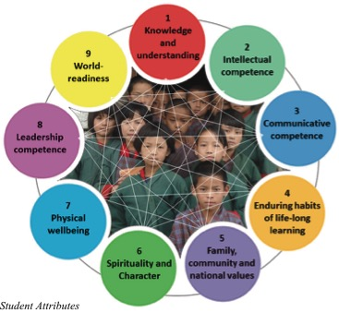
What the policy says…

Slide 8
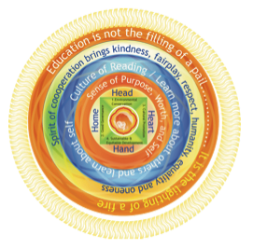
Gross National Happiness Education Mandala

Slide 9
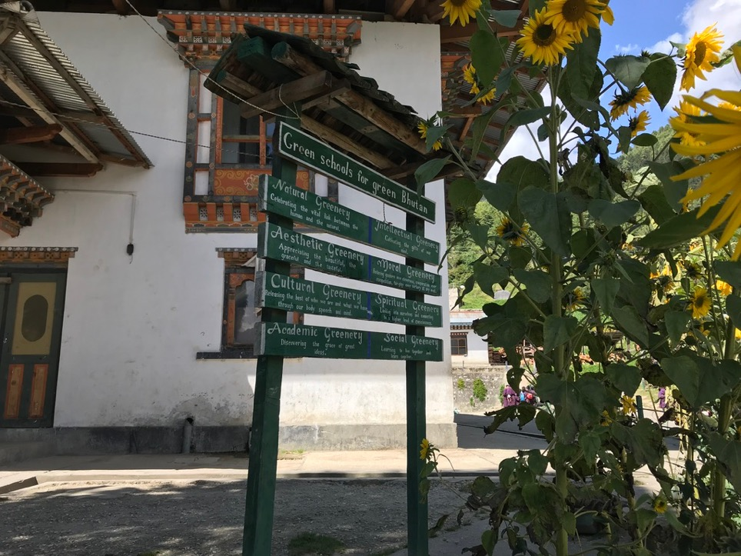

Slide 10
Case Study: The Role of Schools and Teachers in Bhutanese Society
Various promising initiatives around Education for Gross National Happiness
Teachers did not view their role as a role-model or mentor to students, rather as a ‘deliverer of learning content’
When asked about introducing more ‘Bhutanese values’ and other non-cognitive skills into their teaching and curriculum, teachers supported the idea, but only in formal arrangements
(British Academy #PM160061)

Slide 11
Early Take-Aways from the Toyota Foundation Project...
Educational Values for a Sustainable Society: Head, Hands, Heart and Happiness in Bhutan and Beyond
(D17-R-0362)

Slide 12
Access / Inputs
The ‘Resource Trap’ : “If we had more, we could do more with these children”
Teachers are not taught to teach all students
Curriculum: “How can we teach 21st century pedagogy with 20th century curriculum?” (Teacher)

Slide 13
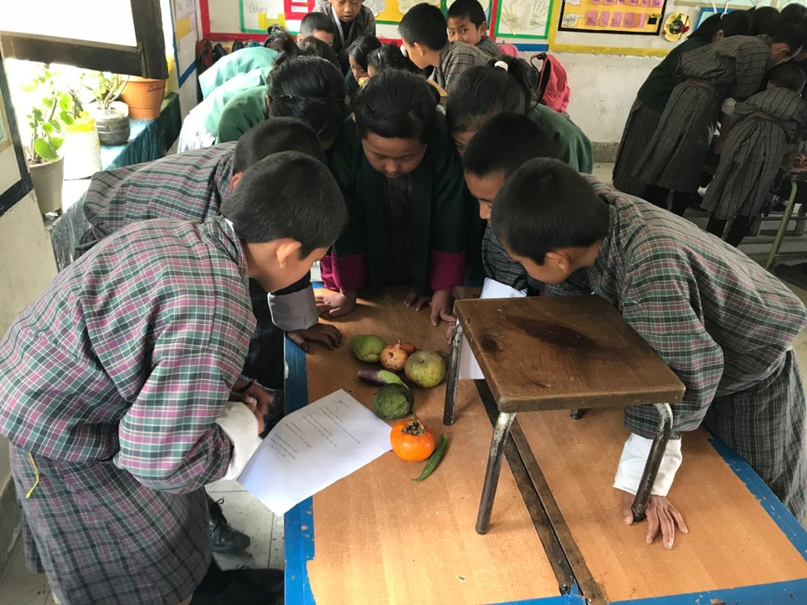

Slide 14
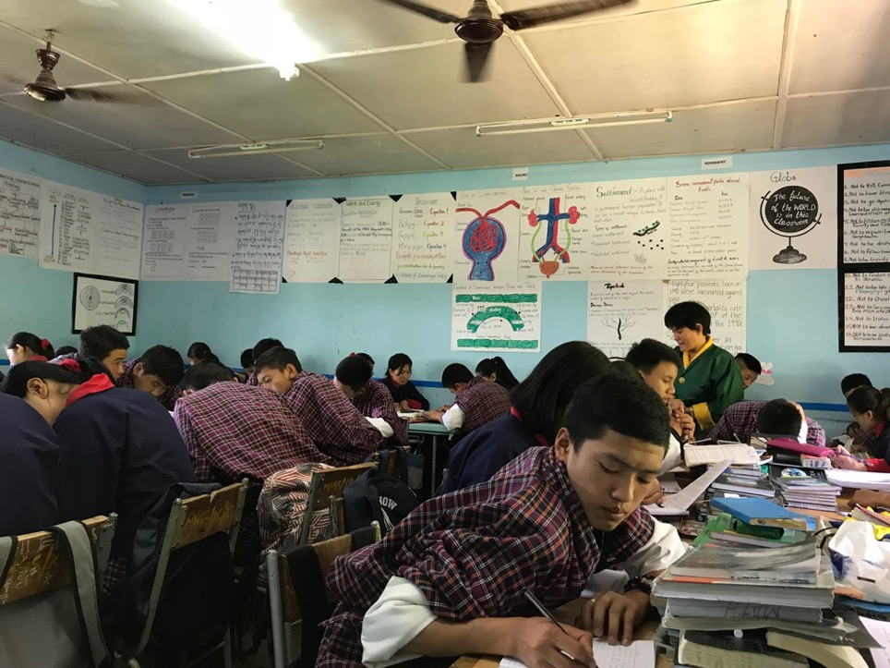

Slide 15
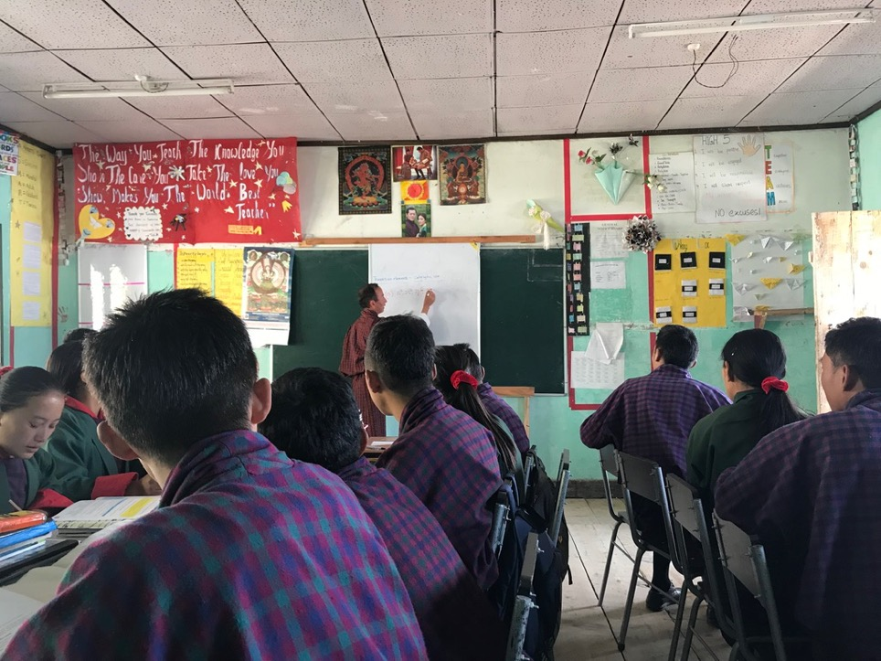

Slide 16
Process / Quality
Highly competitive school culture
Students are viewed as either ‘clever’ or ’lazy’
Little to no room for student diversity of learning (or otherwise)

Slide 17
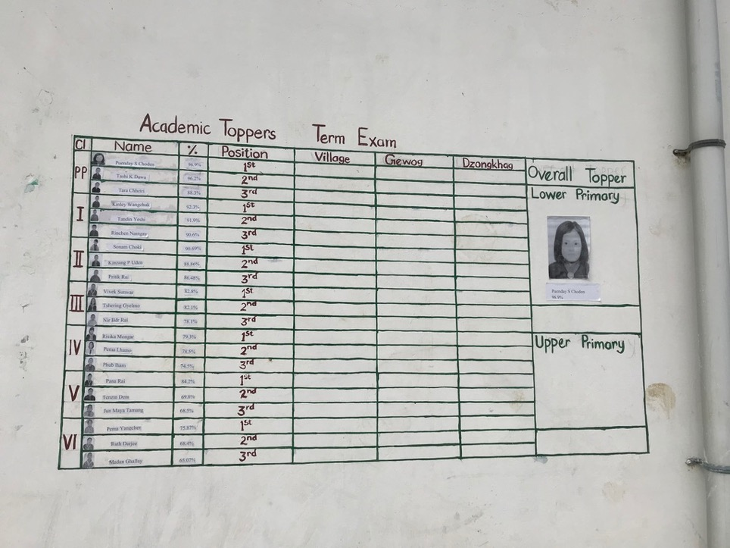

Slide 18
Focus Group Excerpt
  Me: Are you ever afraid in the classroom?
  Students: Yes Sir.
  Me: Is that helpful or is it better if you weren’t afraid of the teachers?
  Students: Helpful
  Me: Helpful?
  Students: Yes Sir.
  Student 3: If teachers are not strict, the students are talking when teachers are trying to teach the other students, are making lots of noise, disturbing by throwing papers. If the teachers are strict, they will concentrate on studies.
  Me: What happens when you answer a question wrong?
  Student 4: You feel nervous.
  Student 5: It is better not to make a mistake than to try.

Slide 19
Utility / Outputs
At the upper end, school provides academic skills but little else: ”our students are taught to take exams, but they don’t learn anything” (Teacher)
Anemic technical and vocational education system
Little opportunity for youth with disabilities particularly
High unemployment rates for youth

Slide 20
Recommendations for future growth
Improve the quality of teachers
Expand inclusive provision that also supports structural changes in curriculum and pedagogy
Continue to increase quality of, and access to, rural schools
Fully embrace Gross National Happiness and its call for an alternative to ‘traditional’ schooling – this means a NEW ‘Bhutanization’ of education
Build the role and integration of tertiary education
(Schuelka & Maxwell, 2016)

Slide 21
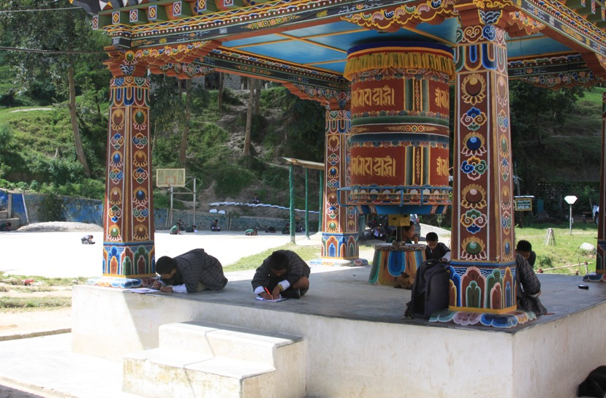
“But what we have to do is being an educated person, we have to convey the message to our own parents. We have to convey them and we have to help them. We are not supposed to go and fight with them. We have to take our culture with us because our culture is identity of our country. And it’s in our hands to save it. And we have to go with the modern technologies because we have to compete with the other modern world. So it’s all in our hand…it’s somewhat like understanding and belief that we need to create and we must give a very strong support to our own creation.”
(Student, Age 9)

Slide 22
Outline of Research Engagement with Bhutan that Informs this Presentation
Work in Bhutan
Publications
Head of Department, Social and Political Science Department, Royal Thimphu College, 2012–2013
Constructing disability in Bhutan: Schools, structures, policies, and global discourses, PhD Thesis, University of Minnesota, 2012–2013
Primary Investigator, Exploring the full potential of education: Non-cognitive skills, inclusivity, and happiness in Bhutan and England. British Academy (#PM160061). Joint project with Royal University of Bhutan, 2016–2017
Primary Investigator, Educational Values for a Sustainable Society: Head, Hands, Heart and Happiness in Bhutan and Beyond. Toyota Foundation. Joint project with Nagoya University and Royal University of Bhutan, 2018–2020
Primary Investigator, Enhancing Mental Health, Counselling, and Wellbeing Support for University Students in Bhutan. Erasmus+ Capacity Building in the Field of Higher Education. Joint project with Royal University of Bhutan, Vrije Universiteit Brussel (Belgium), and Maiêutica Cooperativa de Ensino Superior (Portugal), 2019–2021
Primary Investigator, Understanding, Developing, and Supporting Meaningful Work for Youth with Disabilities in Bhutan: Networks, Communities, and Transitions. Economic and Social Research Council (Global Challenge Research Fund). Joint project with Royal University of Bhutan and University of Minnesota, 2019–2021
Schuelka, M.J., Kezang Sherab & Tsering Y. Nidup (2018). Gross National Happiness, British Values, and non-cognitive skills: Teachers and curriculum in Bhutan and England. Educational Review. DOI: 10.1080/00131911.2018.1474175
Schuelka, M.J. (2018). The cultural production of the ‘disabled’ person: Constructing student difference in Bhutanese schools. Anthropology and Education Quarterly, 49(2), 183–200.
Schuelka, M.J. (2018). Advancing a comparative case study approach towards education and disability research: An example from Bhutan. In N. Singal, P. Lynch, and S. Johansson (Eds.), Education and disability in the global south: New perspectives from Asia and Africa. London: Bloomsbury.
Schuelka, M.J. (2017). Learning at the top of the world: Education policy construction
and meaning in Bhutan. In T.D. Jules & P. Ressler (Eds.), Re-reading educational policy and practice in small and micro states (pp. 217–236). Bern: Peter Lang.
Maxwell, T.W. & Schuelka, M.J. (2016). Conclusion: Key outcomes, challenges, ways forward, and future research. In M.J. Schuelka & T.W. Maxwell (Eds.), Education in Bhutan: Culture, schooling, and Gross National Happiness (pp. 229–239). Singapore: Springer.
Rinchen Dorji & Schuelka, M.J. (2016). Children with disabilities in Bhutan: Transitioning from special educational needs to inclusive education. In M.J. Schuelka & T.W. Maxwell (Eds.), Education in Bhutan: Culture, schooling, and Gross National Happiness (pp. 181–198). Singapore: Springer.
Schuelka, M.J. & Maxwell, T.W. (2016). Education in Bhutan: Introduction. In M.J. Schuelka & T.W. Maxwell (Eds.), Education in Bhutan: Culture, schooling, and Gross National Happiness (pp. 1–18). Singapore: Springer.
Schuelka, M.J. (2015). The evolving construction and conceptualisation of disability in Bhutan. Disability & Society, 30(6), 820–833.
Schuelka, M.J. (2013). Education for youth with disabilities in Bhutan: Past, present, and future. Bhutan Journal of Research and Development, 2(1), 65–74.
Schuelka, M.J. (2013). Constructing a modern disability identity: Dilemmas of inclusive schooling in Zambia. In A. Azzopardi (Ed.), Youth: Responding to lives (pp. 137–152). In Studies in Inclusive Education (Vol. 25). Rotterdam, Netherlands: Sense Publishers.
Schuelka, M.J. (2013). Inclusive education in Bhutan: A small state with alternative priorities. Current Issues in Comparative Education, 15(1), 145–156.

Slide 24
Thank you and Tashi Delek!
Dr Matthew Schuelka
University of Birmingham
m.schuelka@bham.ac.uk
Photo: Clint Chapman

