Slide 1
Dispute Settlement in a Changing Society
Michaela Windischgrätz University of Vienna

Slide 2
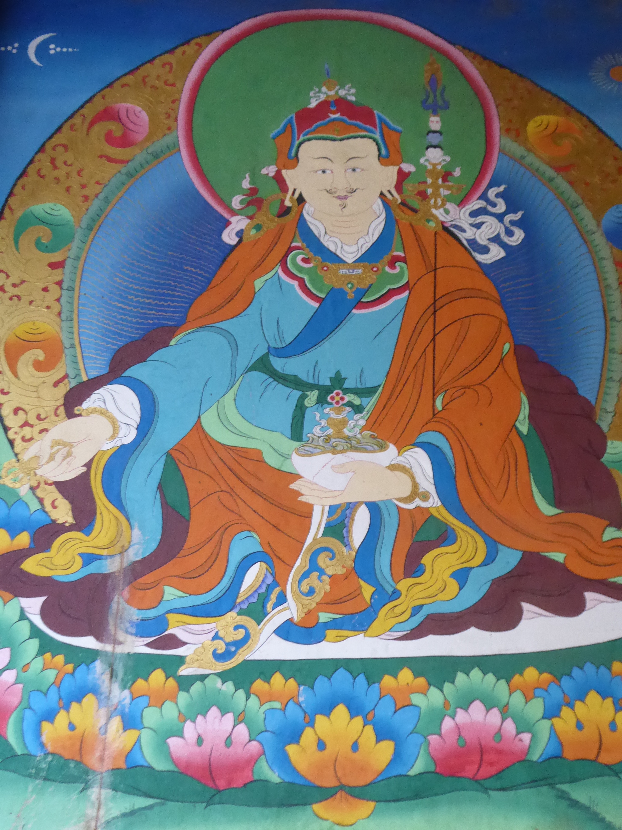
A stable Narrative
Guru Rimpoche
Nangkha Nangdrik
Dispute between Sindhu Raja and King Nawoche

Slide 3
Traditional View
Social agreement for keeping conflicts within the village
“Better to lose in the village than to win in the court”
Win-win situation
Middle path
Saving time and money
Saving faces, raising heads

Slide 4
Testimonials of Change
“Disputes were settled mutually in the village. We did not have an alternative then. Disputing parties always listened to the elders, so there were no complications. They were all simple folks back then. But today, there are a lot of people with money, knowledge, qualification and ideas. So it has changed.”
“Later, when people became bold, they started reporting the disputes to the Dzongda and Thrimpons”.

Slide 5
Dispute Settlement according to Subject Matters
No. | Matters/Issues | Mediation | Litigation | Total
1 | Footpaths and access roads | 830 | 110 | 940
2 | Drinking water and irrigation | 820 | 64 | 884
3 | Irrigation channels and walls | 404 | 37 | 441
4 | Crops damaged by livestock | 1039 | 44 | 1083
5 | General land issues | 223 | 73 | 296
6 | Land bounderies incl. fruit trees | 1495 | 19 | 1514
7 | Inheritance | 1808 | 4496 | 6304
8 | Monetary | 2056 | 9735 | 11791
9 | Matrimonial | 3048 | 2464 | 5512
10 | Miscellaneous | 3593 | 3892 | 7485
 | Total | 15316 | 20934 | 36250
Source: BNLI, Mediation Training Impact Assessment Report (2016)

Slide 6
Dispute Settlement according to Region
No. | Dzongkhag | Mediations | Litigations | Total
1 | Bumthang | 378 | 362 | 740
2 | Gasa | 208 | 81 | 289
3 | Haa | 509 | 380 | 889
4 | Lhuntse | 296 | 1124 | 1420
5 | Mongar | 2997 | 1241 | 4238
6 | Paro | 665 | 2958 | 3623
7 | Pema Gatshel | 313 | 1575 | 1888
8 | Punakha | 351 | 960 | 1311
9 | Thimphu | 160 | 3762 | 3922
10 | Trongsa | 786 | 392 | 1178
11 | Zhemgang | 316 | 603 | 919
Source: BNLI, Mediation Training Impact Assessment Report (2016)

Slide 7
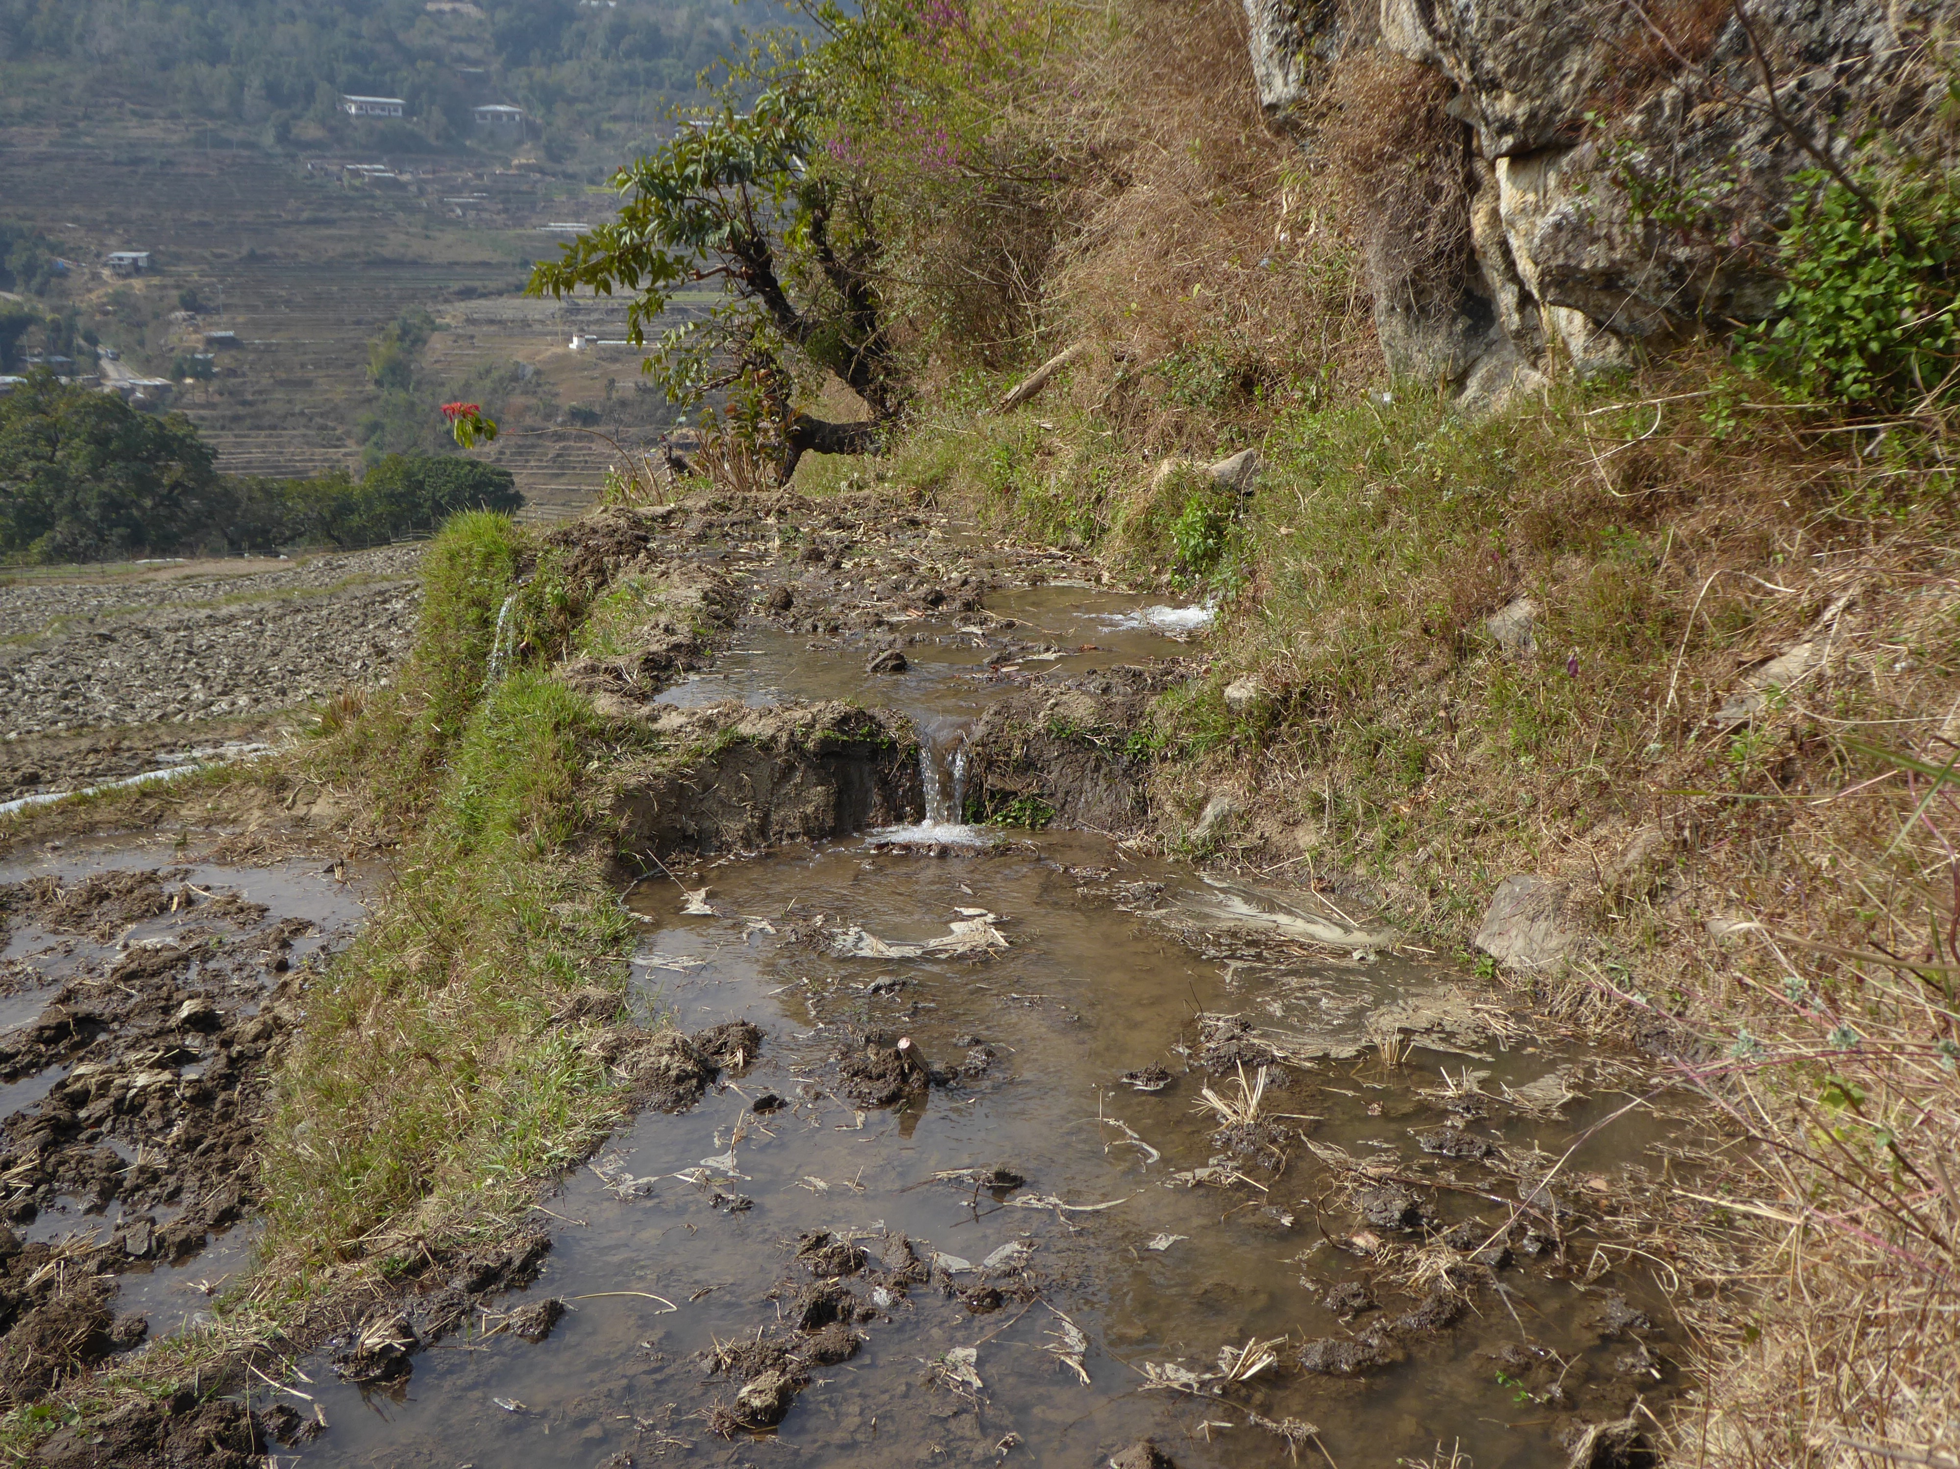
Today´s Choices
Money
Education
Mobility
Roads
Rural-urban migration
Applicable law
Trust

Slide 8
Political Endeavour
“Build up, revive and institutionalize the practice of mediation in Bhutan”
Reasons
Preserve cultural heritage
Community vitality (GNH 9)
Access to justice
Lessen the case loads of the courts

Slide 9
Thank you for your attention!

