Slide 1
ISBS : Identity & Purposes Suggestions from Indo-Tibetan Buddhology
ISBS (10/01/2019 @The University of Oxford
Seiji Kumagai
Divisional Director/Uehiro Associate Professor
Kokoro Research Center, Kyoto University (JAPAN)

Slide 2
Bhutan is a representative Buddhist Vajrayana kingdom in the Himalaya
CHINA
INDIA
NEPAL
Buddhism has influenced Bhutanese culture and society, including GNH
(Gross National Happiness).

Slide 3
Is Buddhism only a religion?
Buddhism
Religious aspect of Buddhism
Science
Physics, Physiology
Faith
Buddha, Saints, Gods
Philosophy
Ontology, Epistemology, Logic
Ethics, Practice
Discipline, moral, meditation
Non-religious aspects of Buddhism.
(Applicable to
secular society)

Slide 4
Suggestion 1
How about applying Buddhist non-religious methodology to Bhutanology via ISBS?
Integration of Wisdom and Compassion:
1. Wisdom ཤེས་རབ་
(*high standard of academic research; journal)
2. Compassion སྙིང་རྗེ་/གཞན་དོན་
(*Contribution to society & all sentient beings)

Slide 5
Suggestion 2
How about involving natural scientists?
(in order to foster interdisciplinarity)

Slide 6
Toward Multidisciplinary Bhutanese Studies

Slide 7
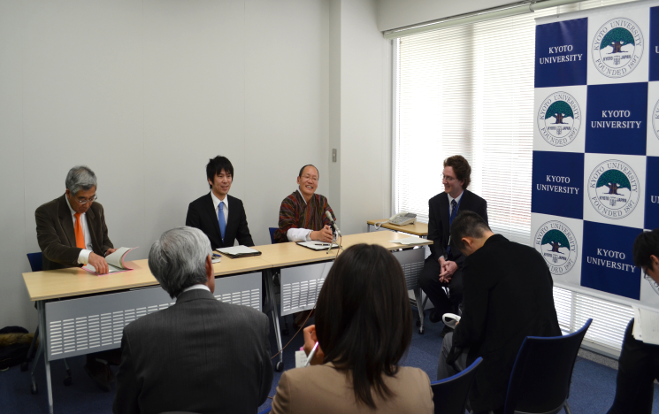
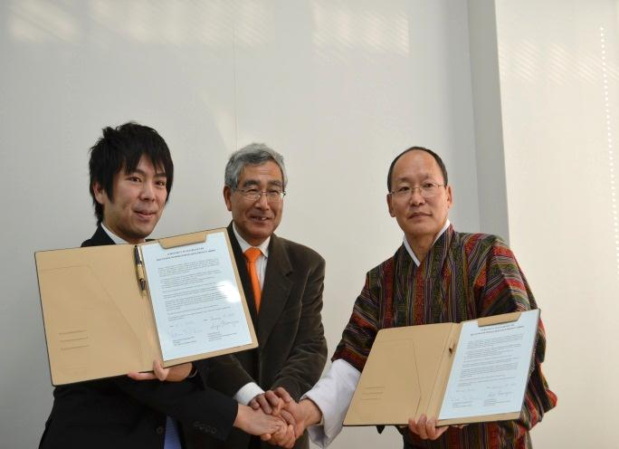
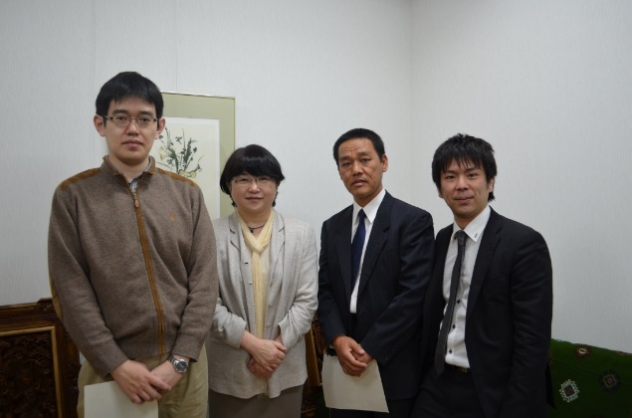
Toward Multidisciplinary Bhutan Studies
Bhutanese Buddhism
2012 Launch of the “Bhutanese Buddhism Research Project” (BBRP) in Kyoto.
Press Conference (@Kyoto University)
MoU with CBS
Establishment of the Department of Bhutanese Studies

Slide 8
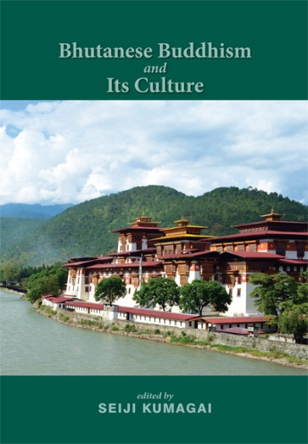
Toward Multidisciplinary Bhutan Studies
Bhutanese Buddhism
2012 Launch of the “Bhutanese Buddhism Research Project” (BBRP) in Kyoto.
2013 Academic panel in IATS (in Ulaanbaatar) : Bhutanese Buddhism and Its Culture
2014 Book: Bhutanese Buddhism and Its Culture (Kathmandu: Vajra Publications).
Bhutanese Buddhism and its Culture

Slide 9
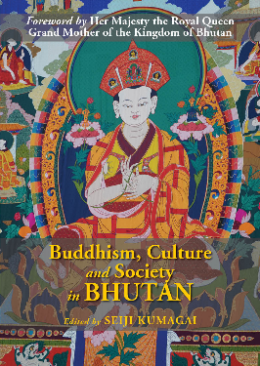
Toward Multidisciplinary Bhutan Studies
Bhutanese Buddhism
2012 Launch of the “Bhutanese Buddhism Research Project” (BBRP) in Kyoto.
2013 Academic panel in IATS (in Ulaanbaatar): Bhutanese Buddhism and Its Culture
2014 Book: Bhutanese Buddhism and Its Culture (Kathmandu: Vajra Publications).
2016 Academic panel in IATS (in Bergen):
Buddhism, Culture, and Society in Bhutan
2018 Book: Buddhism, Culture, and Society in Bhutan (Kathmandu: Vajra Publications).
Bhutanese Buddhism and its Culture
Culture,
Society,
Religion
in Bhutan

Slide 10
Various disciplines in the 2013 Academic Panel
-Religion
-History/ Biography
-Religious Anthropology
-Education
Human Science
Lack of Social and Natural Sciences

Slide 11
Various disciplines in the 2016 Academic Panel
-Religion
-History
-Bibliography
-Education
-Anthropology
-Media Studies
-Developmental Studies
Human Science
Social Science
Lack of
Natural Science

Slide 12
Ideal Image of ISBS
Natural Science
-Geology
-Medical Science
-Agriculture
Etc.
Human Science
-History
-Anthropology
-Philosophy
Etc.
Social Science
-Sociology
-Developmental Studies
-Education
Etc.
Interdisciplinary Bhutanese Studies

Slide 13
Related International Associations
INDIA
-IASS (International Association of Sanskrit Studies): limited to Sanskrit language.
TIBET
-IATS (International Association for Tibetan Studies): limited to human & social science.
*IABS (International Association of Buddhist Studies; International Association for Bon Studies)

Slide 14
I hope
(1) the current (and future) members
will participate in the ISBS
with intelligence and constructively,
(2) contributing to the happiness of society and all sentient beings.

Slide 15
Thank you for your kind attention!

