Slide 1
The Careful Science of Astrology
Tashi Namgyel

Slide 2
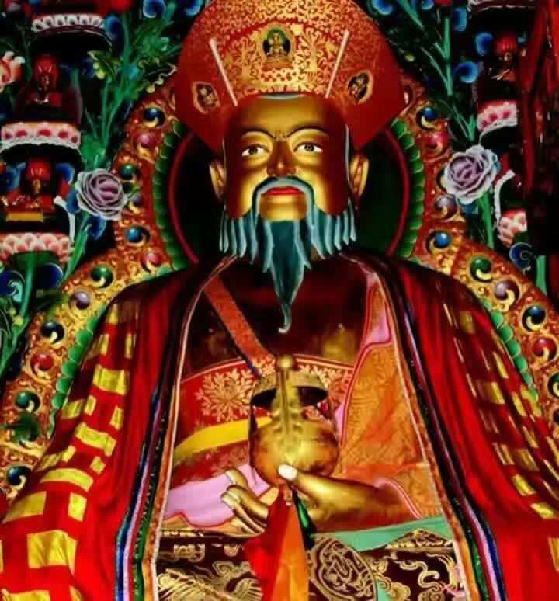
Zhabdrung Ngawang Namgyel (1594-1651)

Slide 3
Pangri Zampa, Druk Phodrangding

Slide 4
Astrological System

Slide 5
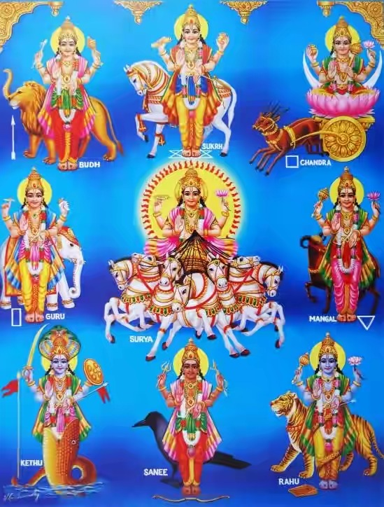
The Nine Planetary Gods of Vedic

Slide 6
Navagrahas / Nine Planetary Gods
Surya (Ravi), the Sun
Chandra (Soma), the Moon
Mangala (Mangal), Mars
Budha (Budh), Mercury
Guru (Brihaspati), Jupiter
Shukra, Venus
Shani, Saturn
Rahu, Lunar ascending node
Ketu, Lunar descending node

Slide 7
White Astrology

Slide 9
Kalachakra

Slide 10
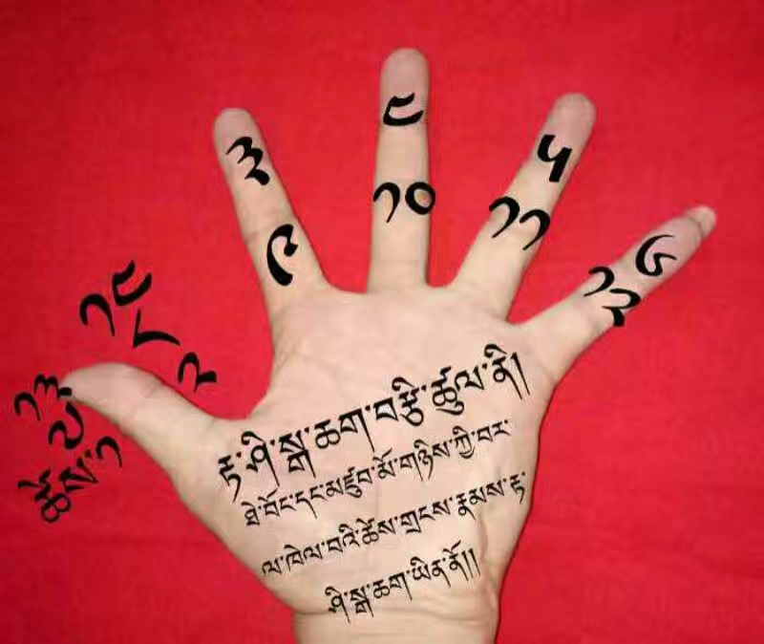
Black Astrology

Slide 11
The Cycles of Twelve Animals

Slide 12
The five element system of Chinese was also incorporated in to Bhutanese

Slide 13
Mewa Grid/ Magic Square

Slide 14
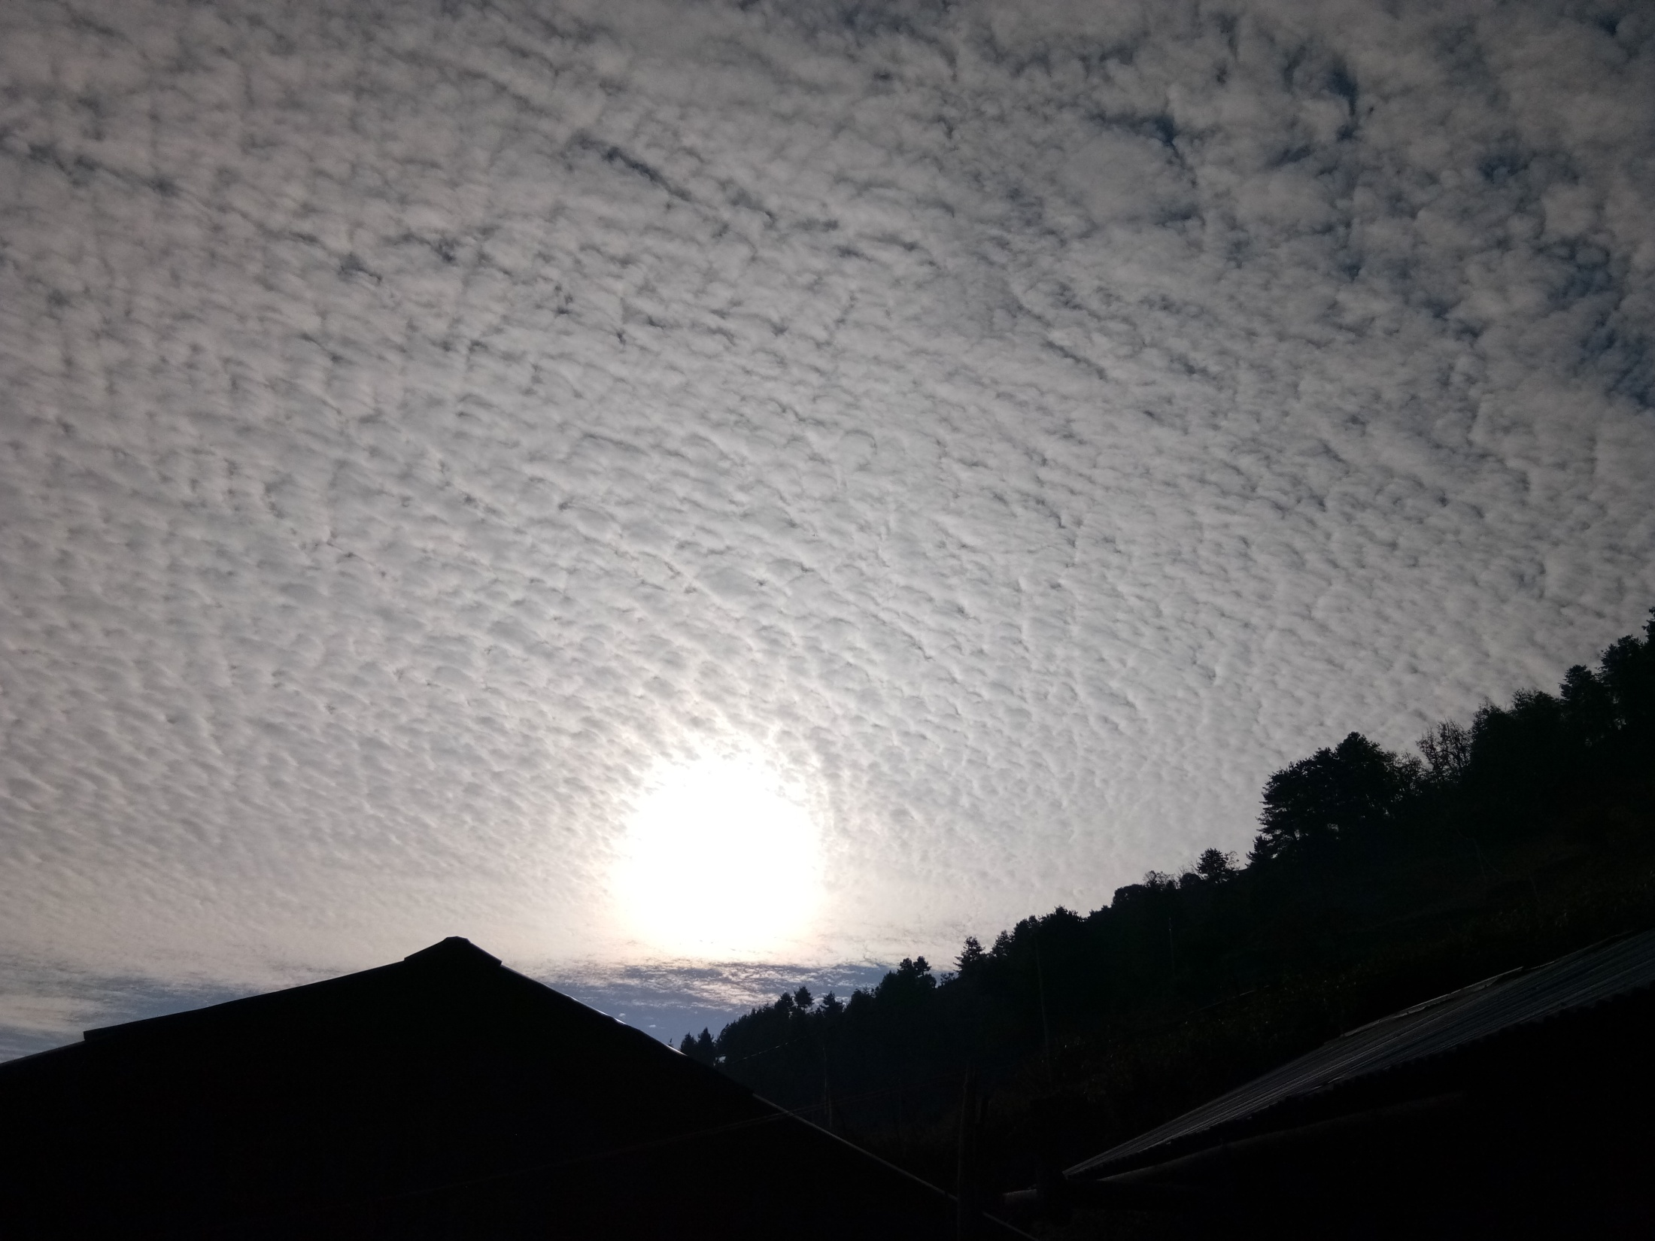
THANK YOU

